Slide 1

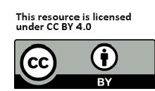
Module 5
AI in Water
Management
Proxylab
www.sustainvet.eu

Slide 2
Contents
01
Unit 1- Introduction
02
Unit 2- Challenges of Water management in modern times
03
Unit 3- How can AI support Water management ?
04
Unit 4- How can we stay ahead? Solutions and Looking forward
05
Unit 5- Controversial Perspective: Water cost of AI

Slide 3
Learning Objectives
In this module, VET teachers and learners will:
• explore why AI is essential for strengthening decision-making across the entire water cycle, including source protection, distribution, treatment, and disaster management.
• learn through practical examples how AI is implemented in vocational practice
• learn to choose appropriate AI tools, interpret their outputs, and design practical learning activities for vocational contexts.
• examine critical issues such as data quality, transparency, privacy, cybersecurity, and the necessity of human oversight through ready-to-use teaching scenarios.

Slide 4
01
Unit 1
Introduction

Slide 5
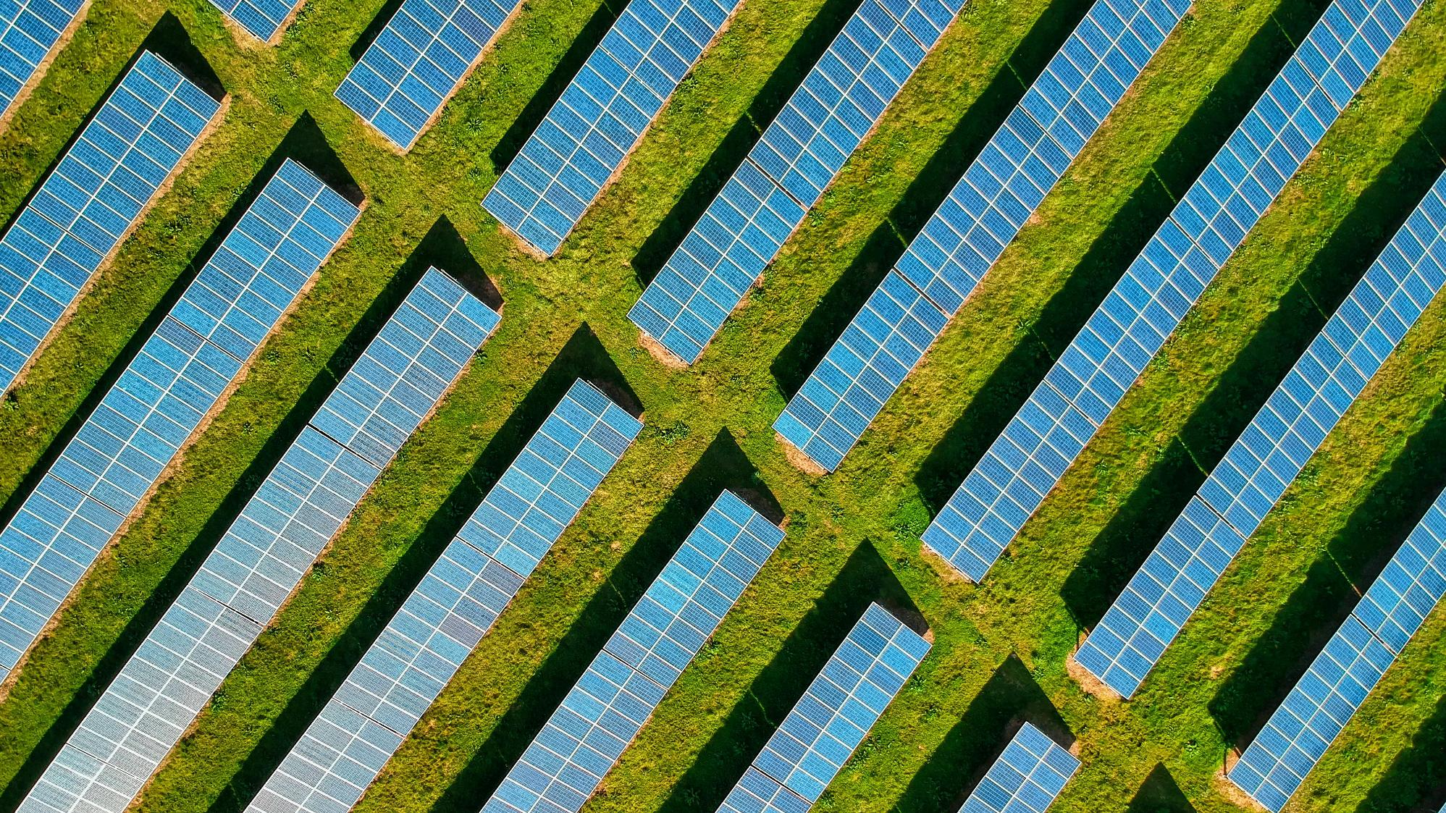
“Save water today; it will rescue you tomorrow”

Slide 6
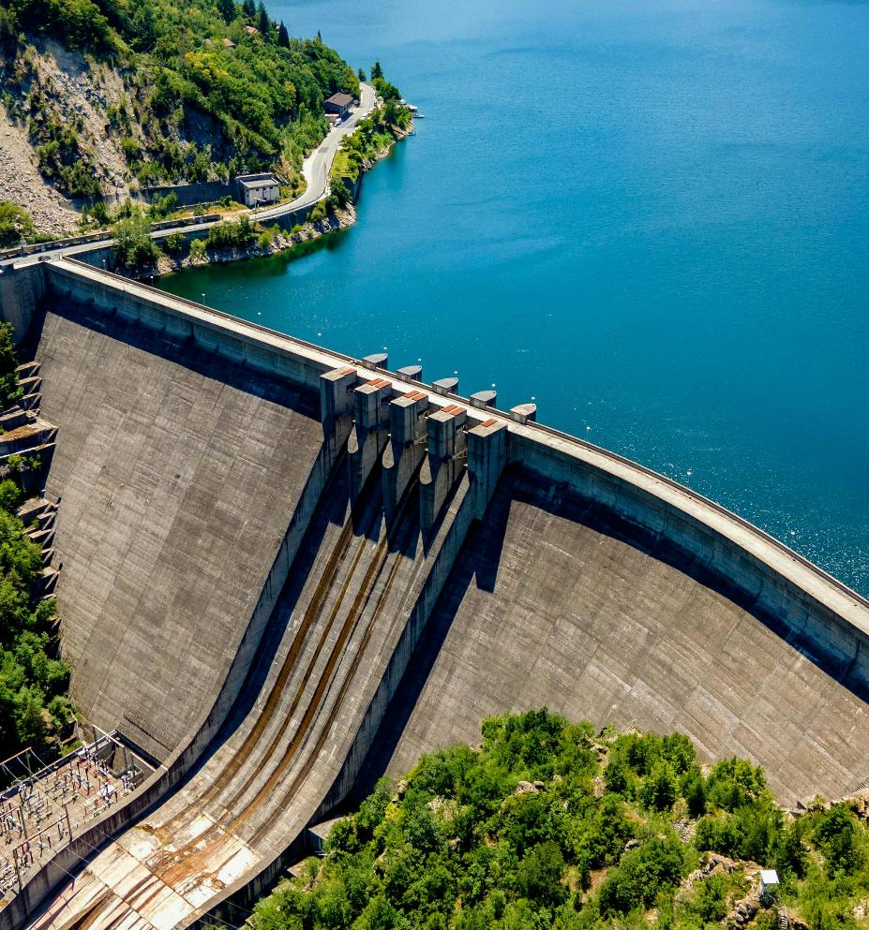
Why AI in water management ?
Water management is becoming one of the defining challenges of our time. Aging infrastructure, increasing water pollution, more frequent droughts and floods, and growing demand from cities, agriculture, and industry all put pressure on water systems.

Slide 7

Why AI in water management ?
In this context, Artificial Intelligence (AI) is emerging as a practical and powerful support for sustainable water management. AI can help water professionals and institutions make faster and more accurate decisions by turning large amounts of data into actionable insights.
Image by WangXiNa

Slide 8
Why AI in water management ?
From sensor networks and smart meters to satellite images and weather data, AI can analyze patterns, detect anomalies, predict risks, and optimize operations, often in real time. However, AI is not a “magic solution.” Its effectiveness depends on data quality, reliable infrastructure, transparency, and responsible use. Poor data, weak systems, or unsafe deployment can lead to wrong decisions and unintended consequences, potentially undermining sustainability progress instead of strengthening it.
This module is designed for VET teachers and learners who want to understand why AI matters in water management and how it can be applied in vocational education and real-world practice.

Slide 9
02
Unit 2
Challenges of Water Management in Modern Times

Slide 10

Water Scarcity and Climate Extremes
01
Droughts, heatwaves, and unpredictable rainfall patterns reduce available freshwater and make supply planning more difficult.
Pollution and Water Quality Issues
02
Industrial discharges, agricultural fertilizers and pesticides, and poor sanitation contaminate surface and groundwater, threaten drinking water safety, ecosystems, and public health.
Urbanization and Population Growth
03
Rapid urban growth puts heavy pressure on water infrastructure. Demand often exceeds capacity, causing supply shortages and unequal distribution.

Slide 11

What do these challenges look like in practice?
Water systems are dynamic (weather, demand, assets) and decisions must be made with incomplete, fast-changing information. Climate extremes and pollution increase operational risk, while budgets, energy costs, and regulations limit how fast systems can adapt.
So… we need smarter monitoring + prediction + optimization.

Slide 12
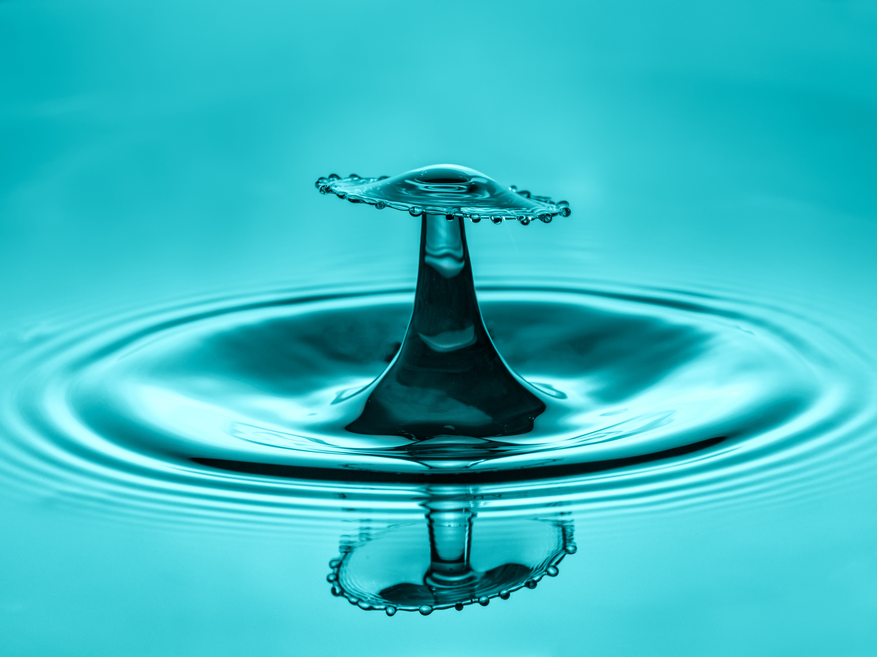
WATCH
Check out the following video about Top 10 Water Management Challenges of the 21st Century (4 min)
Video can also be accessed by clicking on this link:
https://www.youtube.com/watch?v=-lF6hqXYSiY

Slide 13

Mini Discussion
Where do you think the biggest ‘visibility gap’ is in a typical water system:quality, losses, or demand?
01
Which is riskier: making a decision with incomplete data or waiting too long to act?
02
Which step is hardest in real life, monitoring, predicting, or optimizing, and why?”
03

Slide 14

Cause – Impact - Indicator
Pick one challenge and fill this:
Cause: (e.g., aging pipes, fertilizer runoff, heatwave)
Impact: (cost, health, ecosystems, service reliability)
Indicator: (turbidity spikes, pressure drop, customer complaints, reservoir level)

Slide 15
03
Unit 3-
How can AI support Water management ?

Slide 16

AI in practice
Data-driven management means shifting from reactive actions (fix after failure) to preventive and predictive actions (detect early, plan ahead). AI models support this by spotting patterns and anomalies in large datasets and turning them into operational decisions.
Across the water cycle, AI is mainly used to monitor (real-time), predict (ahead of time), and optimize (best action)
Recent “smart water” trends combine AI/ML + IoT across areas like water distribution, rainwater harvesting, irrigation, and wastewater recycling

Slide 17

The AI workflow in water (The key model)
Monitor → Predict → Optimize
Monitor: collect real-time data (sensors, SCADA, meters, satellites)
Predict: forecast demand, failures, and risks (quality, flood/drought)
Optimize: choose the best action (maintenance, pumping, resource allocation)
Which step is most valuable in your vocational field - monitoring, predicting, or optimizing?

Slide 18
What AI actually “does”
Anomaly detection: find unusual patterns (leaks, quality spikes)
Forecasting: predict what comes next (demand, flood risk)
Classification: label risk levels (safe/unsafe zones, pollution risk)
Optimization: recommend best actions (energy-efficient pumping, scheduling)
Which task type fits leak detection? Which fits demand planning?

Slide 19

WATCH
Check out the following video about Real Life AI practices in Water Management (8 min.) :
Video can also be accessed by clicking on this link:
https://www.youtube.com/watch?v=PHZRHNszIG4

Slide 20
Tool Spotlight: SYKE Tarkka
01
Tarkka is an open service by the Finnish Environment Institute (SYKE) for browsing satellite data.
How Tarkka works
02
It provides daily true-color imagery and water quality interpretations such as surface temperature, turbidity, and surface algae blooms
Mini classroom idea
03
Pick a water body, compare two dates, describe changes (turbidity/algae/temperature), discuss possible causes and risks.

Slide 21
Case Study (Finland): AI for Smart Water & District Heating Networks
https://www.silo.ai/
Key partners: Silo AI, HSY (Helsinki Environmental Services Authority), Suur-Savon Sähkö Oy.
Challenge: Aging infrastructure caused water leaks, inefficient energy use, high operating costs, and unreliable service. Maintenance was mostly reactive .
AI Solution: Silo AI’s “Silo Flow”, an AI-powered digital asset optimization tool using machine learning + digital twin technology to create a virtual copy of pipeline networks for monitoring and prediction.
What it does: Predicts pipeline failures early, improves maintenance planning, and supports energy efficiency via a user-friendly dashboard.
Results/Impact: 50% less time spent on network visualization; ~3°C lower heating supply temperature (reduced fuel use); more proactive maintenance; improved sustainability and resilience

Slide 22
04
Unit 4-
How can we stay ahead? Solutions and Looking forward

Slide 23
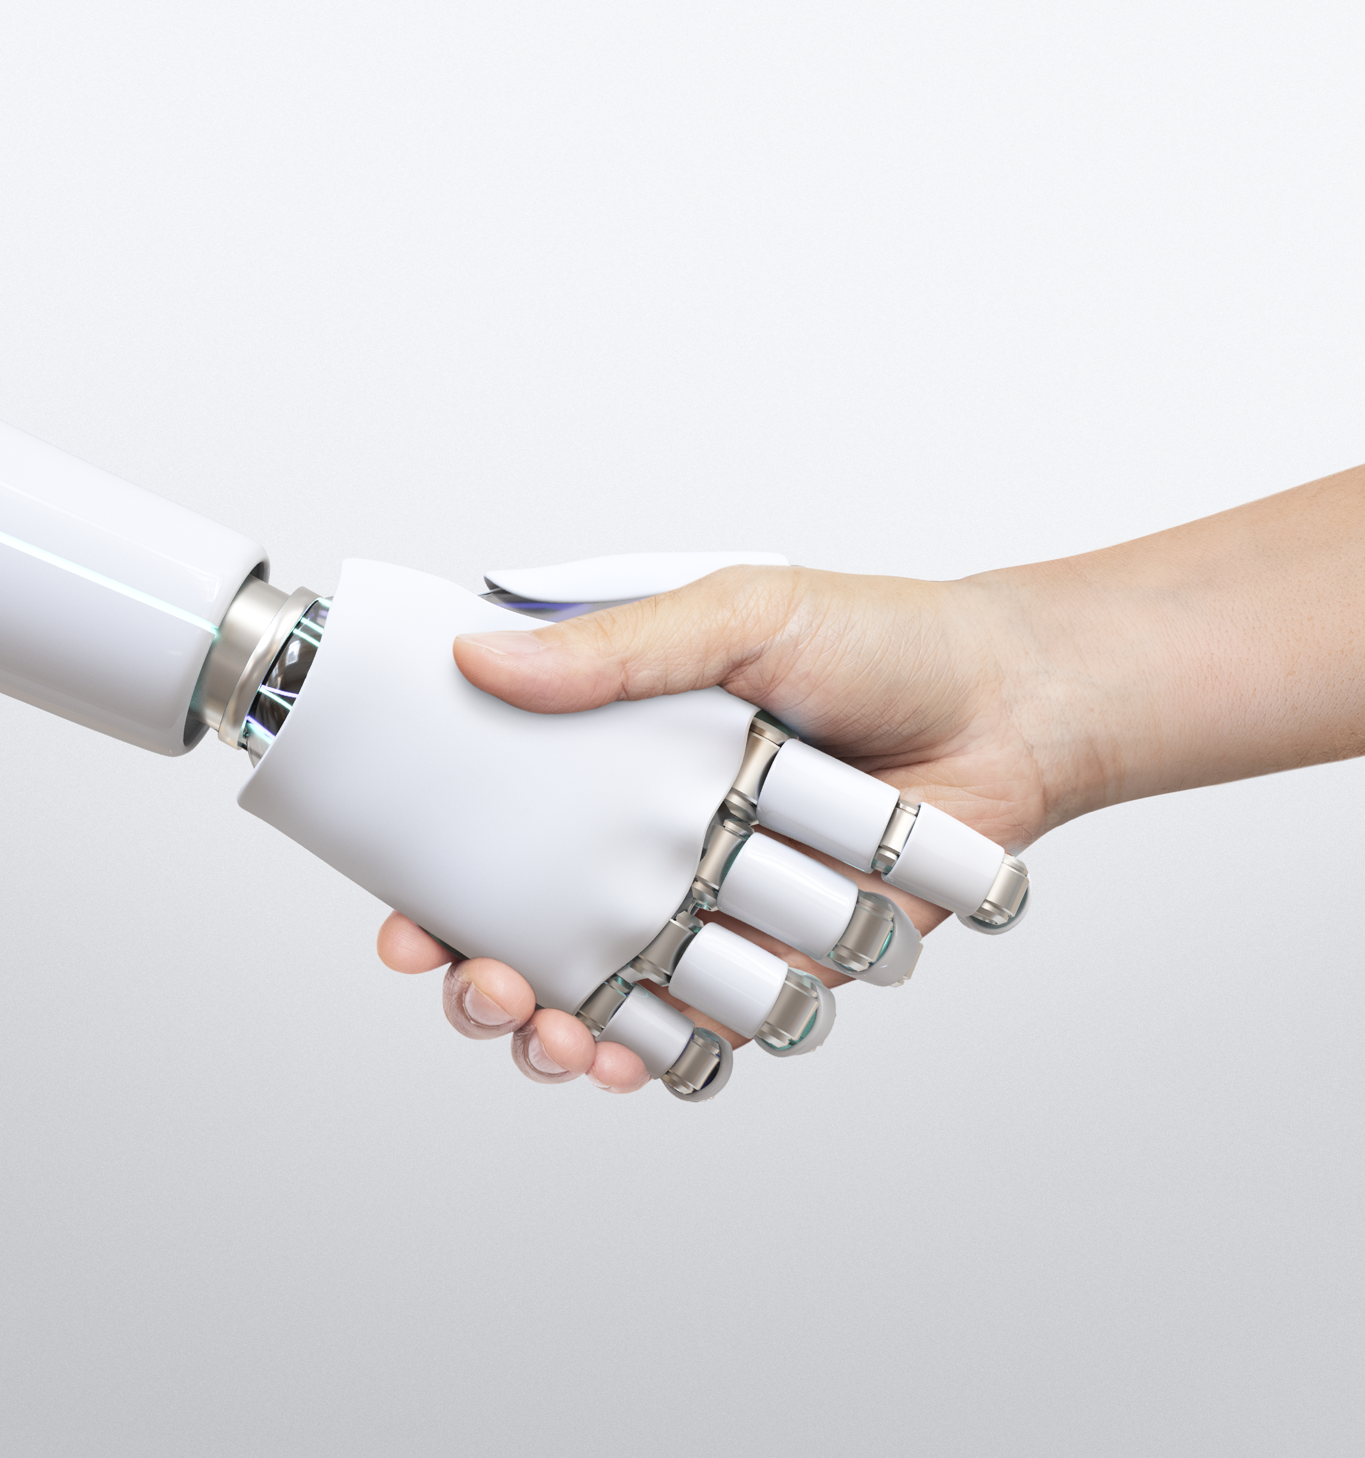
What does “staying ahead” mean?
Staying ahead means preparing for risks before they become failures. In water systems, this requires better visibility, faster decision-making, and planned maintenance.
AI can support this shift, if it is used with clear goals and strong operational processes.

Slide 24
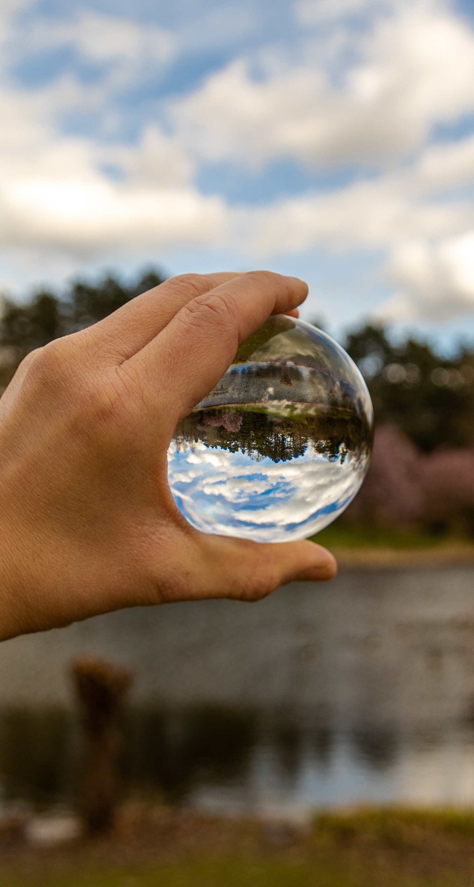
01
Moving from reactive fixes to predictive + proactive operations
02
Using AI for early warning and better planning, not “automation for everything”
03
Focusing on reliability, safety, and sustainability outcomes

Slide 25

Future Solutions
Future solutions aim to improve prediction accuracy and response speed. Digital twins support planning and asset management, while edge AI enables real-time decisions in the field.
Early warning systems strengthen resilience to climate extremes and quality incidents.

Slide 26

What is next?
Digital twins: simulate networks, test scenarios, plan upgrades
Edge AI: faster analysis near sensors (quick detection/response)
Early warning systems: combine weather + sensors + satellite insights

Slide 27

Further Reading/Research
https://www.badgermeter.com/en-gb/blog/
https://www.wateronline.com/
https://www.iwmi.org/news/
https://www.unesco.org/en/articles/applications-artificial-intelligence-water-management

Slide 28
05
Unit 5-
Controversial Perspective:
Water cost of AI

Slide 29

The Hidden Water Footprint of AI
AI growth is accelerating data center expansion, increasing pressure on local resources. Water impacts are site-specific and unequal, some communities carry more burden than others.
This creates tension between digital progress and water justice.
Should a community accept water stress for ‘digital development’?
Photo by Scott Rodgerson

Slide 30

Where does the water go?
Chip manufacturing: AI hardware (GPUs) has a significant embedded water footprint during production.
Cooling on-site: Many data centers use water-based/evaporative cooling, where water is lost to evaporation and must be replaced.
Power supply (indirect water): More electricity use means more water used in power generation, depending on the energy mix

Slide 31
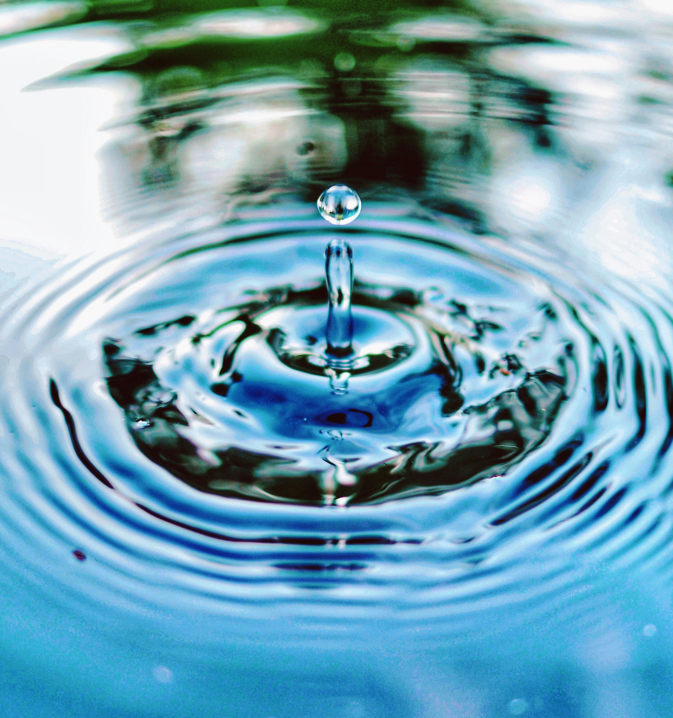
Saving Water, Using Water
AI creates a sustainability paradox: it can help save water through leak detection, forecasting, and monitoring, but the rapid growth of AI data centers can also increase water use, especially for cooling. In water-stressed regions, this raises a tough question, can a technology designed to improve water management be justified if it adds pressure to local water supplies?
Here are some solutions...

Slide 32
Further Reading/Research
https://www.iwmi.org/news/the-cloud-is-running-dry/
The Uneven Distribution of AI’s Environmental Impacts
https://andthewest.stanford.edu/2025/thirsty-for-power-and-water-ai-crunching-data-centers-sprout-across-the-west/

Slide 33
Classroom Tips: Discussion Questions
Should data centers be allowed to use potable water for cooling in water-stressed regions?
Is it fair to approve a data center if it creates few permanent jobs but consumes significant local water?
What’s worse: higher water use or higher electricity use (and why)?
Are “water positive” claims meaningful if replenishment happens in a different basin?
What information should be mandatory in permits? (WUE, source type, basin stress, indirect water, seasonal peaks?)
Should governments prioritize water for people, food, ecosystems, or digital infrastructure?
Who should pay for upgrades: company, utility, taxpayers?
If AI services benefit the whole country, should water burden be “shared”—or must it be local?

Slide 34
Classroom tips
Data Literacy
Materials: One slide with 6–8 short “claims”
For each claim, students answer:
1.What does it mean?
2.What data is missing? (source type, basin stress, seasonal peaks, indirect water, method)
3.What would you ask to verify it?
Output: Minimum Evidence Checklist

Slide 35
follow our journey
Thank you
Any questions?
www.sustainvet.eu

