Slide 1

Module 4
AI in Energy Management
Fagskolen Rogaland, Stavanger, Norway
www.sustainvet.eu

Slide 2
Contents
01
Unit 1- Introduction
02
Unit 2- Challenges of energy in modern times
03
Unit 3- How can AI support energy management?
04
Unit 4- How can we stay ahead? Solutions and looking forward
05
Unit 5- Graphical overview of possible crossing over of the 4 sectors

Slide 3
Learning objectives
Energy management
In this module, learners explore how AI is transforming modern energy management and supporting the transition to more sustainable and resilient energy systems. They gain an understanding of the key challenges facing the energy sector today, including grid stability, integration of renewable energy sources, demand forecasting, and energy efficiency.
Learners are introduced to how AI is applied in practice, with a particular focus on smart grids and renewable energy forecasting, and how data-driven models can support better decision-making, reduce energy waste, and lower carbon emissions. Through real-world examples and sector-specific case studies, they learn how AI tools are already being used by energy providers, engineers, and planners.

Slide 4
Learning objectives
By the end of the module, learners will be able to:
explain the main challenges in modern energy management and the role of digitalisation and AI in addressing them,
describe how AI techniques such as machine learning and predictive analytics are used in smart grids and renewable energy forecasting,
identify opportunities to apply AI for improving efficiency, reliability, and sustainability in energy systems,
reflect on ethical, environmental, and data-related considerations when deploying AI in the energy sector, and,
recognise the importance of continuous learning, collaboration, and networking to stay up to date in a rapidly evolving technological field.
Notes:
This module equips learners with both conceptual understanding and practical insight, enabling them to engage confidently with AI-supported energy management in vocational and professional contexts.

Slide 5
01
Unit 1
Introduction

Slide 6
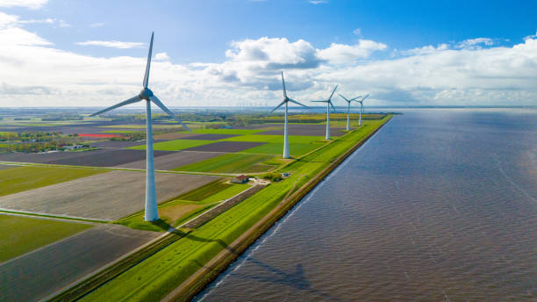
Energy efficiency is the fastest, cheapest and cleanest way to reduce emissions and strengthen energy security.
International Energy Agency (IEA)

Slide 7

Why AI in energy management?
Modern energy systems are complex. Renewable energy is variable, demands changes constantly, and power grids must remain stable and efficient.
AI helps by analysing large amounts of data to predict demand and production, optimise grid operations, and detect problems early.
This supports more reliable, cost-effective, and sustainable energy systems.

Slide 8

Why AI in energy management?
In this section, we explore three main reasons why AI is becoming essential in the energy sector:
1. The growing complexity of modern energy systems
2. Improving forecasting and planning for energy supply and demand
3. Smart grids and real-time optimisation of energy networks
These topics show how AI supports more efficient, reliable, and sustainable energy management.
Notes:
Why AI in Energy Management?
Key Topics
Modern energy systems are becoming more complex, with growing use of renewable energy and rapidly changing demand patterns. Traditional tools are no longer sufficient to manage this effectively.
In the following sections, we explore how AI helps to handle this complexity, improves forecasting and planning, and enables smart grids to operate efficiently and reliably.
These three topics show why AI is becoming a key technology for sustainable and secure energy systems.

Slide 9
Topic 1: The growing complexity of modern energy systems
Energy systems today are very different from those of the past. Traditionally, electricity was produced in large, centralised power plants and distributed in a one-way flow to consumers. This made planning and control relatively predictable.
Today, energy systems are decentralised and dynamic. Thousands of small renewable energy sources such as wind turbines, solar panels, and local energy communities feed electricity into the grid. At the same time, electric vehicles, heat pumps, and smart buildings are increasing and changing electricity demand patterns.

Slide 10
Topic 1: The growing complexity of modern energy systems
This creates three major challenges:
Variability: Renewable energy production depends on weather conditions and time of day.
Uncertainty: Consumption patterns change rapidly due to human behaviour and new technologies.
System balance: Electricity supply and demand must always be equal to avoid blackouts or damage to infrastructure.
Managing this level of complexity using traditional tools and manual planning is increasingly difficult. Energy operators must process vast amounts of data in real time, including weather forecasts, consumption data, market prices, and grid conditions.

Slide 11
Topic 2: Improving forecasting and planning with AI
One of the most important applications of AI in energy management is forecasting.
Accurate forecasts are essential for:
planning electricity production,
balancing renewable and conventional energy sources,
avoiding energy shortages or oversupply,
reducing operational costs, and
lowering CO₂ emissions.
Renewable energy forecasting
Solar and wind energy are highly dependent on weather conditions. Even small changes in cloud cover or wind speed can significantly affect production.

Slide 12

Topic 2: Improving forecasting and planning with AI
To predict how much energy will be produced hours or days ahead, AI models use:
historical production data,
satellite images,
weather forecasts,
seasonal patterns, and
geographical information
This allows grid operators to:
prepare backup generation when renewable output is low,
avoid wasting energy when production is high, and
integrate a higher share of renewables safely into the system.

Slide 13

Topic 2: Improving forecasting and planning with AI
Demand forecasting
AI is also used to predict how much electricity consumers will need at different times of the day or year. For example, AI can learn that:
energy use increases during cold mornings,
demand drops during holidays, or
electric vehicle charging peaks in the evening.
Better demand forecasts help energy providers optimise production schedules, reduce peak loads, and prevent grid congestion.

Slide 14
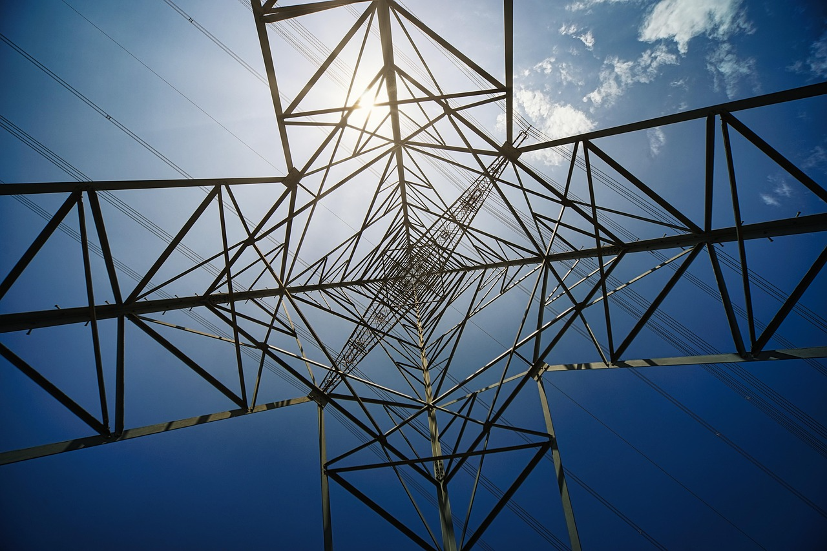
Topic 3: Smart grids and real-time optimization
A smart grid is an electricity network that uses digital technologies to monitor, control, and optimise energy flows. AI plays a central role in making smart grids possible.
Real-time decision making
AI systems can continuously analyse:
sensor data from substations,
voltage and frequency levels,
energy flows between regions, and
equipment performance.

Slide 15
Topic 3: Smart grids and real-time optimization
Based on this data, AI can:
automatically adjust energy distribution,
reroute power during faults,
detect abnormal behaviour that may indicate failures or cyberattacks, and
prioritise renewable energy sources when available.
This reduces downtime, improves safety, and increases overall efficiency.
Predictive maintenance
Instead of waiting for equipment to fail, AI can predict when components such as transformers or cables are likely to break down.
By analysing:
temperature patterns,
vibration data,
usage intensity, and
historical fault records,
AI systems can schedule maintenance before failures occur. This leads to:
fewer blackouts,
lower repair costs,
longer equipment lifespan, and
safer working conditions for technicians.

Slide 16
02
Unit 2
Challenges of energy management in modern times

Slide 17
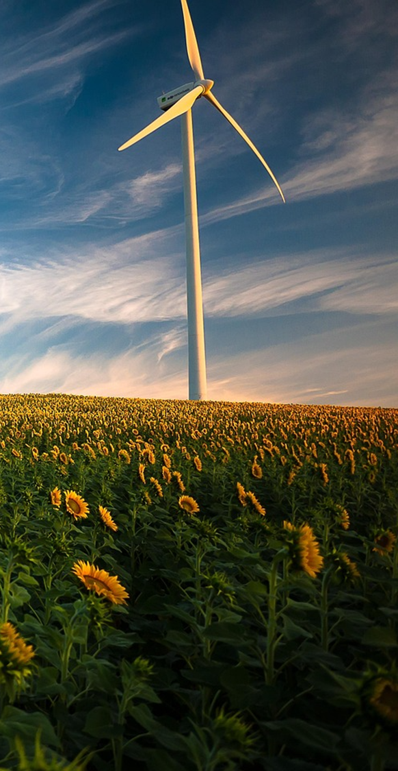
Key challenges in modern energy management
Unpredictable renewable energy supply
Solar and wind power depend on weather conditions, making energy production variable and harder to plan and balance.
01
Rapidly changing energy demand
Electric vehicles, heat pumps, and smart buildings are increasing electricity use and creating new peak demand periods.
02
Maintaining grid stability and reliability
Energy networks must constantly balance supply and demand to avoid outages, even as systems become more complex and decentralised.
03

Slide 18
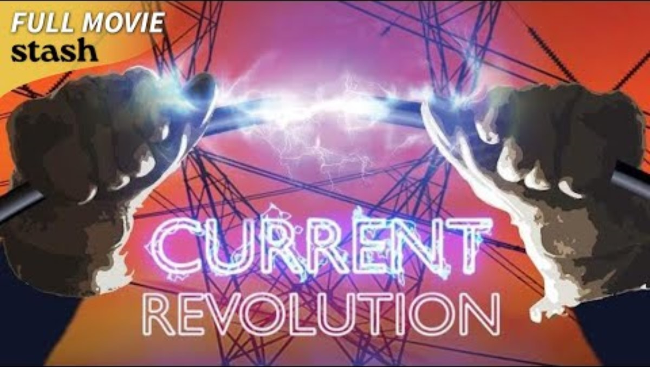
Unpredictable renewable energy supply
📌 Video: Current Revolution | Renewable Energy Documentary
Summary:
This video explains how wind and solar power vary with weather and time of day. It highlights the difficulty of matching energy production to demand when renewables are intermittent, and why new tools (like AI forecasting) are needed to manage these fluctuations.
Key takeaway for learners:
Understand that renewable energy doesn’t produce constant power, and this variability is a major challenge in modern energy systems.

Slide 19

Rapidly changing energy demand
📌 Video: The Grid’s Secret 4th Pillar: Demand
Summary:
This explainer focuses on how energy demand changes throughout the day and in response to technology use (like electric cars and smart appliances). It shows why predicting when people will use electricity is challenging and important for grid planning.
Key takeaway for learners:
Energy managers need reliable demand forecasts, and AI tools can help recognise patterns and improve prediction accuracy.

Slide 20

Maintaining grid stability and reliability
📌 Video: Why Is Grid Stability Getting Harder?
Summary:
This video discusses how integrating distributed energy sources makes it harder to keep the electricity grid stable. It covers issues like frequency control and balancing supply and demand in real-time — activities where AI-driven monitoring and optimisation can make a difference.
Key takeaway for learners:
Grid operators must maintain constant balance; AI systems support real-time decisions and help prevent outages.

Slide 21
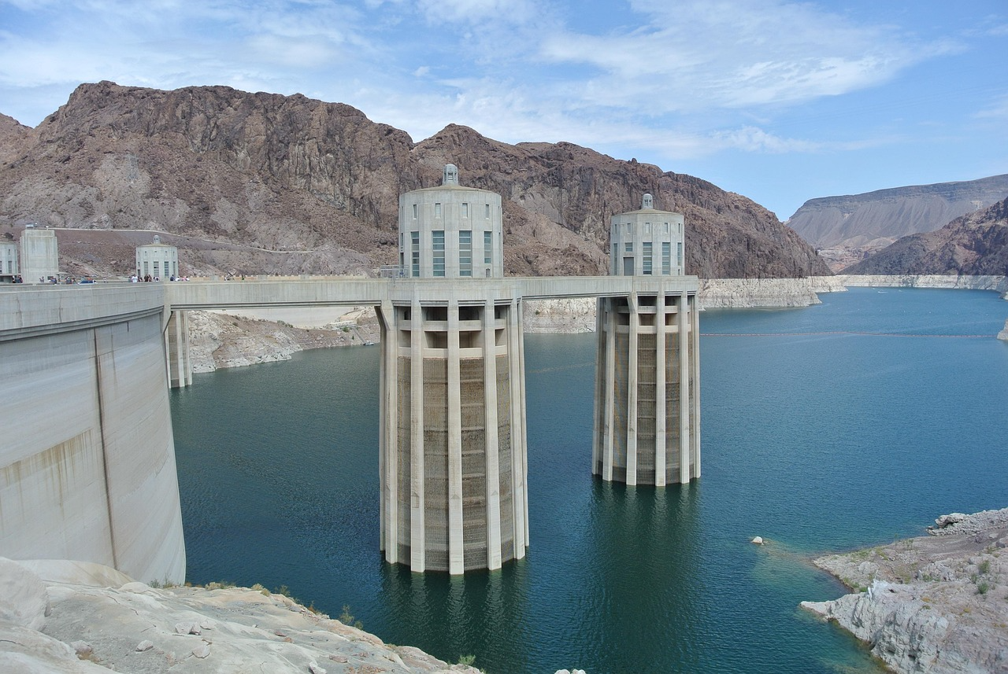
Test your knowledge
01
Q1: Why is renewable energy difficult to manage?
Q2: How do electric vehicles and heat pumps affect energy systems?
02
Q3: What does “grid stability” mean?
Q4: Why is managing energy data a challenge today?
Q5: Why are traditional energy management methods no longer enough?
Q6: How does renewable energy integration increase the complexity of energy management?
03
*Answers are on the following slide.

Slide 22
Q&A on key challenges in modern Energy Management:
Q1: Why is renewable energy difficult to manage?
A: Because solar and wind power depend on weather and time of day, production is not constant. This makes it harder to predict how much electricity will be available.
Q2: How do electric vehicles and heat pumps affect energy systems?
A: They increase electricity demand and create new peak usage times, which puts extra pressure on power grids.
Q3: What does “grid stability” mean?
A: It means keeping electricity supply and demand balanced at all times to avoid blackouts or damage to equipment.
Q4: Why is managing energy data a challenge today?
A: Modern energy systems generate large amounts of real-time data from sensors, smart meters, and weather systems, which is difficult to process manually.
Q5: Why are traditional energy management methods no longer enough?
A: Because energy systems are more complex, decentralised, and fast-changing, requiring advanced digital tools such as AI to support decision-making.
Q6: How does renewable energy integration increase the complexity of energy management?
A: It introduces many small, decentralised producers into the grid, which makes it harder to coordinate supply, balance demand, and maintain stable system operation.

Slide 23
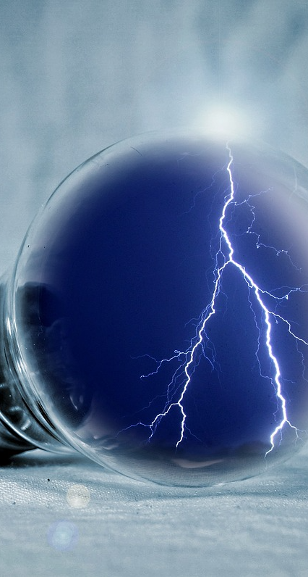
3 real AI tools/platforms used in the energy industry
Grid4C – AI-powered energy analytics
01
Grid4C uses machine learning to analyse billions of smart meter readings and delivers predictions for energy consumption, load forecasting, and distributed energy resource (DER) performance.
https://www.grid4c.com/?utm_source=chatgpt.com
C3 AI energy management
02
C3 AI provides a suite of enterprise AI tools to forecast energy consumption, benchmark performance, and recommend efficiency opportunities across facilities and systems.
https://c3.ai/products/c3-ai-energy-management/?utm_source=chatgpt.com
Trawa – AI-driven energy management platform
03
Trawa integrates AI with energy procurement, load-shifting strategies, and battery storage optimisation, helping organisations reduce electricity costs and meet climate targets.
https://www.enersee.ai/insights/ai-energy-management-software?utm_source=chatgpt.com

Slide 24
3 real AI tools/platforms used in the energy industry
Grid4C – AI-powered energy analytics
How it enhances energy management:
Helps utilities forecast demand and supply at a granular level
Improves planning for renewable integration
Supports decisions on grid balance and reliability
This tool shows how AI is used in real operations to turn raw grid data into actionable predictions.
C3 AI energy management
How it enhances energy management:
Predicts energy use and emissions
Identifies high-value efficiency projects
Supports strategic energy planning
Learners can see how AI helps organisations optimise energy at scale, not just in theory but in real business planning.
Trawa – AI-driven energy management platform
How it enhances energy management:
Balances energy buying and usage
Manages battery storage intelligently
Optimises energy flows in response to changing conditions
This platform shows how AI tools are used in commercial and industrial settings to implement sustainability goals with real financial benefits.

Slide 25
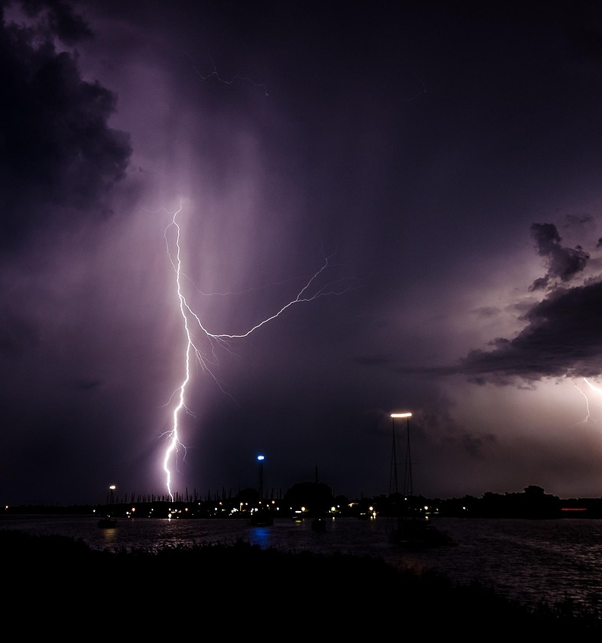
Learning activity for: Grid4C – AI for energy data analytics & forecasting (utilities)*
Activity 1: Interpreting AI demand forecasts (practice)
Goal: Understand how AI supports load forecasting.
Suggested task: Students are given a simplified demand forecast chart (hourly or daily), and a basic context (weather, weekday/weekend, EV charging).
Questions:
When is peak demand expected?
What factors influence the forecast?
What decisions should a grid operator make based on this?
Learning outcome:
Students learn how AI predictions support grid planning and risk reduction.
* suitable for VET (EQF 4–6)

Slide 26
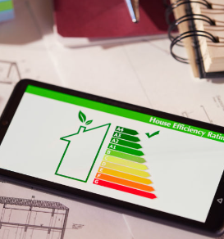
Learning activity for: C3 AI Energy Management – AI for efficiency & strategic planning *
Activity 1 – AI-supported energy audit (practice)
Goal: Learn how AI identifies inefficiencies.
Suggested task: Students receive a fictional company profile:
energy usage by building
operating hours
production levels
Simulate how C3 AI would:
detect abnormal consumption
suggest efficiency actions
propose 3 improvement measures.
Learning outcome:
Understanding AI-driven optimisation and sustainability planning.
* suitable for VET (EQF 4–6)

Slide 27

Trawa – AI for energy procurement & storage optimisation *
Activity 1 – Smart energy buying simulation (decision-making)
Goal: Learn AI-based optimisation logic.
Suggested task: Students are given:
hourly electricity prices
battery capacity
energy demand profile
They decide:
when to buy energy
when to store
when to use stored energy
Then compare with an “AI-optimised solution”.
Learning outcome:
Understanding AI optimisation in cost and sustainability trade-offs.
* suitable for VET (EQF 4–6)

Slide 28

WATCH
Check out the following video about AI in vocational education & training: opportunities, challenges, and future perspectives.

Slide 29
03
Unit 3
How can AI support energy management?

Slide 30
How can AI support energy management?
AI supports modern energy systems by improving:
renewable energy forecasting
demand prediction
smart grid operation
predictive maintenance
energy efficiency
battery and storage management
Together, these applications make energy systems more reliable, cost-effective, and sustainable.

Slide 31

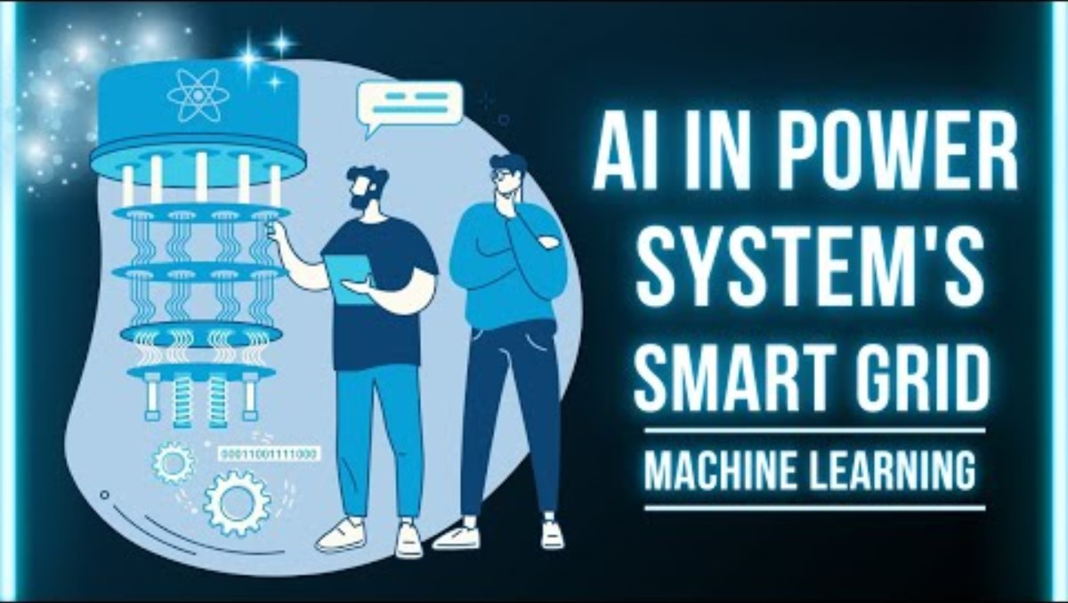
Tool spotlight 1: AI renewable energy forecasting platform
AI-based energy forecasting platforms are used by grid operators and energy companies to analyse weather data, historical production, and consumption patterns to predict electricity supply and demand – especially from wind and solar power.
(Examples: Grid4C, ENTSO-E forecasting tools, national grid AI systems)
This video shows how AI is used in power systems and smart grids to predict demand, optimise grid operation, and support renewable energy integration.

Slide 32
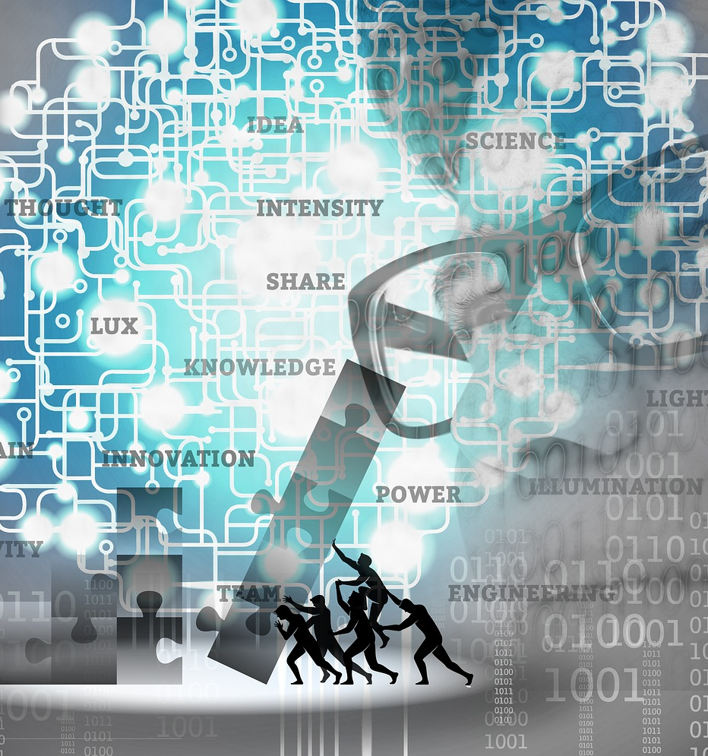
Tool spotlight 1: How the tool works
It combines:
weather forecasts (wind speed, solar radiation, temperature)
historical energy production data
real-time grid and consumption data
AI models process this information to generate short- and long-term forecasts of:
renewable energy production
electricity demand
potential grid stress or shortages
These predictions help operators balance the grid and integrate more renewable energy safely.

Slide 33


Tool spotlight 1: In the classroom
Pick a renewable energy source (wind or solar) or a region.
Compare two different days (e.g. sunny vs. cloudy, windy vs. calm):
estimate expected energy production
discuss how demand might differ
identify possible risks (shortage, overload, price changes)
discuss how AI forecasts could help energy managers make better decisions.
This video discusses how AI tools compete with traditional forecasting methods and are applied to predict renewable generation and market variables, showing real-world energy forecasting applications.

Slide 34

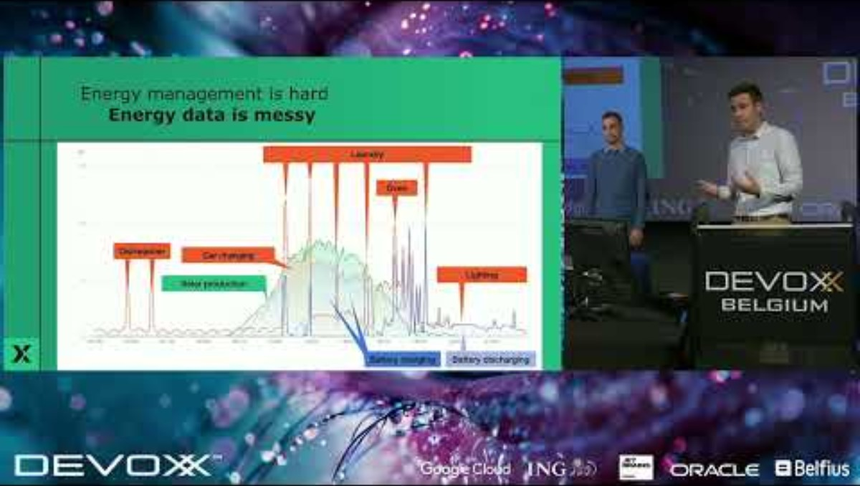
Tool spotlight 2: AI battery & management systems (BMS)
AI-powered battery management systems are used by energy companies and grid operators to control large batteries and storage facilities. They help decide when to store energy, when to release it, and how to protect battery health.
(Examples: Tesla Autobidder, Fluence IQ, Siemens AI Energy Storage, national grid storage systems)
This video shows how AI helps optimise household and grid-level energy usage, including forecasting and control strategies that apply to battery systems and smart energy management.

Slide 35
What is Vehicle-to-Grid (V2G)?
Vehicle-to-Grid (V2G) allows electric vehicles (EVs) to both use and supply electricity. When plugged in, EV batteries can feed power back to the grid during peak demand and recharge when renewable energy is abundant.
How AI enables V2G AI analyses electricity demand, renewable forecasts, vehicle availability, and battery health to decide when EVs should charge, discharge, or stay idle, without affecting driver mobility.
Why V2G matters
balances supply and demand in real time,
reduces peak loads and grid congestion,
supports higher integration of wind and solar power,
turns EVs into flexible, distributed energy storage.
V2G transforms EVs from passive consumers into active contributors to a smarter, more resilient energy system.

Slide 36
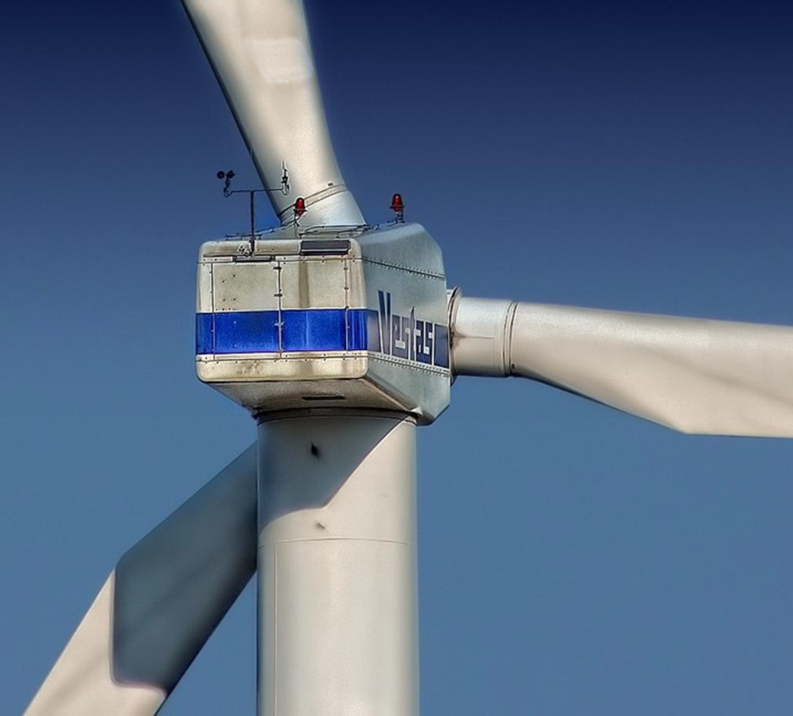
Tool spotlight 2: How the tool works
The system analyses:
electricity prices
renewable energy production forecasts
current demand
battery condition (temperature, charge cycles, capacity)
AI models then decide:
when to charge batteries (e.g. during high wind/solar production)
when to discharge (during peak demand)
how to avoid battery damage and extend lifetime
This improves grid stability and reduces energy waste.

Slide 37

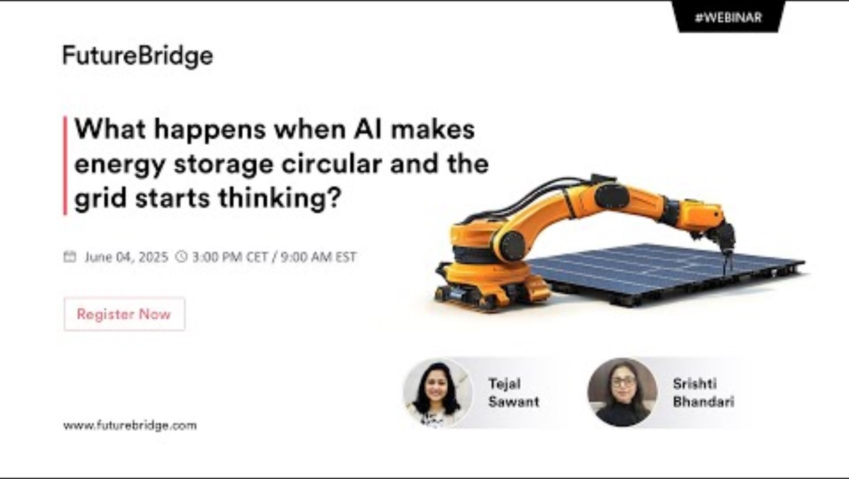
Tool spotlight 2: In the classroom
Choose a simple scenario:
A city has:
solar panels
a large battery
higher demand in the evening
Student activity:
decide when the battery should charge and discharge
compare their plan with an “AI-optimised strategy”
discuss benefits (cost savings, fewer emissions, grid stability)
This webinar-style video explores how AI is transforming energy storage management — from predictive analytics and optimisation to driving smarter, more sustainable energy storage operations.

Slide 38
How can AI support energy management?
AI supports modern energy systems by improving:
renewable energy forecasting
demand prediction
smart grid operation
predictive maintenance
energy efficiency
battery and storage management
Together, these applications make energy systems more reliable, cost-effective, and sustainable.

Slide 39
Case Study
AI in forecasting & battery management
Scenario: A city with solar panels and a large battery faces high evening demand. Weather varies daily, causing unpredictable solar production.
Task: Using AI tools for renewable forecasting and battery management, answer the following:
Production forecast: Compare a sunny day versus a cloudy day. How will solar output differ, and what risks arise (e.g., shortages, overload)?
Demand & grid impact: How can AI demand prediction help manage the 17:00–20:00 peak?
Battery strategy: When should the battery charge and discharge? How might an AI‑optimized plan improve cost, emissions, and grid stability?
System integration: Give two ways AI forecasting and AI‑driven BMS (Battery Management Scenario) can work together to improve overall energy reliability.

Slide 40
Green AI: Balancing AI’s energy use and sustainability benefits
AI also consumes energy
Training and running AI models requires computing power, which increases electricity use and carbon emissions, especially in large data centres.
What is Green AI?
Green AI focuses on developing and deploying AI systems that minimise energy consumption while maximising environmental benefits.
In energy management, this means:
using efficient AI models and algorithms,
optimising when and where AI systems run,
reducing data processing and storage needs,
ensuring that AI saves more energy than it consumes.
Key idea:
AI should not only optimise energy systems. It should also be energy‑efficient itself.

Slide 41
04
Unit 4
How can we stay ahead? Solutions and Looking forward

Slide 42
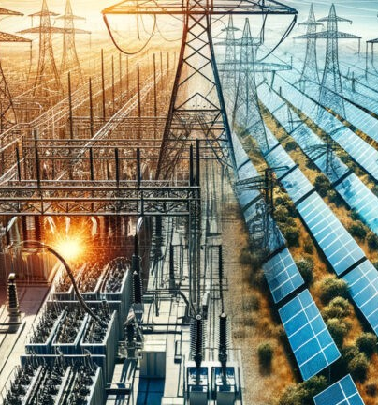
Looking to the future
Leverage predictive analytics for smarter operations
Use AI models to forecast demand, equipment failures, and grid fluctuations.
This allows earlier maintenance, lower downtime, and optimized energy flow - cutting costs and emissions.

Slide 43
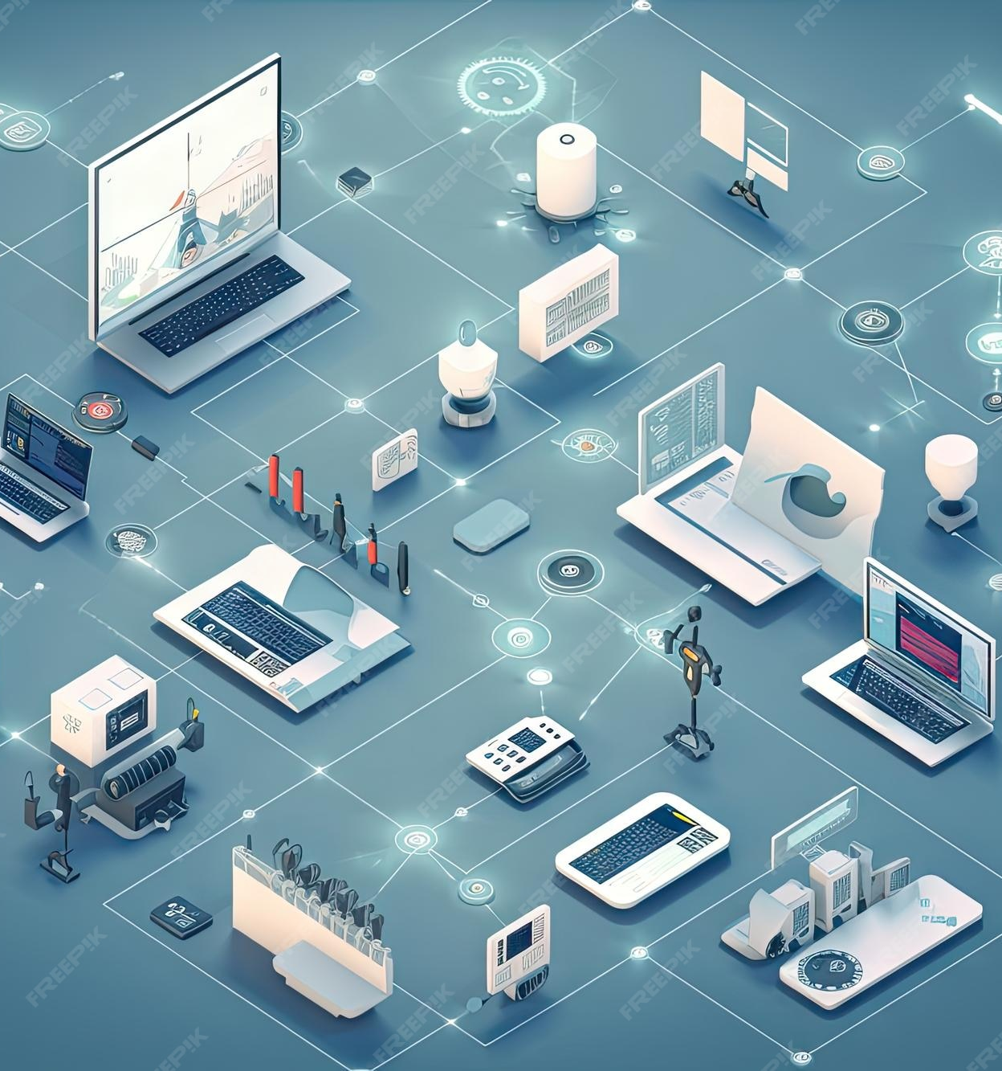
Looking to the future
2. Integrate real time
Discuss how to integrate real‑time data for autonomous decision‑making.
Bring together IoT sensors, smart meters, SCADA data, and weather inputs so AI systems can run continuous optimizations.
Real‑time AI control can balance load, manage storage, and respond instantly to volatility in renewables.

Slide 44

Looking to the future
3. Build hybrid human‑AI management teams
Keep people in the loop. Train operators to work with AI insights rather than oppose them. The organizations that win will combine human experience with machine precision - especially in critical infrastructures.

Slide 45

Looking to the future
4. Prioritize Cybersecurity for AI‑Driven Systems
As energy systems get smarter, they also become more exposed.
Using AI for anomaly detection, intrusion prevention, and resilience planning ensures the digital grid is as robust as the physical one.
List up 5 actions to prevent AI driven autonomous technology being compromised.

Slide 46
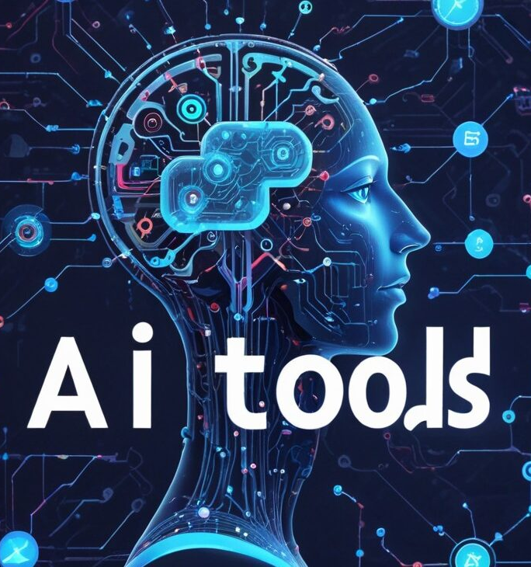
Looking to the future
5. Invest in scalable, interoperable platforms
Avoid isolated tools. Choose AI platforms that integrate easily with existing energy assets and can scale from plant-level optimization to multi-site, multi-country operations. Flexibility today means future-proofing tomorrow.

Slide 47
05
Unit 5
Graphical overview of possible crossing over of the 4 sectors

Slide 48
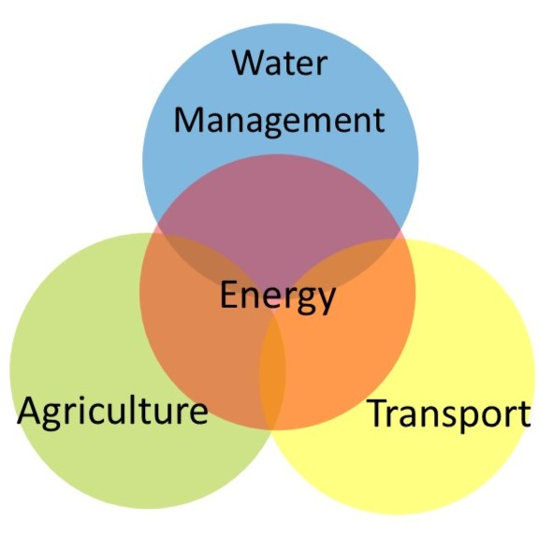
Graphical overview of possible crossings over the 4 sectors
Energy (FR)
Agriculture (TFH & FLC)
Transport (HST)
Water Management (Proxy Lab)

Slide 49
Example of cross-sector AI integration: Energy, water, transport & agriculture
Scenario: AI-powered solar irrigation
In a farming region, solar panels produce large amounts of electricity during sunny periods. AI systems monitor energy production, grid demand and water needs.
When there is excess solar energy, AI automatically:
redirects electricity to power water pumps,
fills irrigation or water storage systems,
reduces energy waste and grid stress.
Cross-sector benefits
Energy: better use of surplus renewable electricity
Water: efficient pumping and storage when energy is cheapest
Agriculture: reliable irrigation with lower costs and emissions
This example shows how AI connects multiple sectors to improve efficiency, sustainability and resilience.

Slide 50

AI in modern energy systems
Conclusions
AI enables smarter, more sustainable, and more reliable energy management across increasingly complex, decentralized grids. It supports operators in handling variability from renewables, rapidly changing demand, and the need for real‑time system balance.
Key challenges addressed by AI
Variable renewable production (solar/wind)
Shifting consumption patterns (EVs, smart buildings, heat pumps)
Maintaining grid reliability and stability
Processing large volumes of real‑time data

Slide 51
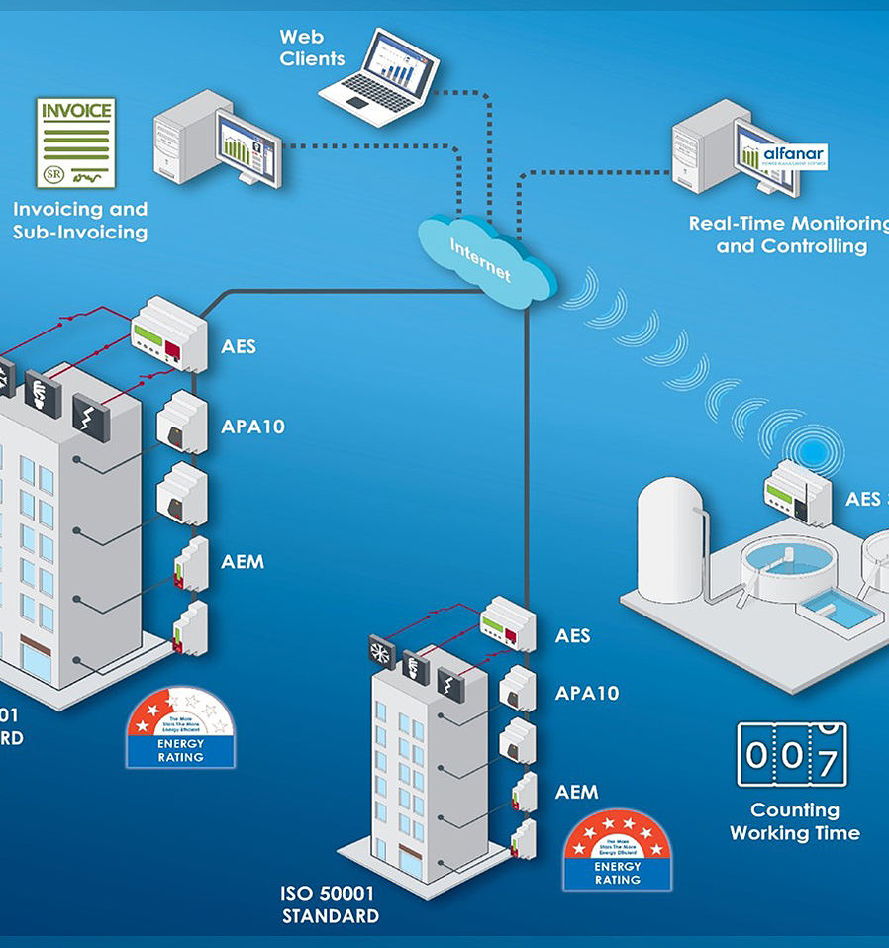
How AI supports energy management
Conclusions
Renewable energy forecasting: Predicts wind/solar output using weather, historical production, and satellite data.
Demand forecasting: Identifies consumption patterns to reduce peak loads and optimise production.
Smart grid optimisation: Real‑time grid control, fault detection, automated balancing, and cyber‑resilience.
Predictive maintenance: Anticipates equipment failures to reduce downtime and extend asset life.

Slide 52
Glossary of key terms
Artificial Intelligence (AI)
Computer systems that can analyse data, learn from patterns, and support or automate decision‑making.
Energy Management
The planning, monitoring, and optimisation of energy production, distribution, and consumption to improve efficiency, reliability, and sustainability.
Renewable Energy
Energy from natural sources that are continuously replenished, such as solar, wind, and hydropower.
Demand Forecasting
The use of data and AI models to predict how much electricity will be needed at different times.
Renewable Energy Forecasting
The prediction of solar or wind power generation based on weather data, historical patterns, and AI models.
Smart Grid
A digital electricity network that uses sensors, data, and AI to monitor, control, and optimise energy flows in real time.
Grid Stability
The ability of the electricity grid to keep supply and demand balanced at all times to avoid outages or equipment damage.
Distributed Energy Resources (DERs)
Small, decentralised energy sources such as solar panels, wind turbines, batteries, and electric vehicles connected to the grid.
Battery Management System (BMS)
A system that monitors and controls battery charging, discharging, and health to ensure safe and efficient operation.
Energy Storage
The process of storing electricity (for example in batteries) for later use when demand is higher or production is lower.
Vehicle‑to‑Grid (V2G)
A technology that allows electric vehicles to return stored energy to the grid, helping balance supply and demand.
Predictive Maintenance
The use of data and AI to predict equipment failures before they happen, reducing downtime and repair costs.
SCADA (Supervisory Control and Data Acquisition)
Systems used to monitor and control critical infrastructure such as power grids, water systems, and industrial processes.
Interoperability
The ability of different systems, devices, or platforms to work together and exchange data effectively.
Green AI
An approach to AI that aims to minimise energy use and environmental impact, ensuring that AI saves more energy than it consumes.

Slide 53
follow our journey
Thank you
www.sustainvet.eu​

