Slide 1

Module 3
AI in Transport
www.sustainvet.eu

Slide 2
Contents
01
Unit 1- Introduction
02
Unit 2- Challenges of transport in modern times
03
Unit 3- How can AI support transport?
04
Unit 4- Staying ahead
05
Unit 5- Graphical overview of possible crossing over of the 4 sectors

Slide 3

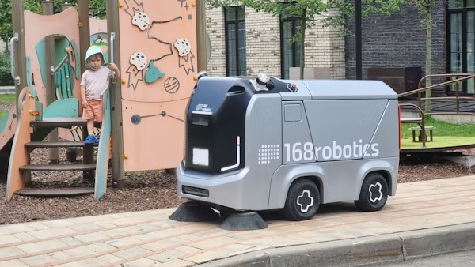
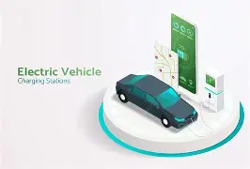
Learning Objectives
Core concepts & integration
In this module, learners will explore how AI is transforming the transport sector and why it has become essential for modern transport education and operations.
Participants will:
Understand the core concepts of AI applications in transport systems, including autonomous vehicles, traffic management, logistics optimization, and predictive maintenance.
Learn practical approaches for integrating AI tools into transport planning, operations, and safety management.

Slide 4

Learning Objectives
Ethics & impact
Examine ethical considerations specific to AI in transport, including safety responsibility, data privacy, algorithmic bias, and social equity.
Discover how AI can improve transport efficiency, reduce environmental impact, enhance safety, and create new career opportunities.
Gain hands-on knowledge of AI tools that transport professionals can confidently apply in real-world scenarios.

Slide 5
01
Unit 1
Introduction

Slide 6
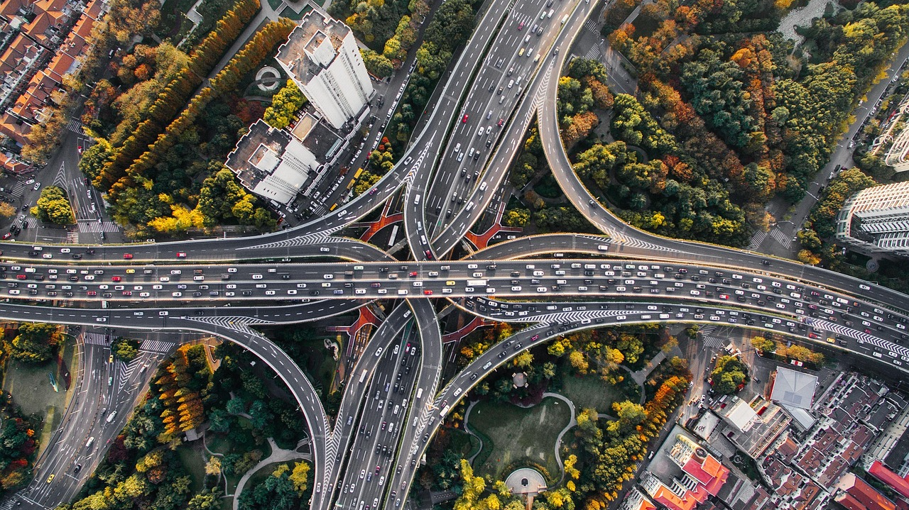
"The future of transportation is not just about moving faster - it's about moving smarter, safer, and more sustainably. AI is the compass that will guide us there."

Slide 7
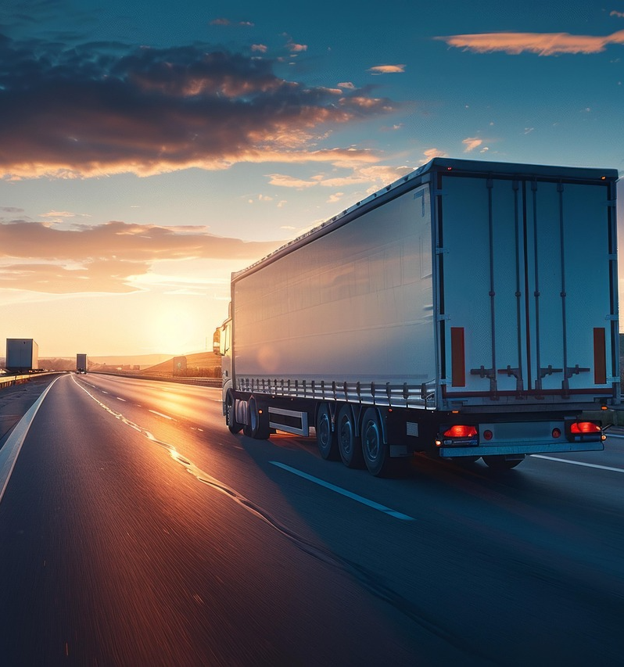
Why AI in transport?
AI offers transformative solutions
The transport sector faces unprecedented challenges: growing urbanization, climate change pressures, safety concerns, and demand for efficient mobility.
AI enables transport systems to process vast amounts of real-time data from vehicles, infrastructure, traffic patterns, and environmental sensors. This allows for intelligent decision-making that was previously impossible. Key drivers:
• Safety: AI can predict and prevent accidents through advanced driver assistance systems and predictive maintenance.
• Efficiency: Optimization algorithms reduce congestion, fuel consumption, and delivery times.
• Sustainability: Smart routing and traffic management minimize environmental impact.
• Accessibility: Autonomous vehicles promise mobility for elderly and disabled populations.

Slide 8
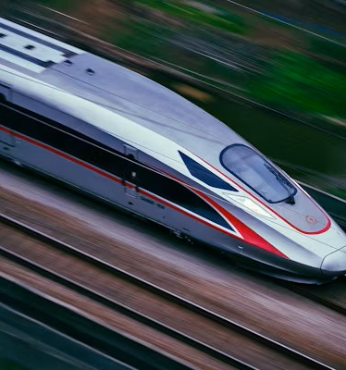
Why AI in transport?
The predictive shift: The evolution of transport intelligence
Transport has always been about connections—moving people and goods from point A to point B. But modern transport systems are becoming intelligent networks that learn, adapt, and optimize continuously.
From reactive to predictive: Traditional transport relies on schedules and fixed plans. AI-enabled transport anticipates demand, predicts disruptions, and proactively adjusts to changing conditions in real-time.

Slide 9
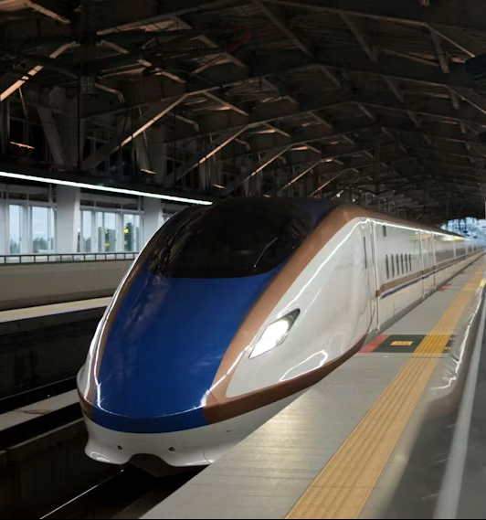
Why AI in Transport?
Real-world impact
Railway operators use AI to predict equipment failures before they occur.
Logistics companies optimize delivery routes that save millions in fuel costs.
Cities reduce traffic congestion by 20-30% through AI-powered traffic signal management.
Autonomous vehicles are already operating in controlled environments, learning from billions of kilometers of driving data.
The human factor: AI doesn't replace transport professionals - it empowers them with better tools, deeper insights, and the ability to focus on strategic decisions while automation handles routine tasks.

Slide 10
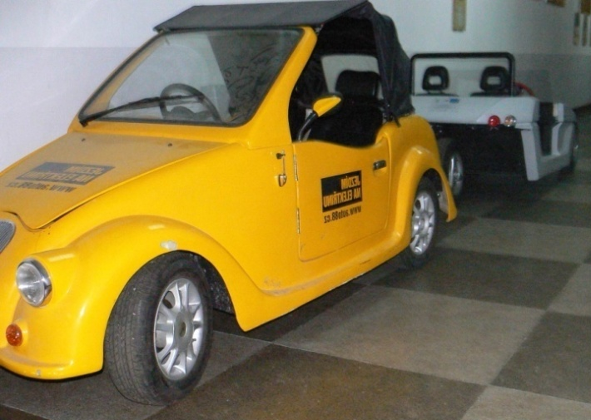

The transport sector at a crossroads
We stand at a pivotal moment in transport history. The decisions we make today about integrating AI will shape mobility for generations to come. HST Todor Kableshkov prepares students not just to use these technologies, but to lead their responsible development and deployment.
Transport professionals must understand both the capabilities and limitations of AI, ensuring that technological advancement serves human needs, safety, and environmental sustainability. This module equips you with that critical knowledge.

Slide 11
02
Unit 2
Challenges of transport in modern times

Slide 12

Major challenges facing modern transport:
Environmental/Urban (congestion, emissions)
01
Traffic congestion in cities, carbon emissions and air pollution, climate change implications, energy consumption in transport and noise pollution
Safety/Security (accidents, threats)
02
Road traffic accidents and fatalities (1.35M deaths annually - WHO), human error as primary cause (94% of accidents), vehicle theft and cargo security, cybersecurity threats in connected vehicles, infrastructure vulnerability and emergency response delays
Infrastructure/Operations (efficiency, capacity)
03
Aging transport infrastructure and maintenance backlogs, inadequate public transport systems, poor intermodal connectivity, inefficient route planning and resource allocation, driver shortages in freight and public transport, last-mile delivery challenges, supply chain disruptions and delays and high operational costs

Slide 13
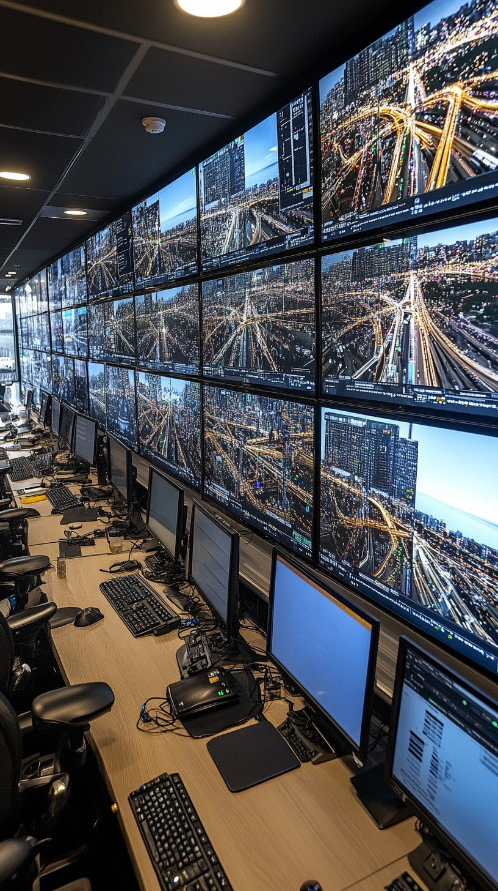
Start small and purposeful
01
Focus on the most pressing challenges: congestion hotspots, high-accident zones, or infrastructure bottlenecks where AI can make immediate impact.
Leverage data-driven insights
02
Use AI tools that analyze real-time traffic data, accident patterns, and emissions to inform evidence-based transport solutions.
Prioritize scalable solutions
03
Choose AI applications that can start small (pilot projects) but scale across networks, cities, or regions for maximum effectiveness.

Slide 14

Challenges of transport in modern times
The data challenge in transport
Modern transport generates massive amounts of data - from GPS trackers to traffic sensors, from vehicle diagnostics to passenger flows. However, most of this data remains underutilized.
The problem: Transport operators collect terabytes of information daily but lack the tools to extract actionable insights quickly enough to matter. By the time patterns are identified through traditional analysis, the moment for intervention has passed.

Slide 15
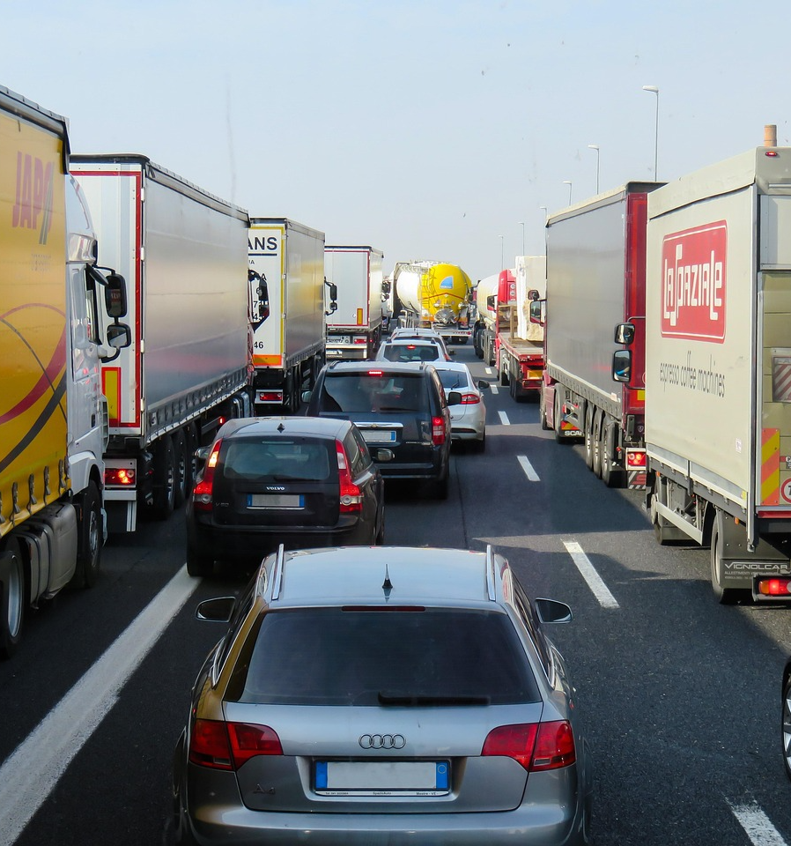
Challenges of transport in modern times
Why this matters:
Delayed responses to traffic incidents cascade into hours of congestion.
Maintenance issues go unnoticed until catastrophic failure occurs.
Inefficient routes waste fuel and increase emissions.
Capacity planning based on outdated data leads to service mismatches.
The opportunity: This is precisely where AI excels - processing complex, dynamic data in real-time to enable immediate, intelligent responses. The transport sector has the data; AI provides the intelligence to use it effectively.

Slide 16

Unit 2 continued
Skills gap and workforce transformation
The transport sector faces a critical challenge: the skills needed for tomorrow's transport systems differ significantly from those that built yesterday's infrastructure.
Current workforce challenges:
Traditional transport education focuses on mechanical and operational knowledge.
Limited understanding of data science, AI, and digital systems among existing professionals.
Rapid technological change outpaces training program development.
Shortage of professionals who bridge transport domain expertise with AI competence.

Slide 17

Unit 2 continued
Educational imperative: Transport educational institutions like HST Todor Kableshkov must evolve curricula to prepare students for AI-integrated transport systems. This doesn't mean everyone becomes a data scientist, but all transport professionals need AI literacy to work effectively in modern environments.
The challenge for educators:
How do we teach students to use AI responsibly?
How can we understand its capabilities and limitations?
How can we make critical decisions when AI provides recommendations?
These questions drive the development of this module.

Slide 18

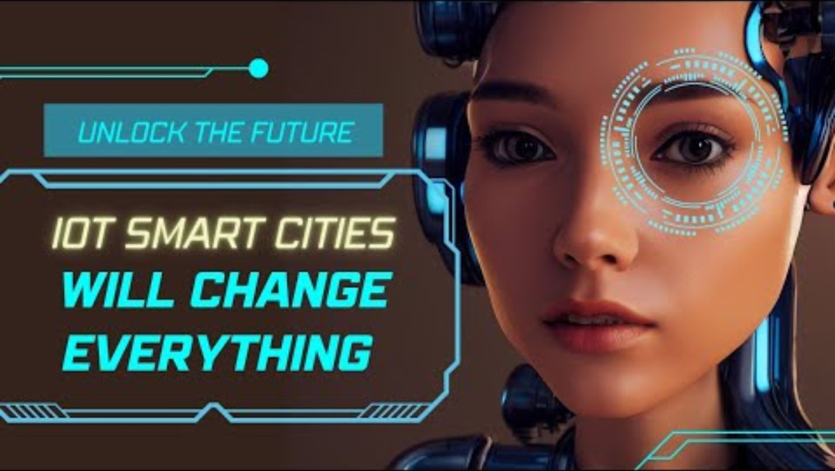
Video 1 & 2
For Unit 2 (Challenges) - Smart cities & AI traffic management
Video 1: “What a driverless world could look like" (TED Talk)
Link: https://www.ted.com/talks/wanis_kabbaj_what_a_driverless_world_could_look_like
Duration: 11:31 minutes
Content: Transportation geek Wanis Kabbaj explains traffic challenges and proposes AI-driven solutions including modular buses, flying taxis, and suspended magnetic pods. Great for showing the problem and introducing future solutions.
Key highlights: Addresses traffic congestion challenges, innovative thinking about urban mobility
Video 2: "Understanding the Role of IoT in Smart Cities" - TechNation
Link: https://www.youtube.com/watch?v=cEGjB7NaPCw
Duration: 10:02 minutes
Content: Focuses on smart city infrastructure and IoT integration with traffic systems.

Slide 19
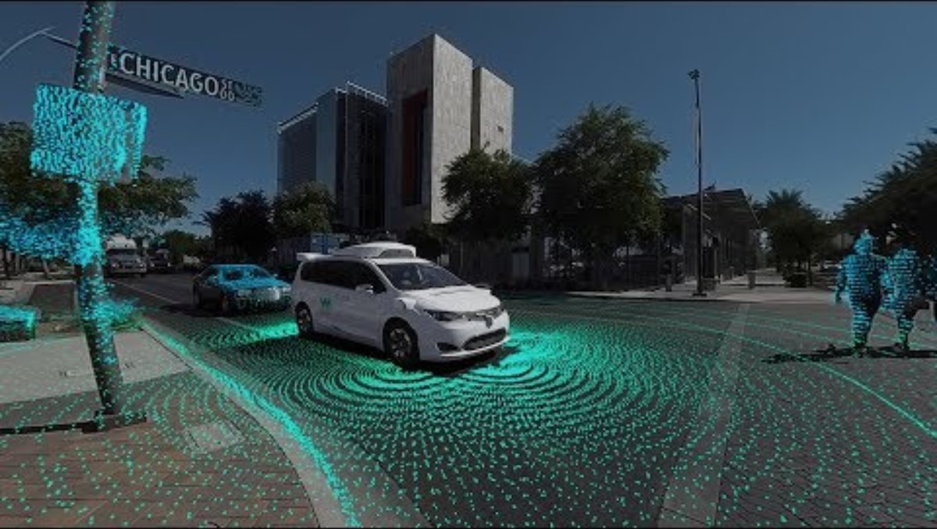
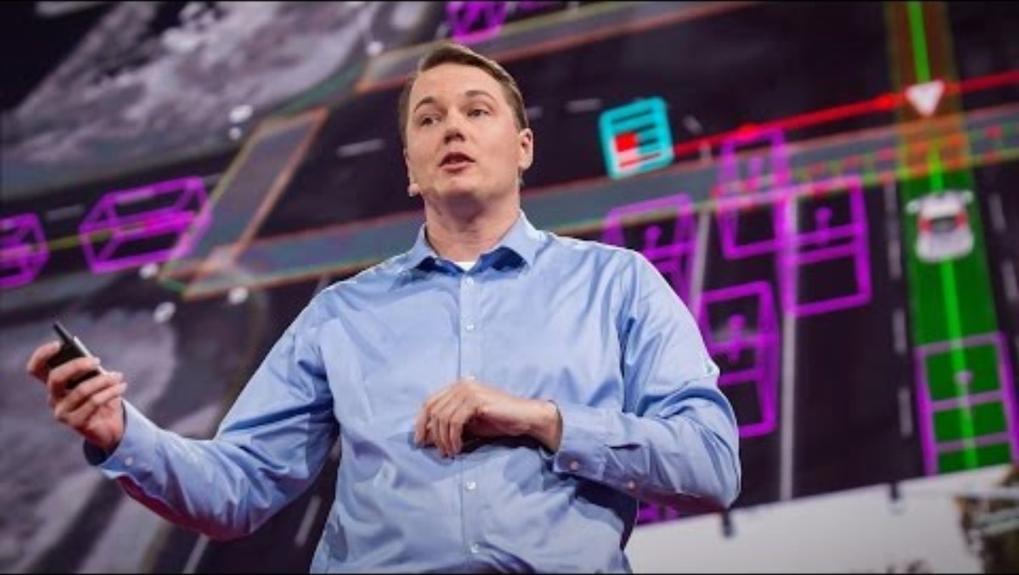
Video 3 & 4
For Unit 3 (AI Solutions) - Autonomous vehicles & AI
Video 3: "Waymo 360° Experience: The World's Most Experienced Driver"
Link: https://www.youtube.com/watch?v=B8R148hFxPw
Duration: 3:36 minutes
Content: Immersive 360° view showing how Waymo's AI sees the road using LIDAR, radar, cameras, and computer vision to predict movement and make decisions
Key highlights:
Shows real-world AI in action.
Demonstrates how autonomous vehicles detect objects up to 300 yards away.
Shot in Phoenix, Arizona showing actual implementation Visualization of AI solving transport challenges.
Video 4: "How a Driverless Car Sees the Road" - Chris Urmson (TED Talk)
Link: https://www.ted.com/talks/chris_urmson_how_a_driverless_car_sees_the_road
Duration: 15:29 minutes
Content: Former head of Google's self-driving car program (now Waymo) shows fascinating footage of how cars make autonomous decisions.

Slide 20
03
Unit 3
How can AI support transport?

Slide 21

AI applications across transport modes
AI is not a single technology but a family of tools and techniques that can be applied throughout the transport ecosystem. This unit explores concrete applications across different transport domains.
Key application areas:
• Autonomous and connected vehicles
• Intelligent traffic management systems
• Predictive maintenance and asset management
• Logistics and route optimization
• Safety analysis and accident prediction
• Demand forecasting and capacity planning
Each application demonstrates how AI transforms data into decisions, patterns into predictions, and reactive systems into proactive intelligence.

Slide 22
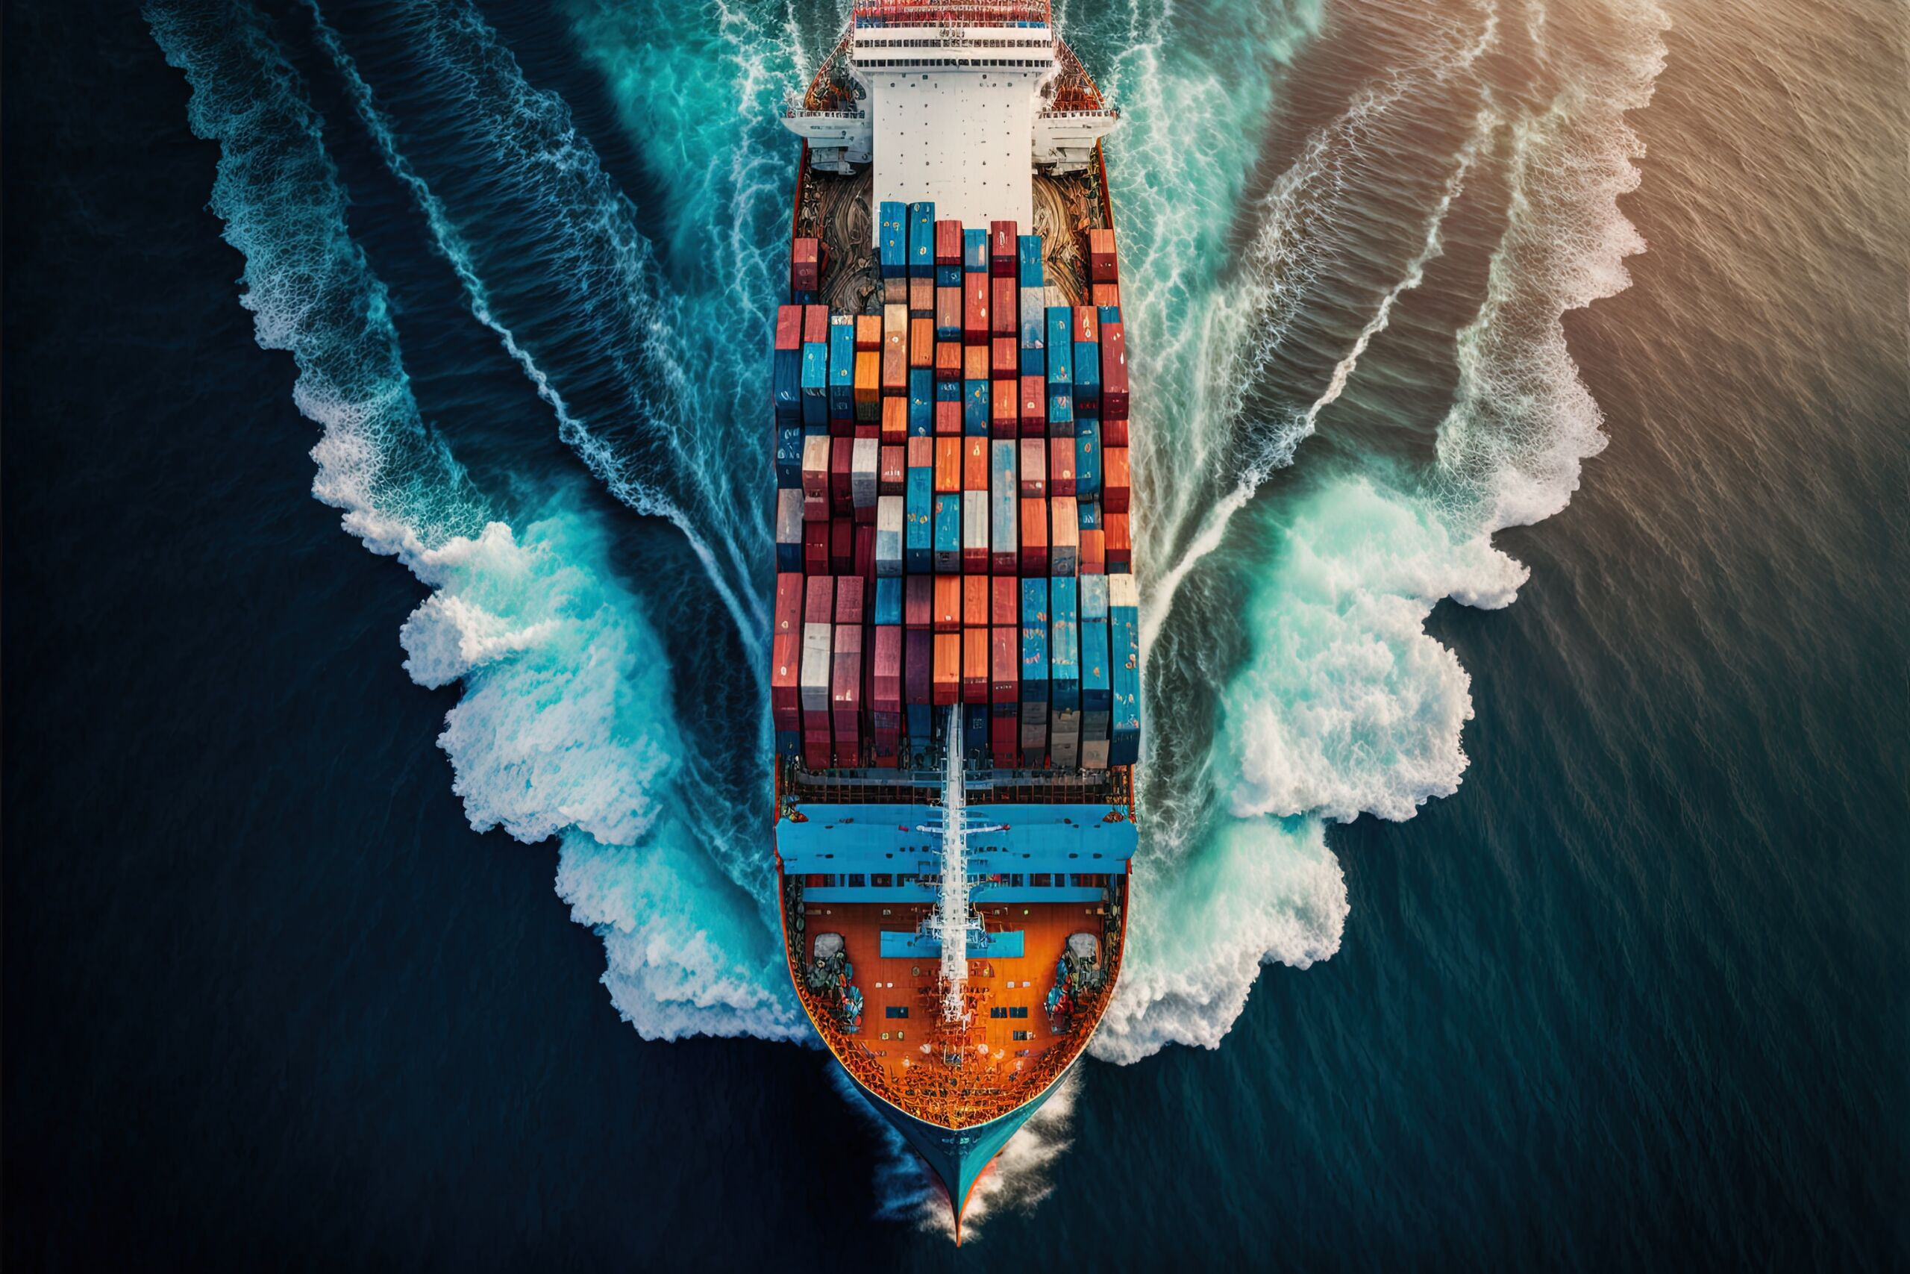
AI applications across transport modes: From assistance to autonomy
Advanced Driver Assistance Systems (ADAS):
AI-powered systems like adaptive cruise control, lane-keeping assist, and automatic emergency braking are already standard in many vehicles. These systems use computer vision and sensor fusion to understand the driving environment and intervene when needed.
Route optimization and navigation:
AI algorithms process real-time traffic data, historical patterns, weather conditions, and events to suggest optimal routes. For commercial fleets, this translates to significant fuel savings and improved delivery reliability.

Slide 23

AI applications across transport modes
Traffic flow management:
Cities use AI to analyze traffic patterns and dynamically adjust signal timing, lane configurations, and speed limits. Machine learning models predict congestion before it occurs, enabling proactive interventions.
The autonomous vehicle frontier:
Self-driving vehicles represent the most ambitious AI application in transport. While fully autonomous cars remain under development, AI is already handling specific scenarios like highway driving, parking, and operation in controlled environments.

Slide 24
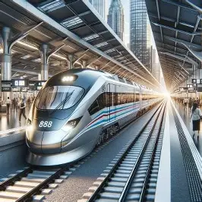
Unit 3 continued
AI in railway operations
Predictive maintenance:
AI analyzes data from thousands of sensors on trains and tracks to predict component failures days or weeks before they occur. This prevents costly breakdowns and improves safety by addressing issues proactively.
Timetable optimization:
Machine learning algorithms create railway schedules that maximize network capacity while minimizing conflicts and delays. AI can simulate thousands of scenarios to find optimal solutions that human planners would need months to develop.

Slide 25

Unit 3 continued
Energy efficiency:
AI systems optimize train acceleration and braking patterns to minimize energy consumption while maintaining schedules. Some railway operators have reduced energy use by 15-20% using AI-powered driving assistance.
Safety monitoring:
Computer vision systems inspect tracks, detect obstacles, and monitor passenger behavior to identify safety risks. AI can spot maintenance issues that human inspectors might miss and alert operators to potential security concerns.

Slide 26
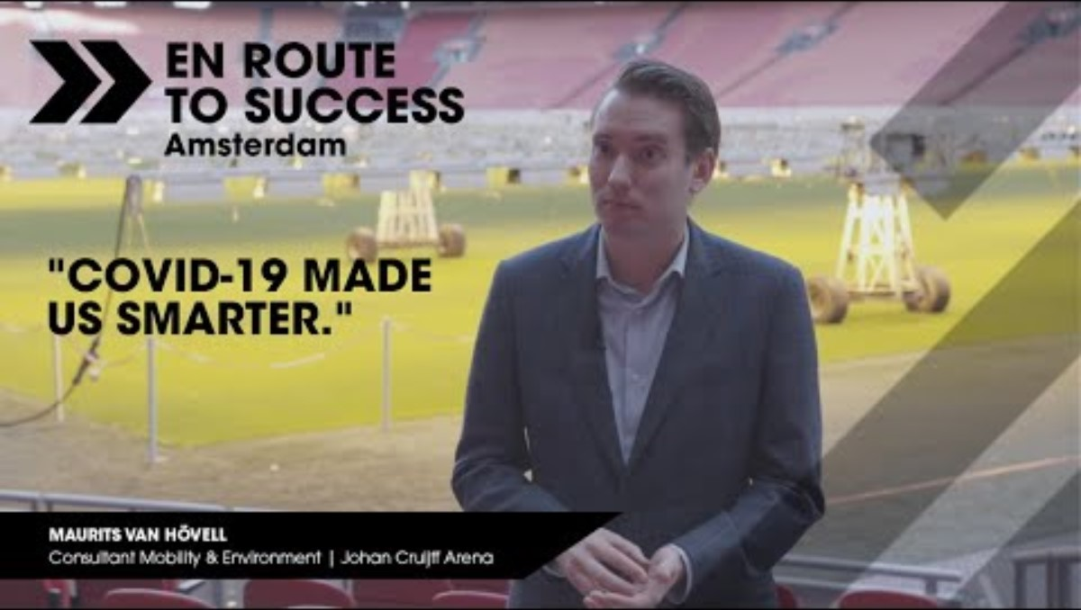
Amsterdam’s smart traffic management
Video 5: “En Route to Success"
Link: https://www.youtube.com/watch?v=fkj0TDPEVTk
Duration: 04:29 minutes
Content: In En Route to Success, mobility experts look at Amsterdam, a city with more bikes than people and big ambitions to become the world’s leading smart mobility hub. With all its challenges, how is Amsterdam mapping its route to success?
• 10% reduction in vehicle loss hours
• Joint automated management across 3 road authorities
• Smart parking reduces search time by 43%
• EU-funded innovation project

Slide 27
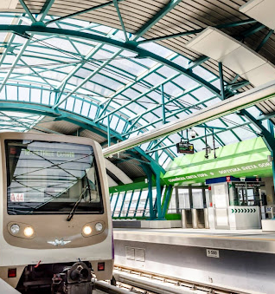
Case Study 1: AI-powered predictive maintenance in Sofia metro
Background:
Sofia's metro system serves over 300,000 passengers daily. Unplanned equipment failures caused service disruptions averaging 15 incidents per month, affecting passenger satisfaction and operational costs.
AI solution:
Installed vibration, temperature, and acoustic sensors on critical components. AI system analyses sensor data in real-time, comparing patterns against historical failure data to predict maintenance needs.
Implementation:
• 6-month pilot on Line 2.
• Machine learning model trained on 3 years of maintenance records.
• Integration with existing maintenance scheduling system.

Slide 28

Case Study 2
Results:
• 70% reduction in unplanned failures
• 25% decrease in maintenance costs
• Improved service reliability from 94% to 98.5%
• Maintenance teams can plan interventions during low-traffic periods
Lessons learned:
AI predictions required validation by experienced technicians initially. Human expertise remains essential for interpreting AI recommendations and making final maintenance decisions. Success came from combining AI capabilities with professional judgment.

Slide 29
04
Unit 4
Staying ahead

Slide 30
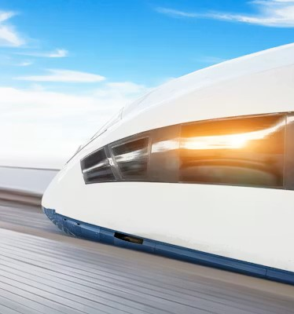
Looking to the future
Preparing transport professionals for an AI-enabled future
The transport sector's AI transformation is inevitable, but its direction is not predetermined. Transport professionals shape how these technologies are deployed and ensure they serve public interest.
Essential competencies for future transport professionals:
AI Literacy, understanding what AI can and cannot do, when to trust it, and when to question its recommendations.

Slide 31
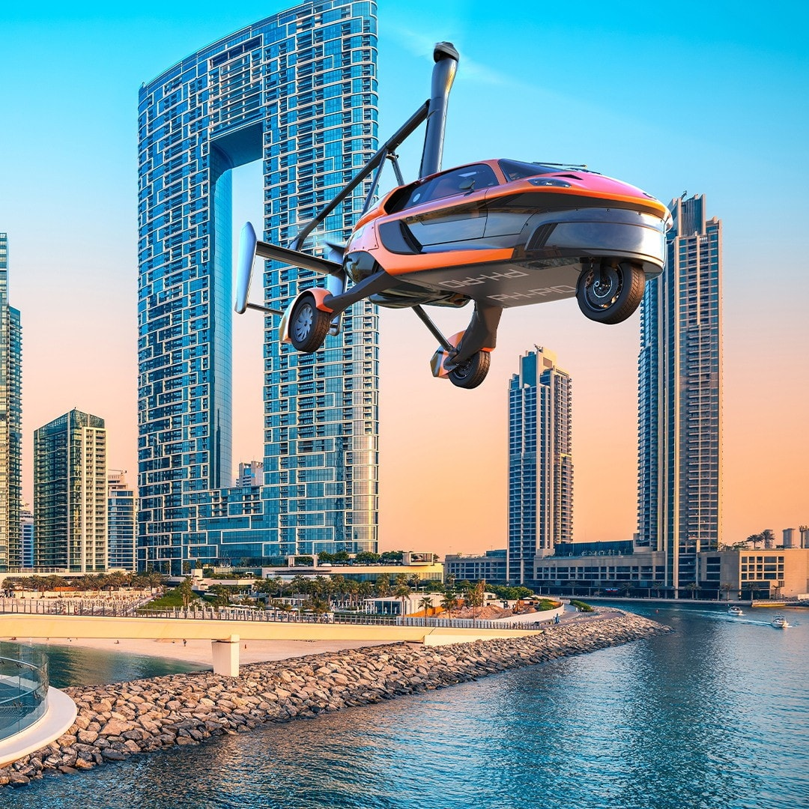

Looking to the future
Data competence: Ability to work with data, understand its limitations, and recognize bias or quality issues.
Ethical reasoning: Making responsible decisions when AI raises questions about safety, privacy, or social impact.
Systems thinking: Seeing how AI components fit within larger transport systems and considering unintended consequences.
Adaptability: Continuous learning as AI capabilities evolve and new applications emerge.

Slide 32

Unit 4 continued
Strategies for responsible AI integration
1. Start with clear objectives: Don't use AI because it's trendy. Identify specific problems where AI adds genuine value. For example, use AI for predictive maintenance because it reduces failures, not because everyone else is doing it.
2. Maintain human oversight: AI should augment human decision-making, not replace it entirely. Critical safety decisions must always involve human judgment. Create protocols for when and how humans intervene in AI systems.
3. Prioritize explainability: Prefer AI systems that can explain their recommendations. "Black box" AI is inappropriate for safety-critical transport decisions. Professionals must understand why AI suggests specific actions.

Slide 33
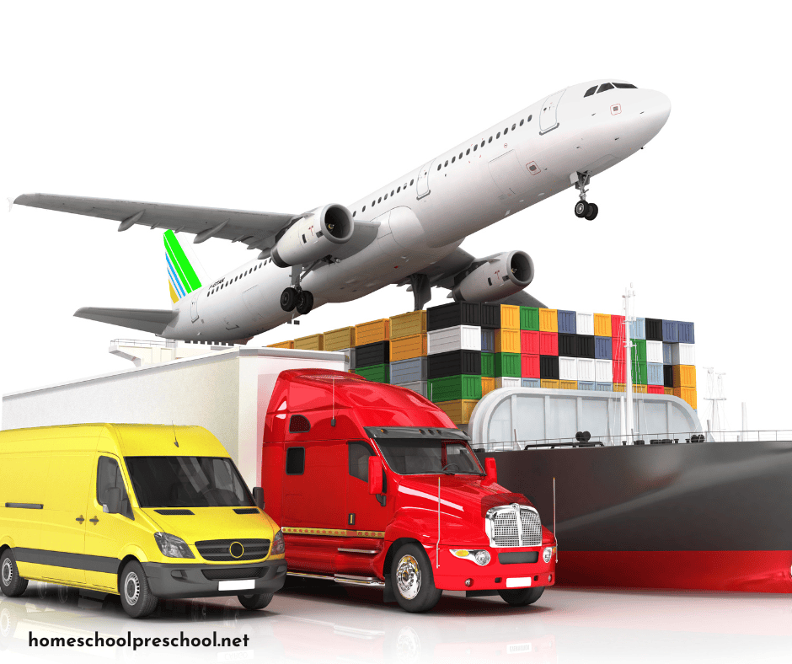
Unit 4
4. Address bias and equity: AI systems can perpetuate existing biases in data. Ensure AI-optimized transport serves all populations fairly, not just those well-represented in training data. Question whether "optimal" solutions disadvantage vulnerable groups.
5. Invest in education and training: Continuous professional development is essential. Transport organizations must support staff in developing AI competencies. Education institutions like HST must update curricula regularly.

Slide 34
05
Unit 5
Graphical overview of possible crossing over of the 4 sectors

Slide 35

Why cross-sectoral integration matters:
Traditional approach:
• Each sector operates in isolation
• Duplicate data collection and infrastructure
• Missed opportunities for resource sharing
• Higher costs and environmental impact
AI-powered integration:
• Sectors share real-time data through common platforms
• Coordinated decision-making across systems
• Resources optimized holistically
• 25-35% improvement in efficiency and sustainability

Slide 36
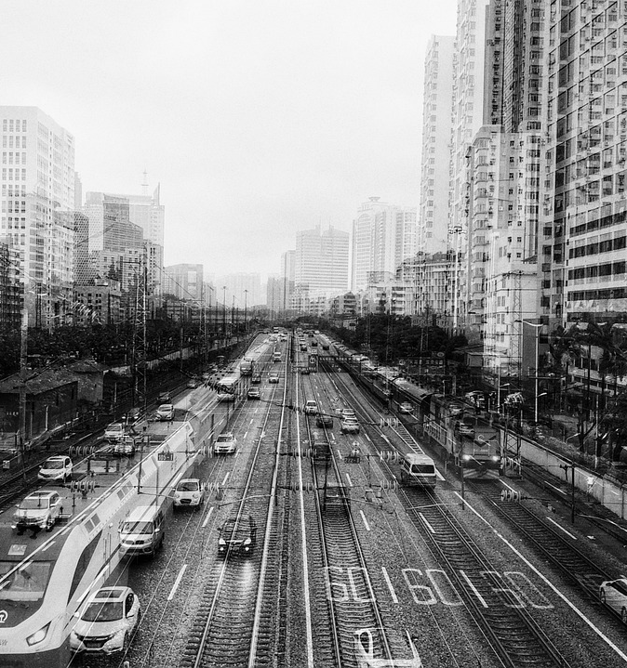
The 6 key connections
1. Transport ↔ Agriculture: Smart logistics
2. Transport ↔ Energy: EV integration with grids
3. Transport ↔ Water: Maritime optimization
4. Agriculture ↔ Energy: Solar-powered farming
5. Agriculture ↔ Water: AI irrigation systems
6. Energy ↔ Water: Smart water treatment

Slide 37

EU cross-sectoral AI success stories
1. BARCELONA SMART CITY (Spain)
All 4 sectors on one platform
Results: 25% cost reduction, 35% emissions cut
2. NETHERLANDS PRECISION AGRICULTURE
Agriculture + Energy + Water integration
Results: 37% water savings, 23% less food waste
3. COPENHAGEN GREEN MOBILITY
Transport + Energy coordination
Results: €400,000/year savings, stable grid
4. AMSTERDAM INTEGRATED SYSTEMS
Water + Energy + Transport coordination
Results: 28% energy cost reduction
Key lesson: Integration creates value greater than individual sectors. AI enables this coordination at scale.

Slide 38
Conclusions
AI is transforming key sectors: Transport, Energy, Water and Agriculture - by enabling smarter, safer, and more efficient operations through connected, data‑driven systems.
It helps address major challenges such as congestion, resource scarcity, climate impacts, safety risks, logistics complexity, and workforce skill gaps.
Real‑world applications already in use include autonomous mobility, predictive maintenance, smart grids, precision irrigation, renewable energy forecasting, and optimized logistics.
Cross‑sector integration delivers far greater impact than isolated solutions, as AI platforms can link transport, energy, water, and agriculture into unified, intelligent ecosystems.
Responsible use of AI requires human oversight, ethical reasoning, transparency, and fairness - AI enhances professional judgment rather than replacing it.
Continuous learning is essential as AI evolves rapidly, requiring professionals to develop new skills and collaborate across sectors.
Future sustainability and mobility professionals will shape how AI is deployed to serve society, strengthen safety, and build resilient, sustainable systems for all.

Slide 39
follow our journey
Thank you!
https://sustainvet.eu/

