Slide 1
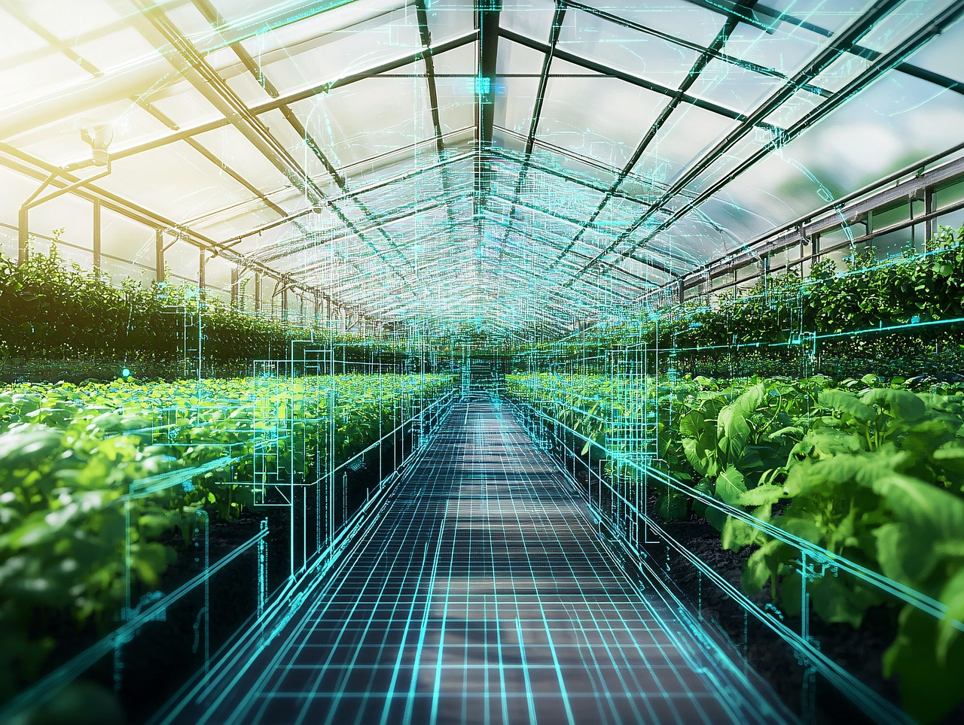
MODULE 2
AI in Agriculture
www.sustainvet.eu

Slide 2
Contents
01
Unit 1- Introduction
02
Unit 2- Challenges of agriculture in modern times
03
Unit 3- How AI can support agriculture
04
Unit 4- How can we stay ahead? Solutions and looking forward

Slide 3
Learning objectives
By the end of this module, learners will be able to:
Explain the key environmental, economic, and workforce challenges affecting modern agriculture.
Describe how AI technologies are applied in crop management, livestock monitoring, and resource optimisation.
Interpret basic farm data and identify where AI tools can improve decision-making.
Assess the benefits and risks of AI adoption, including ethical, environmental, and cybersecurity considerations.
Identify practical opportunities to integrate AI tools into everyday agricultural tasks in a responsible and sustainable way.

Slide 4
01
Unit 1
Introduction

Slide 5
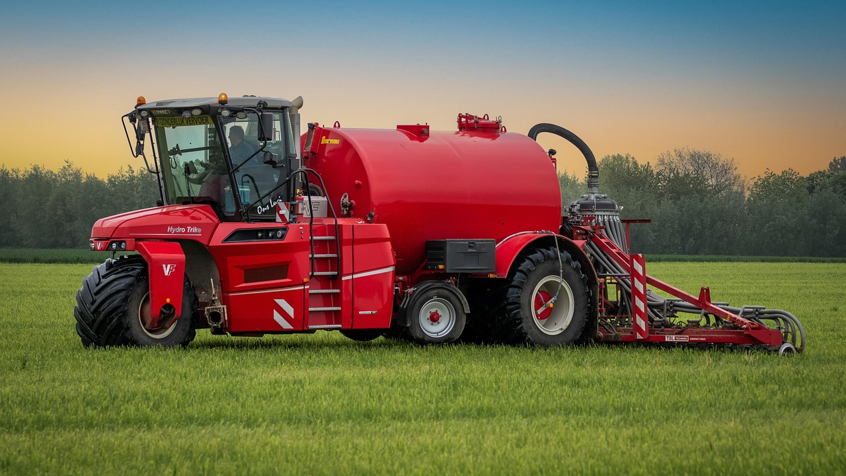
“The ultimate test of a moral society is the kind of world that it leaves to its children.”
Dietrich Bonhoeffer

Slide 6
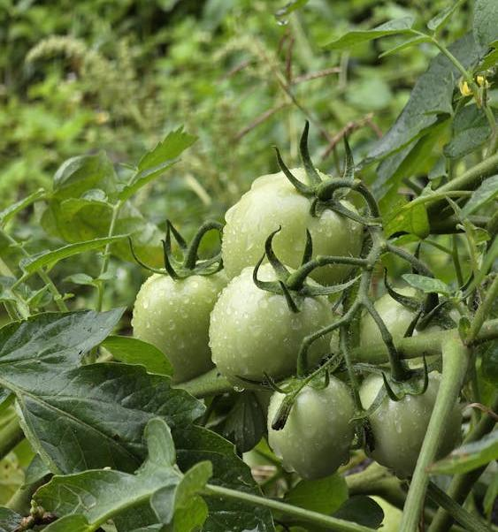
Why AI in agriculture?
Agriculture is undergoing rapid transformation. Climate pressure, rising input costs, labour shortages, and increasing sustainability expectations are forcing farmers and agri-food professionals to rethink how food is produced, monitored, and managed.
Artificial Intelligence is emerging as a practical support tool within this transition, helping agriculture become more resilient, efficient, and environmentally responsible.

Slide 7
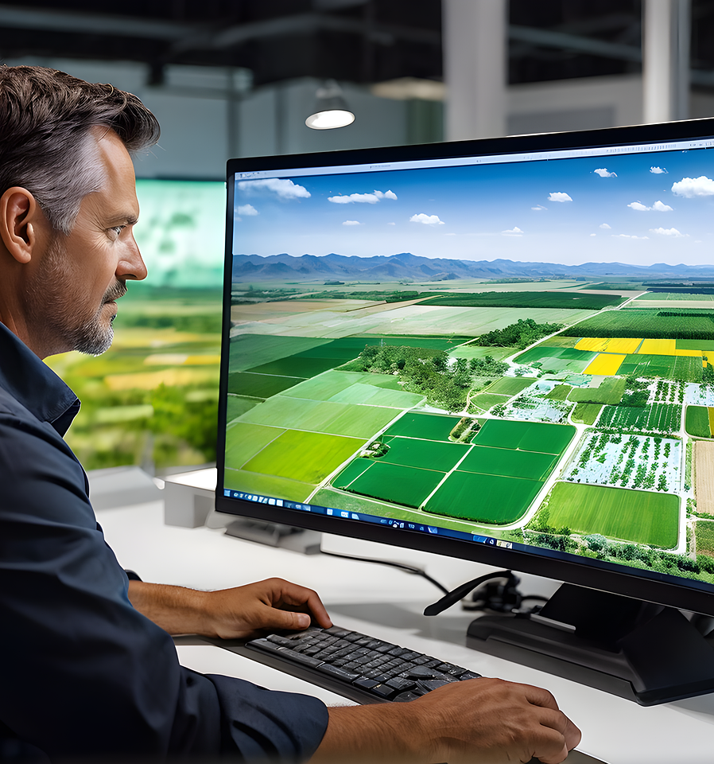
Why AI in agriculture?
AI in agriculture is about strengthening decision-making by combining human experience with data-driven insights, not replacing farmers or traditional knowledge.
From monitoring animal health to optimising water use and reducing chemical inputs, AI is already being applied in ways that support sustainable farming practices and improve long-term viability for farms of all sizes.

Slide 8
Why AI matters now
Modern agriculture generates large volumes of practical data through everyday farm operations, including weather patterns, soil conditions, animal health indicators, and machinery performance.
AI tools help farmers and agricultural workers analyse this information efficiently, identifying patterns that are difficult to detect through manual observation alone.
Within the SUSTaiN project, AI is positioned as an enabling, workplace-relevant technology that supports three interconnected priorities in agricultural VET:
reliable food production
reduced environmental impact
economic sustainability for farms and rural communities
AI supports these priorities by improving precision in daily tasks, reducing waste, and enabling earlier, preventative decision-making rather than reactive responses.

Slide 9
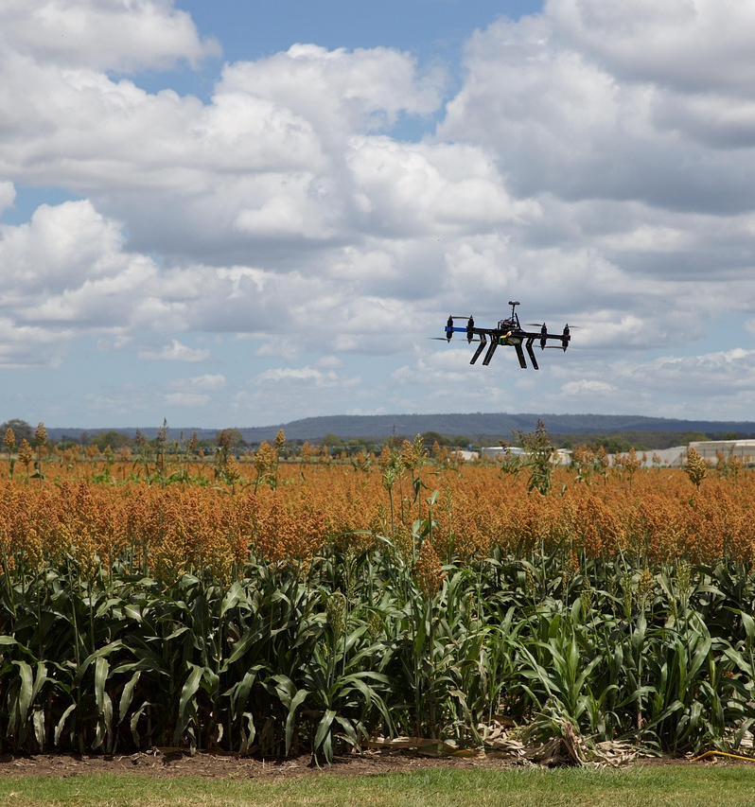
How is AI being used?
AI today is already making concrete differences on farms, from disease detection to autonomous machines:
In the Netherlands, farms use AI-driven robots to inspect tulip fields and automatically identify and remove diseased bulbs.
These robots process thousands of images with GPS accuracy to protect crop health and prevent disease spread.

Slide 10
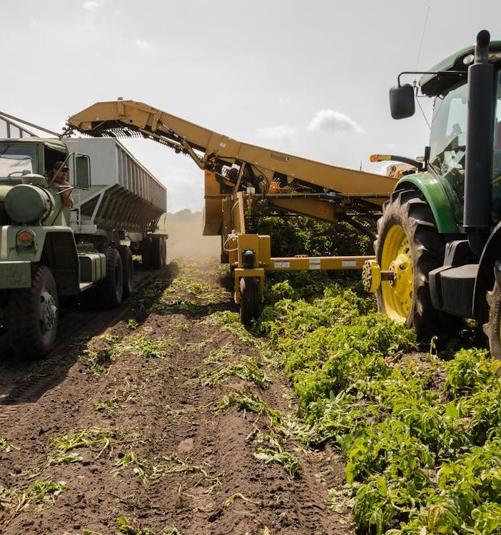
How is AI being used?
In Kenya, smallholder farmers use AI tools like Virtual Agronomist and PlantVillage to diagnose pests and optimise fertiliser use via smartphone. One farmer saw his coffee yield jump from earlier levels after adopting AI recommendations tailored to soil and weather data.
Advanced AI systems are being developed for automated pest control on the ground, where robots equipped with cameras detect diseases and apply treatments with precision, reducing health risks from manual spraying and improving crop outcomes.
SOURCE
SOURCE

Slide 11
02
Unit 2
Challenges of agriculture in modern times

Slide 12
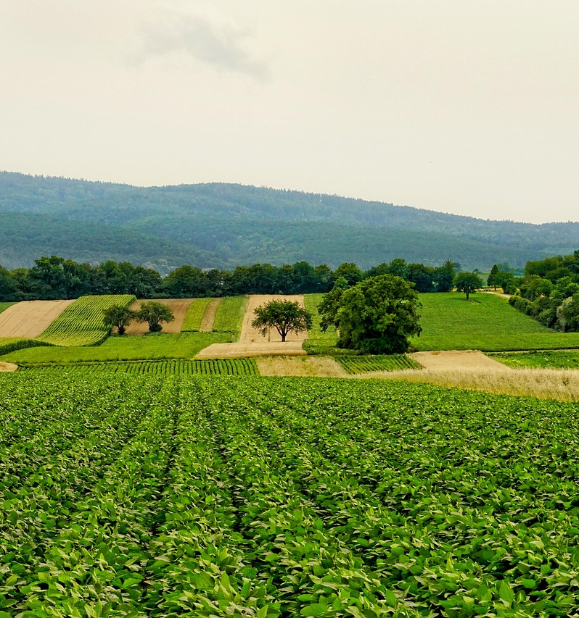
Challenges of agriculture in modern times
Agriculture today faces a mix of environmental, economic, and social pressures that are increasingly difficult to manage through traditional practices alone.
These challenges are closely connected, placing growing pressure on farmers, agri-food workers, supply chains, and local ecosystems.
Understanding this context is an essential starting point before exploring how AI can offer practical, job-relevant support within agricultural training and practice.

Slide 13
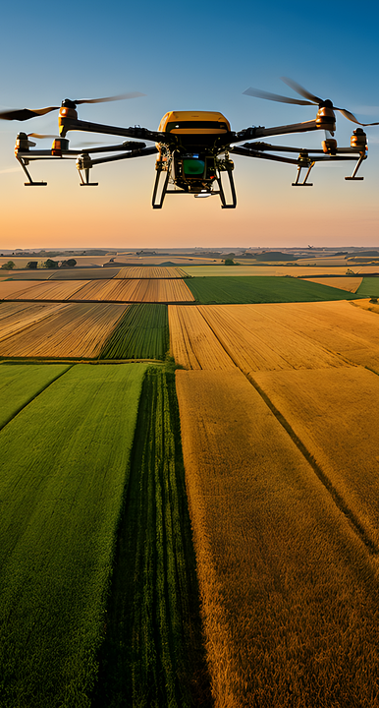
Climate variability and environmental pressure
01
Farmers face more extreme weather, unpredictable rainfall, droughts, and increasing pest and disease pressures across regions.
Resource efficiency and rising input costs
02
Rising costs for water, fertiliser, feed, and energy increase pressure to produce efficiently while meeting sustainability requirements and regulations.
Labour shortages and skills gaps
03
Ageing workforces and limited digital skills make it harder to maintain, adapt, and modernise farm operations.

Slide 14

Challenge 1: Climate variability and environmental pressure
Farmers increasingly face unpredictable weather patterns, including droughts, floods, heatwaves, and unseasonal frosts.
These conditions make it harder to plan planting, irrigation, harvesting, and livestock management using past experience alone.
Extreme weather events also increase the risk of crop failure, soil degradation, and animal health issues, placing additional pressure on farm resilience and food security.

Slide 15
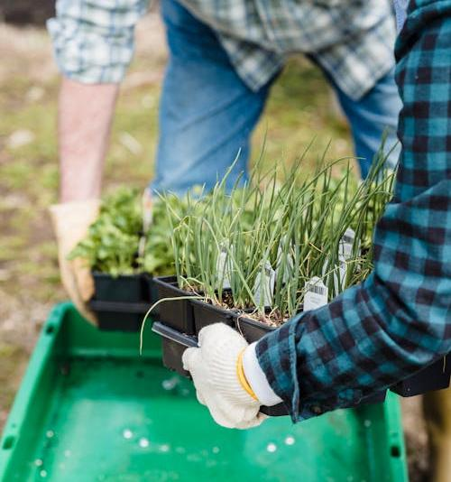
Environmental pressure on farming systems
Agriculture is expected to reduce its environmental footprint while maintaining productivity.
This includes lowering water use, reducing fertiliser and pesticide runoff, protecting biodiversity, and improving soil health.
Meeting these expectations often involves more monitoring, record-keeping, and compliance with environmental standards, adding complexity to everyday farm work.

Slide 16
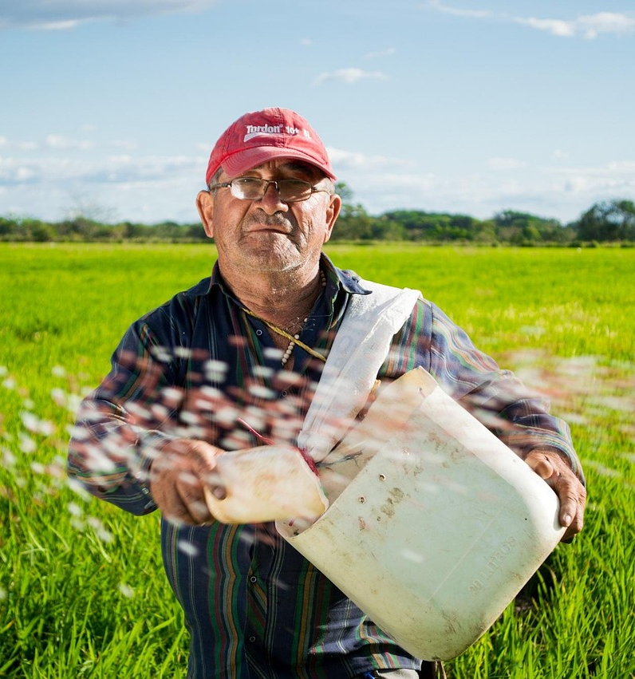
Challenge 2: Resource efficiency and rising input costs
Agricultural workers and farm managers are facing steady increases in the cost of essential inputs such as fertiliser, animal feed, water, fuel, and energy. These rising costs directly affect day-to-day farm operations, work planning, and financial decision-making.
From a VET perspective, this means learners need stronger skills in monitoring input use, understanding cost–benefit trade-offs, and making informed operational choices
Efficient use of resources has become a core workplace competence, particularly in roles linked to crop management, livestock care, and farm machinery operation.

Slide 17
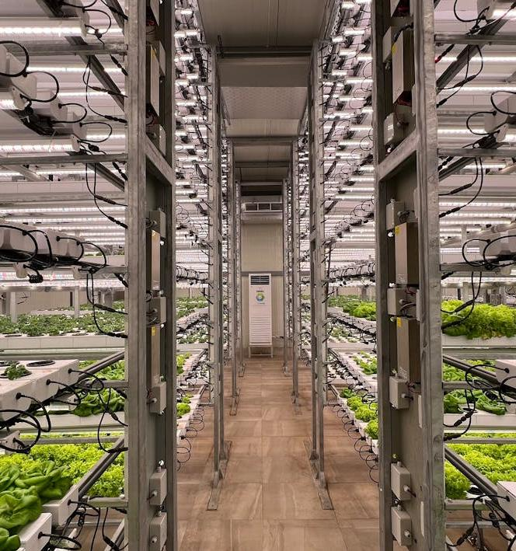
Efficiency under regulatory pressure
Alongside rising costs, agricultural workers must operate within increasingly detailed sustainability standards and environmental regulations. These include limits on fertiliser use, water abstraction rules, animal welfare requirements, and record-keeping obligations.
For vocational learners, this creates a need to develop practical skills in monitoring, documenting, and adjusting farm practices to remain compliant.
Training that links efficiency with regulation helps learners understand how everyday tasks, such as input application, equipment calibration, and data recording all contribute to sustainable and compliant farm operations.

Slide 18
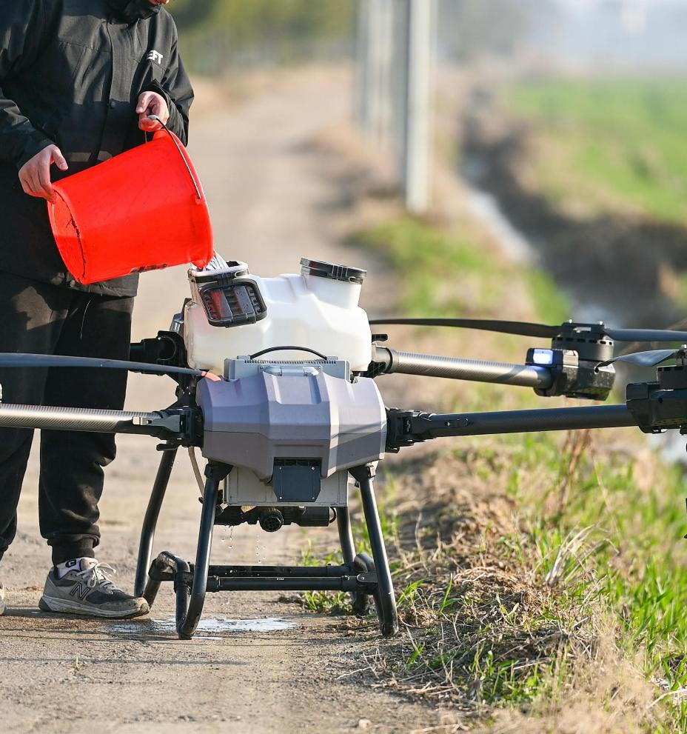
Challenge 3: Labour shortages and skills gaps
Many farms and agri-food businesses are experiencing ongoing labour shortages, driven by ageing workforces, rural depopulation, and reduced interest in agricultural careers among younger generations. This increases pressure on existing workers, often leading to longer working hours and reduced capacity to adapt practices or introduce new methods.
From a VET perspective, this highlights the importance of equipping learners with multi-skilled, adaptable competences that allow them to carry out a wider range of tasks safely and efficiently. Training plays a key role in preparing workers to operate modern equipment, manage workloads, and maintain productivity with smaller teams.

Slide 19
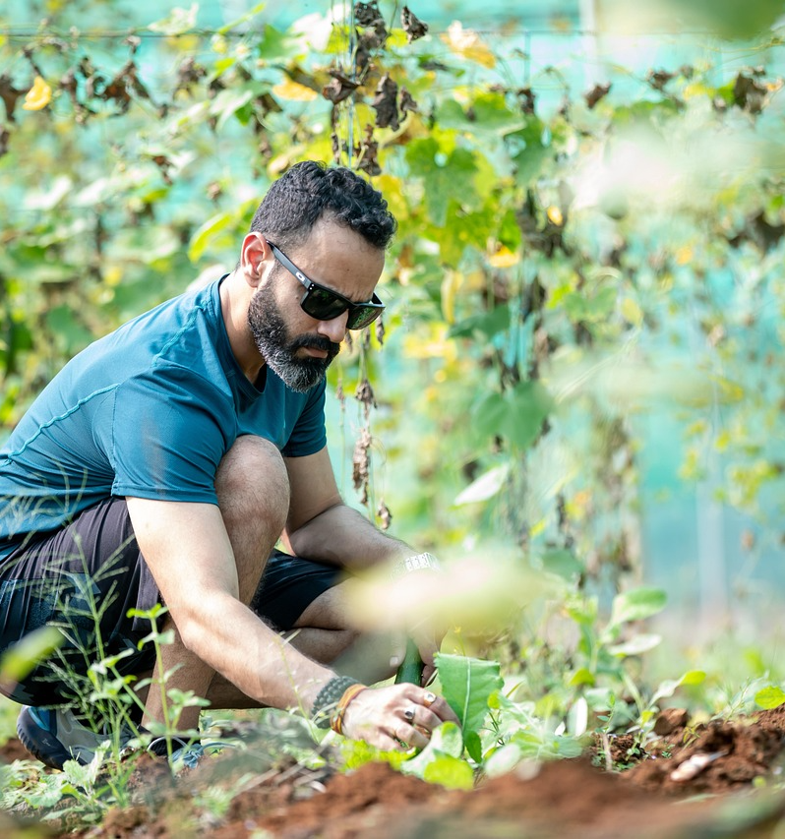
Skills gaps and digital readiness
As agriculture becomes more technology-supported, workers are expected to engage with digital tools such as sensors, farm management software, and automated systems.
However, many current and future workers have uneven access to training in digital and data-related skills. Vocational education has a central role in building confidence and competence in using these tools.
Developing digital readiness through hands-on training helps learners interpret information, support decision-making, and integrate technology into everyday farm tasks without losing the value of practical, experience-based knowledge.

Slide 20
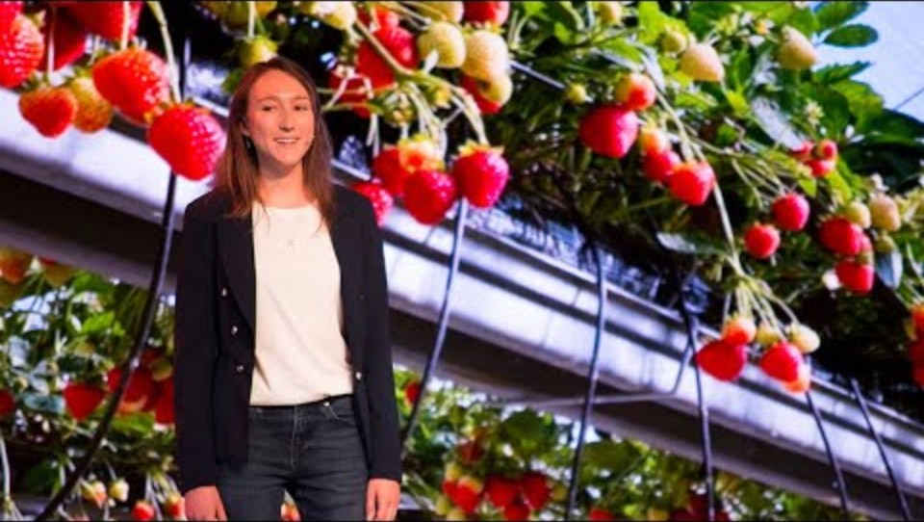
WATCH
Impact of AI on food sector
Check out the following TED video about “How agri-robotics will change the food you eat”.
This talk explores how robotics and AI are being introduced into real farming environments to address labour shortages, efficiency challenges, and sustainability pressures.
Can also be accessed at https://youtu.be/RjJfcoeFS5c?si=nJFAI5jM1-kKT3U1

Slide 21
03
Unit 3-
How AI can support agriculture

Slide 22
Can AI be an ally for modern agriculture?
In the previous chapter, we analysed the key challenges that modern agriculture is facing today - ranging from climate variability and resource scarcity to labour shortages and increasing production demands. This chapter provides an overview of how these challenges can be addressed using Artificial Intelligence (AI).
AI is becoming a valuable tool for modern agriculture by helping farmers make faster, more accurate, and more sustainable decisions. Through data‑driven insights, automation, and predictive capabilities, AI supports farmers in optimising inputs, improving yields, and managing risks more effectively.

Slide 23
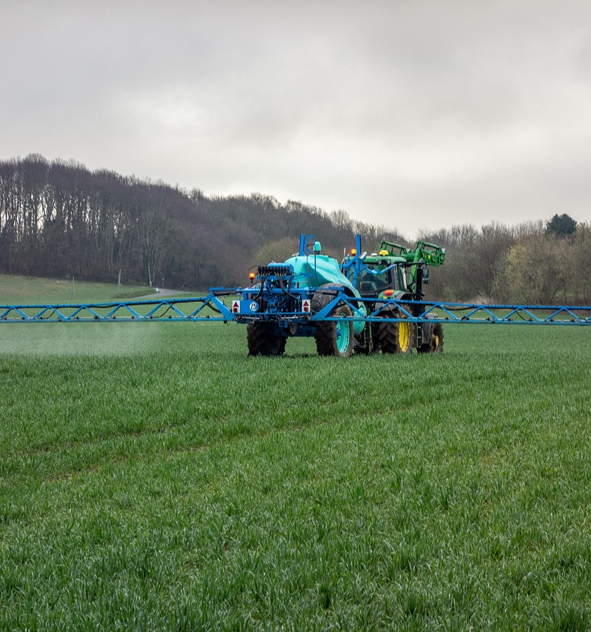
Climate variability and environmental pressure: AI solutions
Artificial intelligence offers powerful new solutions that can help us respond more effectively.
From improving climate forecasting to strengthening adaptation strategies, AI provides tools that enhance decision‑making, increase efficiency, and support more sustainable development.
Check out how AI can support you in your daily work!

Slide 24
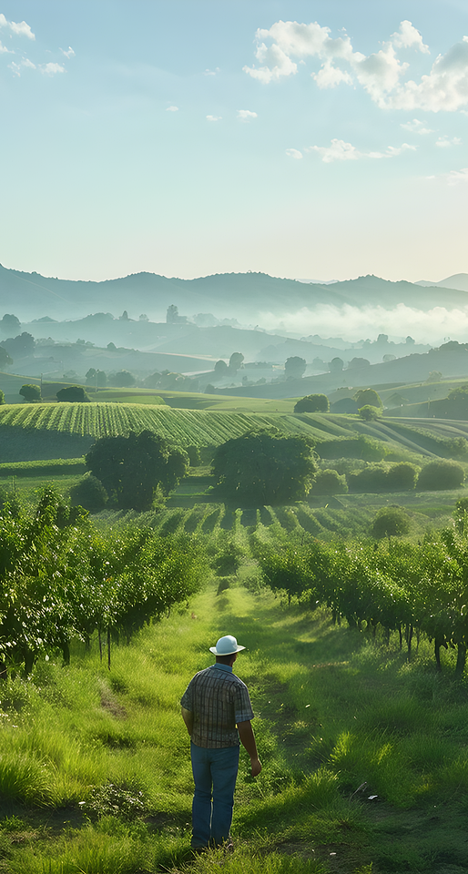
Climate prediction & early warning
01
Analyses climate, satellite, and weather‑station data
Predicts extreme events (droughts, floods, heatwaves)
Supports proactive crop and risk‑management decisions
.
Plant health & disease management
02
Detects diseases, pests, and nutrient deficiencies early
Uses computer vision for rapid diagnosis
Enables targeted, low‑chemical treatments
Climate smart farming
03
Uses AI to optimise planting schedules and crop selection
Adapts farming practices to changing climate conditions
Improves resilience while reducing environmental impact

Slide 25
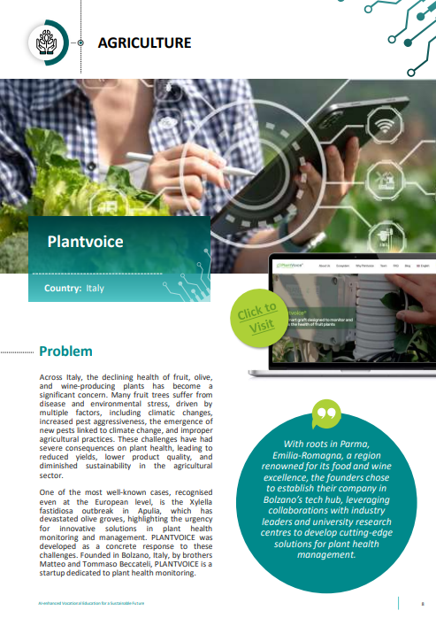


Case study: Plantvoice
PLANTVOICE® helps farmers predict the quality of agricultural production and maximise crop yields. It is based on an as-a-service sensor technology that collects and analyses internal physiological data of plants, offering farmers detailed information on the health status of crops. The system consists of a minimally invasive Phyto compatible device, which is inserted into the plant stem and allows monitoring salinity and sap flows, a sort of “plant electrocardiogram”. It allows to:
- Identify signs of water stress
Recognise early attacks by fungi, bacteria and other pathogens,
Analyse the plant’s response to agronomic treatments,
(Subtitles) Plantvoice for APPLES growers in Val di Non (Trentino) and South Tyrol - YouTube

Slide 26
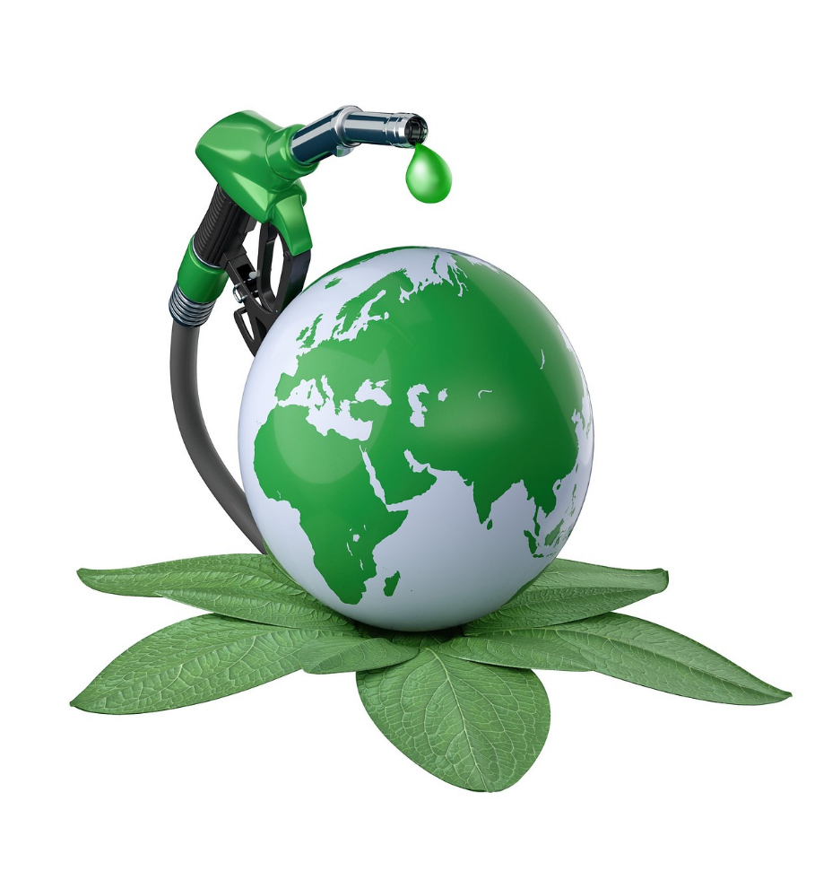
Resource efficiency & cost reduction in agriculture:
AI solutions
Artificial Intelligence offers powerful tools that help farmers produce more with less, optimise operations, and reduce financial risk. By transforming data into actionable insights, AI enables smarter decisions, higher efficiency, and long‑term sustainability.

Slide 27
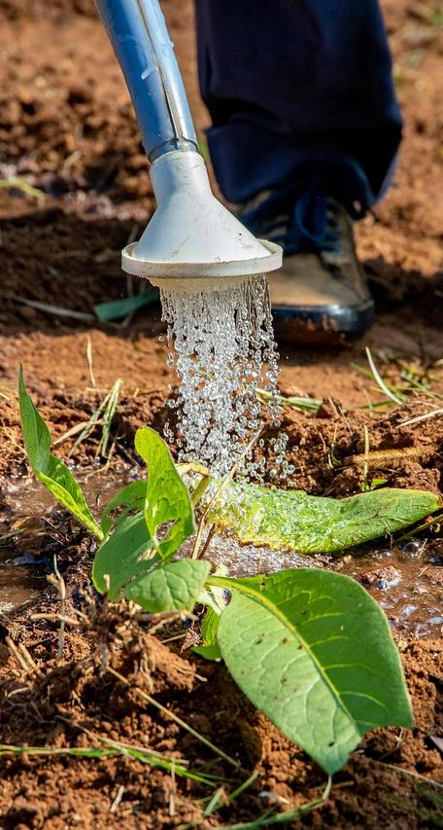
Precision irrigation
01
Analyses soil moisture, weather forecasts, and crop needs
Delivers water only where and when needed
Reduces water waste and energy use
.
Smart fertilisation
02
Machine‑learning models calculate exact nutrient needs
Prevents over‑application and runoff
Lowers fertiliser use while maintaining yields
Energy optimisation
03
Plans machinery and irrigation in low‑cost energy periods
Improves use of pumps, greenhouses, storage systems
Cuts fuel and electricity consumption

Slide 28
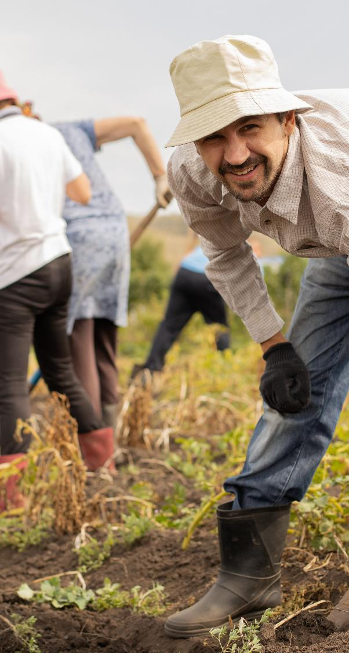
Optimised input use
04
AI recommends minimal doses of seeds, fertilisers, pesticides
Reduces dependency on expensive inputs
Maintains or improves productivity
.
Early detection of problems
05
Computer vision identifies pests, diseases, nutrient issues early
Prevents costly crop losses
Enables targeted, low‑cost interventions

Slide 29
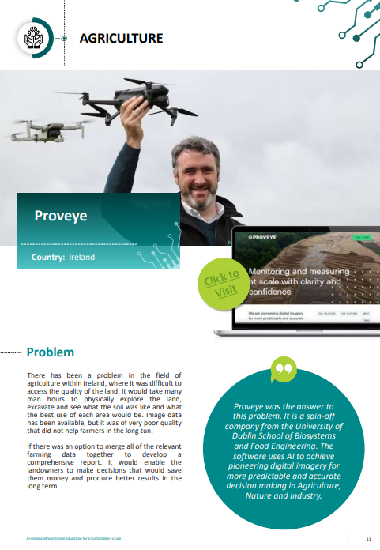
Proveye
Proveye is a an AI‑driven remote sensing system that processes satellite, drone, and ground‑based imagery to deliver accurate, near real‑time insights for agriculture and environmental management.
Its key capabilities are:
Grassland Monitoring (ProvGrass): Automatically measures pasture cover, growth, and yield potential.
Precision Fertiliser Application (ProvVari): It generates variable‑rate fertiliser maps that can cut nitrogen use.
Environmental & Sustainability Tracking: Supports verification of carbon sequestration, biodiversity, and nature‑based solutions in grasslands and wetlands.
Integrated Data Hub: Combines satellite, UAV, and field‑sensor data into a single platform for monitoring land‑use changes and risks such as drought or fir

Slide 30
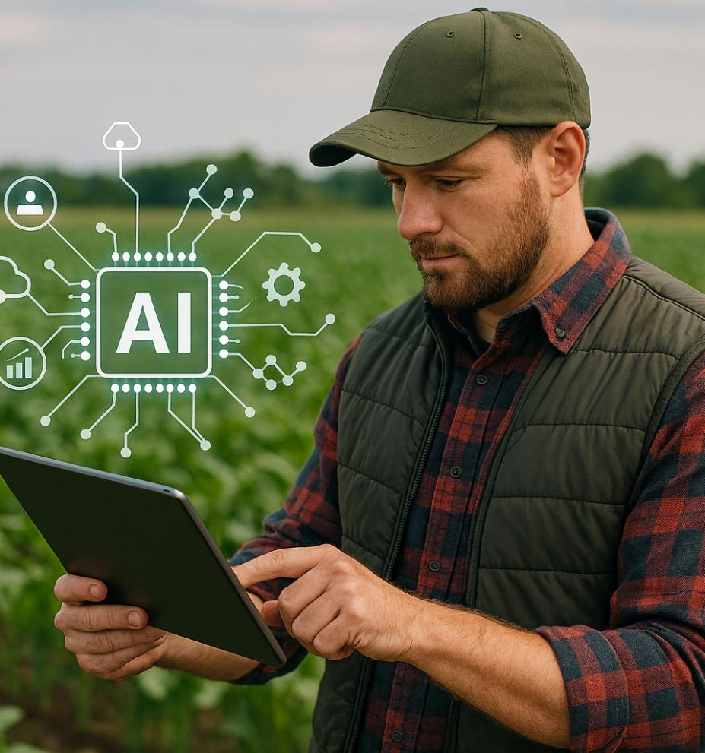
Labour shortages and skills gaps: AI Solutions
Artificial Intelligence offers practical, scalable solutions that help bridge the gap created by the lack of workers and the increasing need for socialised skill.
By automating key tasks, simplifying complex decisions, and supporting rapid skill development, AI enables farms to operate effectively even with limited human resources.

Slide 31
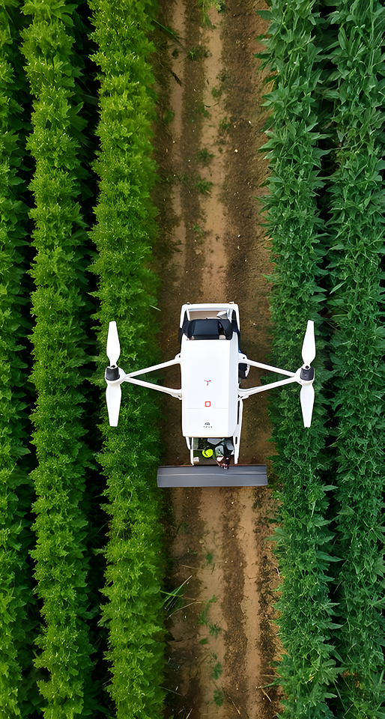
Automation & robotics
01
Autonomous machines cut the need for manual labour
Drones perform monitoring, spraying, mapping tasks efficiently
Robots handle repetitive, time‑consuming tasks with high precision
.
AI‑Powered decision support
02
Provides guides on planting, irrigation, and crop management
Simplifies complex agronomic decisions
Real‑time recommendations improve productivity
Smart training & knowledge transfer
03
AI‑based apps provide step‑by‑step guidance for farm tasks
Virtual assistants and chatbots offer instant agronomic support
Digital training tools help upskill staff fast and cost‑effectively

Slide 32
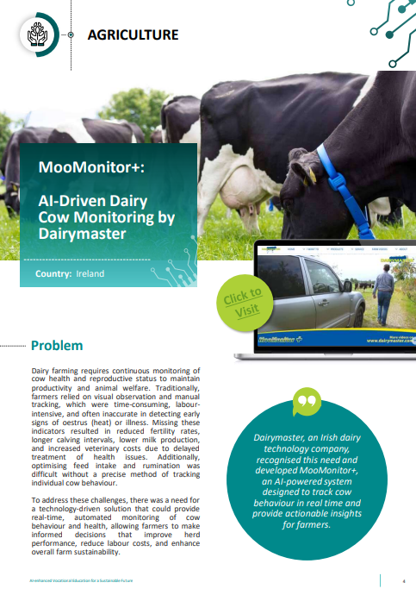
Case study: MooMonitor
MooMonitor+ is a system that monitors cows' behaviour. It tackles the area of fertility and animal health by introducing revolutionary wearable technology to the farmyard. This changes agriculture by utilising technology from cloud computing, wearable sensors and big data to make health and reproductive monitoring better. It allows individual animal attention by sending behaviour alerts to farmers when it detects possible health problems. This allows early intervention, reduced antibiotic usage and better recovery rates on farm.
What is MooMonitor+ ? - YouTube

Slide 33

Self-reflection exercise
Practical application of AI in your environment
Where in your daily or seasonal agricultural work could AI reduce effort or improve quality?
(Think about the entire value chain: planning → production → harvest → logistics.)
If you could automate or enhance one task with AI, what would it be and why?
What small, low‑risk AI experiment could you try in the next season?
What skills, partners, or technology would you need to make this happen?

Slide 34
04
Unit 4-
How can we stay ahead? Solutions and looking forward

Slide 35
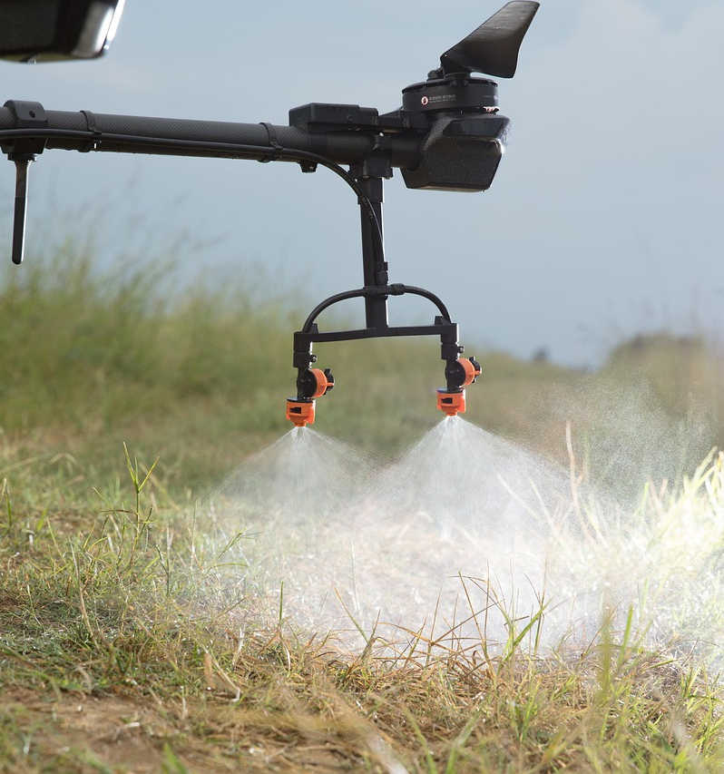
Staying ahead of AI‑driven challenges in farming
AI can support farming, but staying ahead requires strong digital skills, practical experience, and informed decision-making. Farmers should combine AI insights with their own knowledge, choose technologies that fit their needs, and work closely with partners. A clear focus on sustainability and responsible use will ensure long-term resilience and success.

Slide 36
Key risks and challenges
1. Data ownership and privacy
Who owns the data collected by sensors, drones, and AI platforms?
- Farmers
- Tech companies
- Governments
This is still a grey area, and it could create power imbalances.
2. Dependence on big tech companies
If AI tools become essential, there is the risk that small farmers may become dependent on expensive proprietary systems. This could widen the gap between large industrial farms and smallholders.

Slide 37
Key risks and challenges
3. Job displacement
Automation may reduce the need for:
Field labour
Equipment operators
Some agronomy roles
New jobs will emerge, but not everyone will transition easily, especially for an older workforce
4. Environmental risks
AI can optimise farming, but it can also encourage:
Over‑intensification
Monocultures
Excessive resource use
If profit algorithms dominate, sustainability could suffer.

Slide 38
Key risks and challenges
5. Bias and inaccurate predictions
AI is not perfect, AI models trained on limited or biased data can:
Misjudge soil conditions
Recommend harmful practices
Fail under unusual climate events
We have to remember that Agriculture is messy and unpredictable.
6. Cybersecurity threats
Connected farms can be hacked. The following challenges could arise:
Irrigation systems shut down
Autonomous tractors misdirected
Supply chains disrupted
.

Slide 39
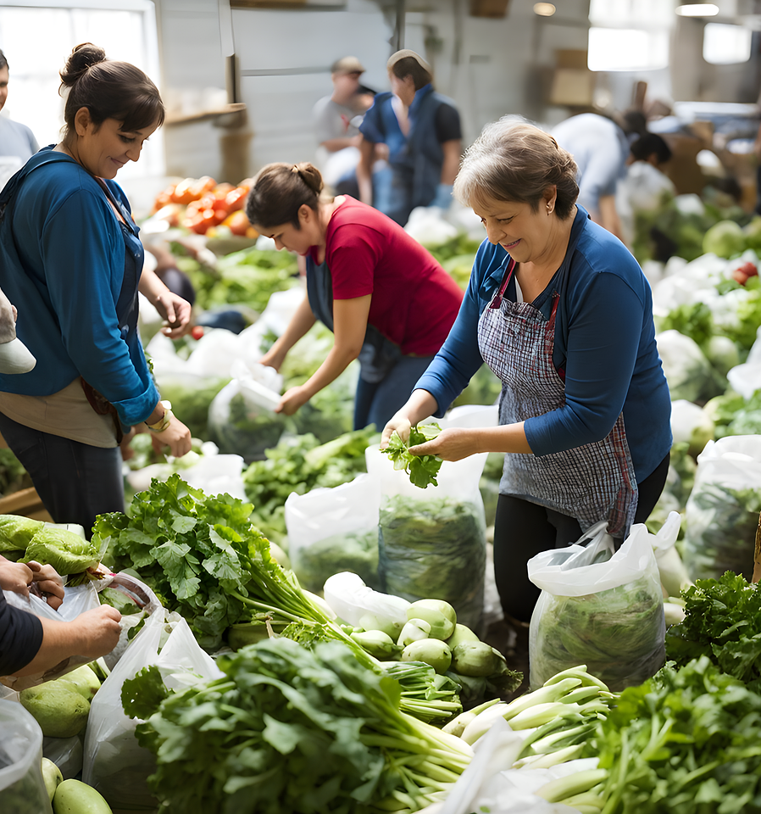
Looking to the future
Farmers, policymakers, and technology providers need to consider and anticipate these vulnerabilities by building safeguards for every stage of implementation. It has to be ensured that human expertise remains central. By approaching AI with both enthusiasm and caution, the agricultural sector can leverage innovation while protecting the resilience and sustainability of the food systems we all rely on.

Slide 40
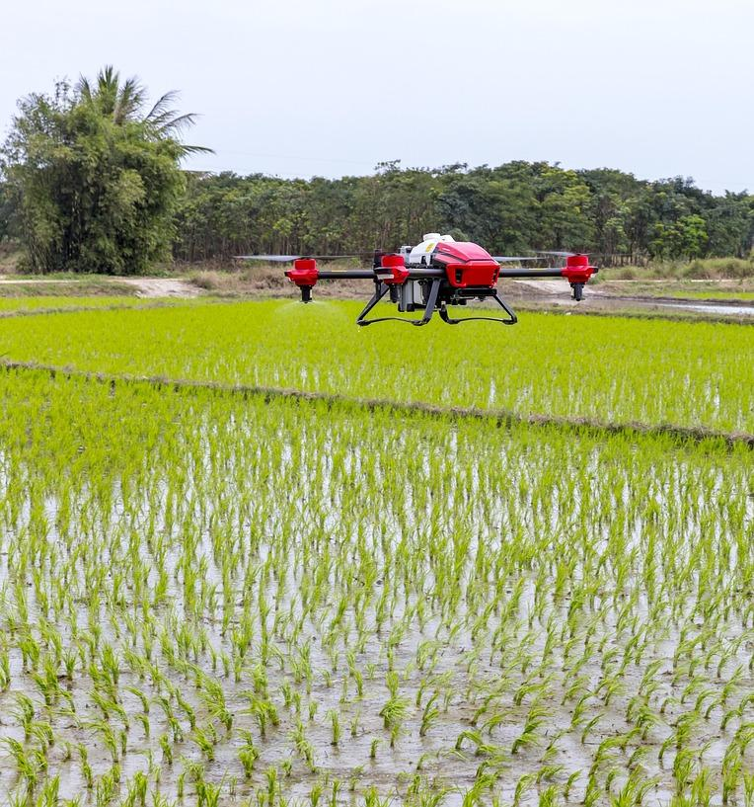
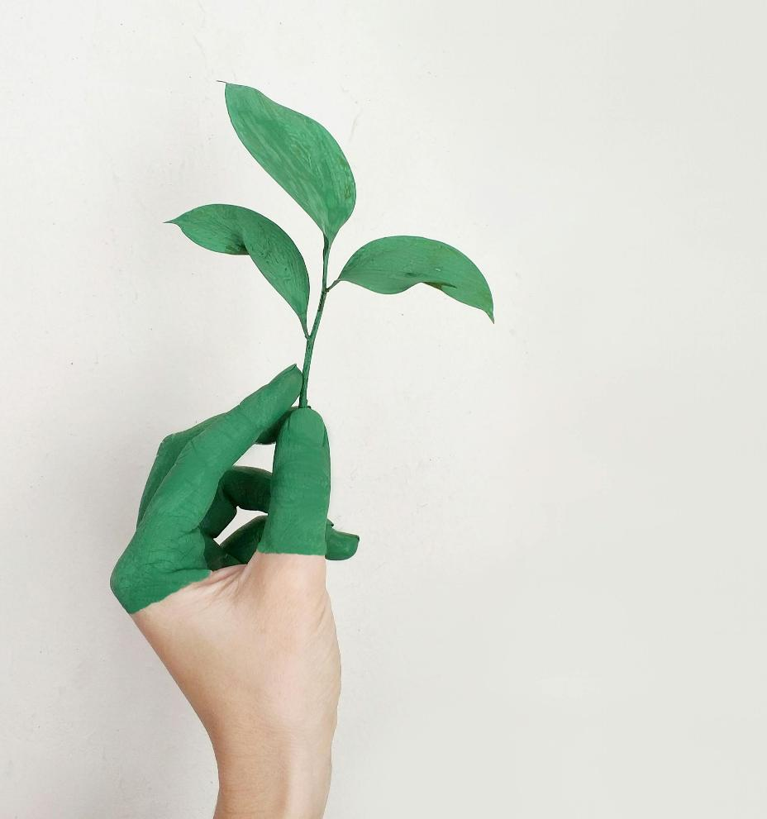
Countries using AI the most in agriculture
Based on global analyses and rankings, the countries most advanced in AI‑driven agriculture tend to be those with strong tech sectors, large agricultural industries, and significant investment in digital farming.

Slide 41

Leading countries using AI in agriculture
🇯🇵 4. Japan
Japan integrates AI heavily in:
Robotic harvesting
Smart greenhouses
Automated livestock monitoring
US 1. United States
The U.S. is widely recognised as a global leader in AI agriculture, driven by:
Advanced precision farming technologies
Strong ag‑tech startups
Widespread use of robotics, drones, and machine learning
🇨🇳 5. China
China is rapidly scaling AI in agriculture through:
Drone‑based crop spraying
Smart farming platforms
Government‑backed digital agriculture programs
🇧🇷 7. Brazil
Brazil uses AI to optimise:
Large‑scale crop production
Satellite‑based monitoring
Precision livestock management
🇮🇱 3. Israel
Israel is known for cutting‑edge ag‑tech, including:
AI‑powered irrigation systems
Computer‑vision crop monitoring
Early‑stage disease detection tools
🇮🇳 6. India
India is expanding AI adoption to support millions of farmers, focusing on:
Predictive analytics for weather and crop yields
Mobile‑based AI advisory tools
Public‑private partnerships
🇳🇱 2. Netherlands
Despite its small size, the Netherlands is a powerhouse in agricultural innovation, using AI for:
Greenhouse automation
High‑tech crop monitoring
Sustainable food production

Slide 42
Case study: Transforming sugarcane farming with AI
In Barmati, India, Sugarcane farming has been a crucial agricultural practice, but traditional agricultural approaches and tools lead to high costs and inefficiencies. The company Map my Crop implemented its Satellite Crop Monitoring Platform to improve sugarcane cultivation. Using AI-driven agronomic advisory and precision agriculture techniques, the company helped farmers in improving productivity, reducing cost and promoting the health of the crop.
Objective: Enhancing Sugarcane Crop Quality and Yield while optimising resource utilisation.
Solution: Use of a satellite crop monitoring platform which offered
Real time insights
Detection of potential challenges
Precession farming recommendations
For more details

Slide 43
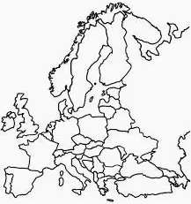
EU and AI in agriculture
Netherlands
Pioneer in smart greenhouses and precision horticulture
Heavy use of sensors, robotics, and climate‑control AI
Across Europe, the EU’s agricultural policies promote AI adoption in global agriculture, accounting for 5% of worldwide AI applications in farming.
AI-powered soil analysis optimises fertiliser use.
European Agrifood Tech companies enhance precision agriculture.
Smart farms with AI automation reduce carbon footprints.
France
Large agricultural sector
AI applied to vineyards, crop disease detection, and supply‑chain optimisation
Germany
Strong engineering sector
AI used for machinery automation, livestock monitoring, and soil analysis
Spain
AI for irrigation management in water‑scarce regions
Drone monitoring for fruit and olive production
Italy
AI in vineyards, olive groves, and specialty crops
Focus on quality improvement and climate‑risk prediction

Slide 44
Key take aways
Agriculture is facing major pressures—from climate instability to labour shortages and increasing global demand—but these challenges also create opportunities for improvement through Artificial intelligence.
AI does not replace farmers but it enhances their expertise and supports more resilient, efficient food systems.
AI is reshaping how we grow, manage, and protect our food systems. From predictive analytics that help farmers anticipate droughts, to autonomous machinery that reduces labour pressure, to precision tools that minimize waste and environmental impact.
Embracing AI also means acknowledging its risks such as data privacy, algorithmic bias, over‑reliance on automation, and the widening gap between technologically advanced regions and those left behind are real challenges.

Slide 45
Key take aways
The future of agriculture will depend on how responsibly we use AI. AI is not magic; it is a powerful tool. And like any tool, its impact depends on the values, governance, and responsible use of it.
Therefore, we need to make sure to empower farmers rather than replace them, to protect ecosystems rather than exploit them, and to ensure that technological progress strengthens food security for everyone.
Responsible use of AI can help us develop an agriculture which is more resilient, more sustainable, and more human than ever.

Slide 46
follow our journey
Thank you
www.sustainvet.eu

