Slide 1

Module 1
Foundations of AI in VET
www.sustainvet.eu

Slide 2
Contents
01
Unit 1- Why AI in VET?
02
Unit 2- Tips for introduction of AI
03
Unit 3- Ethical Considerations
04
Unit 4- Benefits of AI in teaching and learning
05
Unit 5- AI tools for teaching and learning

Slide 3
Learning Objectives
By the end of this module, I will be able to…
Explain why AI is relevant to vocational education and training today, and how it connects to the twin green and digital transitions shaping Europe's workforce.
Identify practical, low-risk strategies for introducing AI tools into my own teaching practice, starting with small, purposeful steps.
Recognise the key ethical considerations, including bias, data privacy, academic integrity, and environmental impact, that I must keep in mind when using AI in VET.
Describe at least three evidence-based benefits of AI for teaching and learning in vocational contexts, including personalisation, workload reduction, and inclusive education.
Select and begin using at least two AI tools that are appropriate for my vocational subject area and my learners' needs.
Reflect critically on how AI can support, but never replace, the human, social, and practical dimensions of vocational education.

Slide 4
01
Unit 1
Why AI in VET?

Slide 5

“Some jobs will be destroyed, but the overall jobs impact is modest. Technology much more often replaces tasks rather than entire jobs, while actually creating a lot of new ones. The questions we should all be asking ourselves are: How can we get people ready to work alongside AI?”
— Jürgen Siebel, Executive Director, Cedefop (2024)

Slide 6
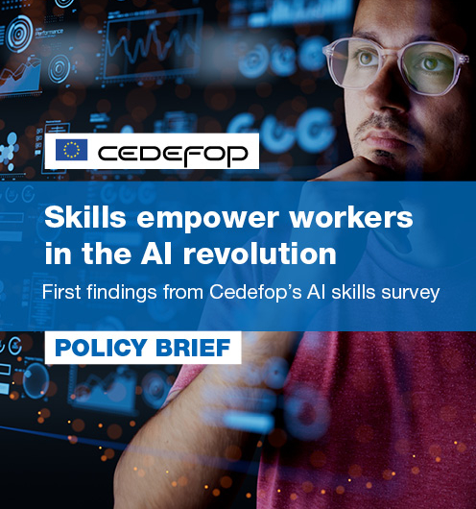
AI is already reshaping the world of work
Artificial intelligence is no longer a future concern, it is a present reality in workplaces across Europe.
Cedefop's 2024 AI Skills Survey, covering over 5,000 employees across 11 EU Member States, found that more than 28% of the European adult workforce is already using AI tools at work. At the same time, six in ten employees are susceptible to some form of AI-related task transformation in the coming years. For VET educators, these numbers carry a clear message: the learners we train today will enter workplaces where AI is a normal part of daily operations.
Notes:
https://www.cedefop.europa.eu/en/publications/9201

Slide 7

AI is already reshaping the world of work
Yet the challenge is not only about learners. Cedefop's survey also revealed that 40–60% of adult workers have a poor understanding of what AI is, how it operates, and its consequences for society. Nearly 44% of workers expressed concern that they would not receive adequate training to work alongside AI. This gap between AI's rapid adoption and people's readiness to use it effectively and critically is exactly where VET educators can make a decisive difference.

Slide 8
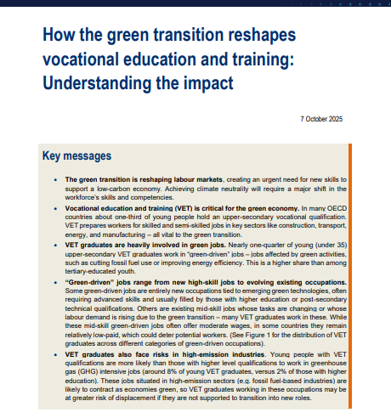
VET sits at the crossroads of the twin transitions
Europe's two defining transformations, the green transition and the digital transition, intersect directly in vocational education. The OECD (2025) reports that nearly one-quarter of young upper-secondary VET graduates already work in 'green-driven' jobs, a higher share than among their university-educated peers. VET prepares workers for sectors like construction, energy, transport, agriculture, and manufacturing, all of which are central to the EU Green Deal and all of which are being reshaped by AI. The SUSTaiN project exists precisely at this intersection, exploring how AI can advance sustainability across these key sectors.
Notes:
https://www.oecd.org/content/dam/oecd/en/publications/reports/2025/10/how-the-green-transition-reshapes-vocational-education-and-training_c3ba6762/4819bf34-en.pdf

Slide 9

VET sits at the crossroads of the twin transitions
Recent Cedefop analysis of European online job advertisements shows a striking trend: since the emergence of generative AI in late 2022, occupations relying on physical presence, manual expertise, and applied technical skills have actually increased their share of vacancies. AI is not replacing these jobs; it is changing how they are done. This means VET systems must equip learners not just with traditional vocational skills, but also with the AI literacy to use new tools confidently and critically in their trades.
Notes:
https://www.oecd.org/content/dam/oecd/en/publications/reports/2025/10/how-the-green-transition-reshapes-vocational-education-and-training_c3ba6762/4819bf34-en.pdf
https://www.cedefop.europa.eu/en/publications/9201

Slide 10
The policy landscape supports action now
The EU has put clear policy weight behind AI integration in education. The Digital Education Action Plan 2021–2027 calls for updating digital competence frameworks to include AI-related skills, and the updated DigComp 2.2 framework now includes over 70 examples related to AI. Crucially, Article 4 of the EU AI Act , which took effect on 2 February 2025, requires all organisations deploying AI systems to ensure a sufficient level of AI literacy among their staff. For VET institutions, this is not just an aspiration, it is becoming a legal obligation.
Globally, UNESCO published its landmark Guidance for Generative AI in Education and Research in September 2023, the first-ever global framework of its kind. UNESCO's subsequent AI Competency Framework for Teachers (2024) provides a structured pathway from basic AI literacy to confident, innovative use. The direction of travel is clear: VET educators are expected to develop AI competence, and the frameworks to support them now exist.

Slide 11
Three reasons AI matters for VET right now
Why AI matters for VET
The workplace has already changed. Over 28% of European workers use AI on the job, and six in ten face AI-related task changes,our learners need to be ready. (Cedefop, 2025)
VET is central to the green transition. Nearly 25% of young VET graduates work in green-driven jobs; AI is a powerful tool for accelerating sustainability across these sectors. (OECD, 2025)
Policy demands action. The EU AI Act now requires AI literacy for all staff working with AI systems, VET institutions included. (EU AI Act, Article 4, February 2025

Slide 12

CASE STUDY Germany's KI B³ Project; Bringing AI into Dual VET
Germany's KI B³ project introduced an additional qualification in AI and machine learning for apprentices in the dual VET system, open across sectors from commercial to industrial to technical trades. A mixed-methods study of 73 learners and 4 educators found strong demand for AI basics combined with practical, workplace-relevant applications.
The study also highlighted the urgent need for professional development for VET teachers before AI can be implemented effectively at scale.
Notes:
Petridou, E., & Lao, L. (2024). Identifying challenges and best practices for implementing AI additional qualifications in vocational and continuing education: a mixed methods analysis. International Journal of Lifelong Education, 43(4), 385–400. https://doi.org/10.1080/02601370.2024.2351076
https://www.cedefop.europa.eu/en/news/germany-ai-emerging-key-vet-competence

Slide 13
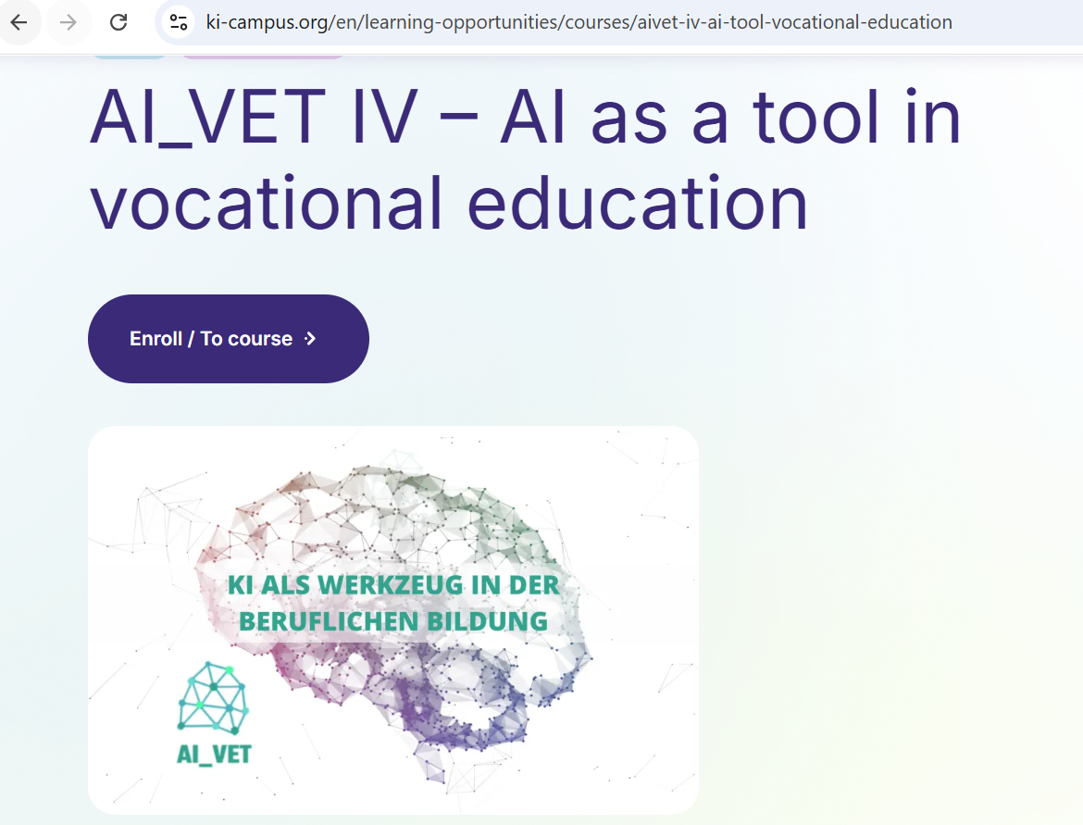
Additional resource
KI-Campus: AI as a Tool in Vocational Education
Free self-paced online course for VET contexts, smart classrooms, tutoring systems, chatbots.
https://ki-campus.org/en/learning-opportunities/courses/aivet-iv-ai-tool-vocational-education

Slide 14
02
Unit 2
Tips for introduction of AI

Slide 15

Begin with curiosity, not expertise
You do not need to be a technology expert to start using AI in your teaching. The most effective first step is simply to try a tool yourself, with no students watching and no stakes involved. Open ChatGPT or a similar tool and ask it to draft a warm-up question for your next lesson, suggest a workplace scenario for a class discussion, or simplify a technical paragraph for lower-level readers. AI gives you a fast first draft, and your professional judgement turns it into something useful for your learners.
Common Sense Education (2024)

Slide 16

Begin with curiosity, not expertise
Common Sense Education (2024) offers a practical starting principle: use AI for language tasks, ideas, explanations, and editing, but never for final research or fact-finding without verification. Generative AI is most helpful as a thought partner and starting place. It is not reliable as a sole source of truth, because it can generate plausible-sounding inaccuracies, known as 'hallucinations.' Treat everything AI produces as a rough draft that requires your professional review before it reaches your learners.
Common Sense Education (2024)

Slide 17

Build your confidence step by step
UNESCO's AI Competency Framework for Teachers (2024) outlines three progression levels: Acquire (basic AI literacy), Deepen (confident, ethical use), and Create (using AI to innovate teaching). Most VET teachers will begin at the Acquire level, and that is exactly the right place to start. The framework's five competency areas, human-centred mindset, ethics, AI foundations, AI pedagogy, and professional learning, provide a useful mental map for your own development journey.
UNESCO (2024); EDU-AI Erasmus+ Project (2025)

Slide 18

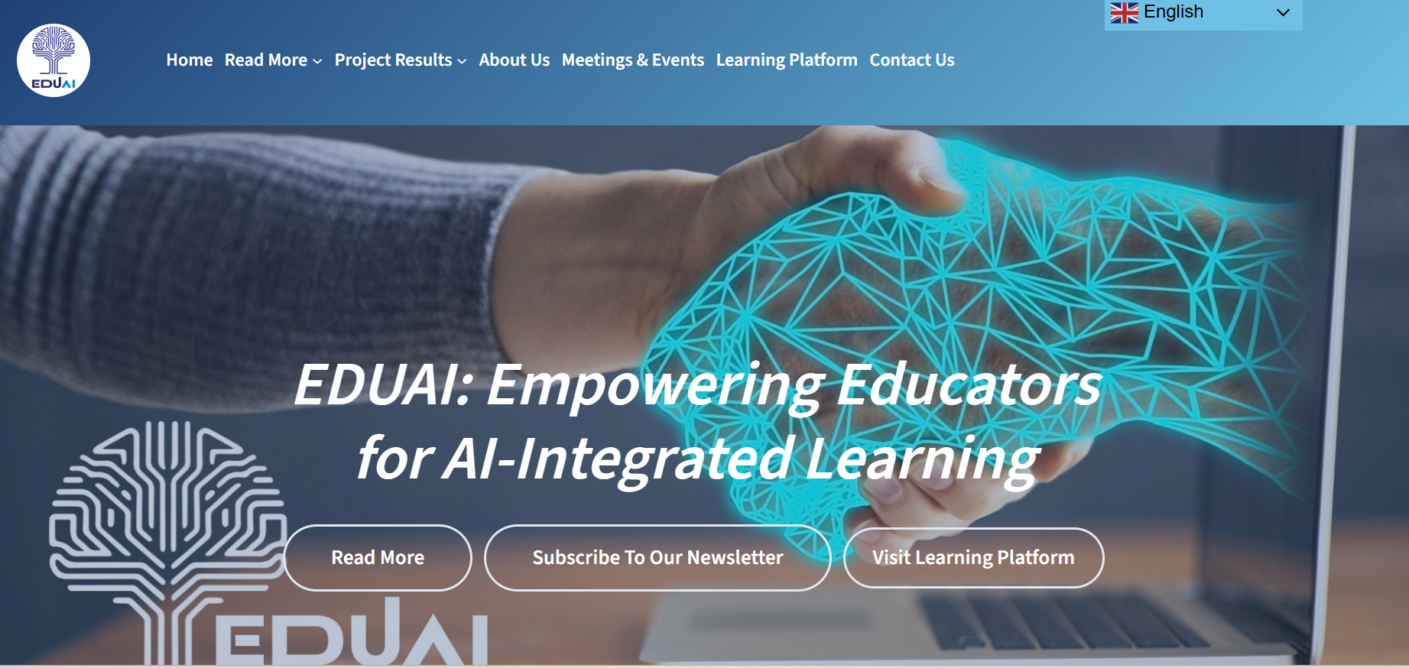
Build your confidence step by step
Research consistently shows that hands-on, practical training is what makes the difference. The EDU-AI Erasmus+ project (2024–2025), which trained VET teachers across Lithuania, Belgium, and Italy, found that 66.7% of participating educators had received no prior AI training before the programme.
After modular, hands-on workshops, the share of teachers with a 'good' AI understanding rose by nearly 30 percentage points. Structured, practical exposure works, you do not need a degree in computer science; you need permission to experiment and a safe space to learn.
Notes:
UNESCO (2024); EDU-AI Erasmus+ Project (2025)

Slide 19
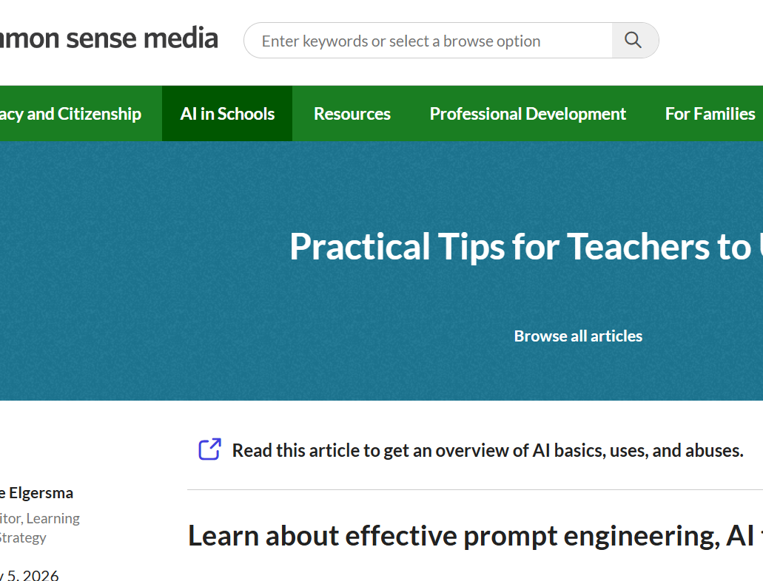
Protect privacy and verify everything
Two non-negotiable rules apply from day one. First, never enter personally identifiable information about yourself or your students into open AI tools such as ChatGPT or Gemini. These tools may store and process data you input in ways that conflict with GDPR and your institution's data protection policies. If you need to use student-related examples, anonymise them completely or use fictional scenarios. Always consult your institution's data protection officer before using a new AI tool.
Common Sense Education (2024); New guidelines to help teachers lead Europe’s digital education (Mar 2026)

Slide 20
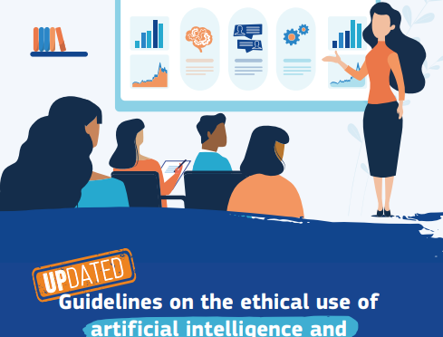
Protect privacy and verify everything
Second, always verify AI-generated content before using it with learners. AI tools can produce text that reads confidently but may contain factual errors, outdated information, or fabricated references. This is especially important in VET, where inaccurate safety information or incorrect technical procedures could have real consequences. Build a habit of checking AI outputs against trusted sources, and model this critical evaluation practice for your students, teaching them to question AI is as important as teaching them to use it.
Common Sense Education (2024); New guidelines to help teachers lead Europe’s digital education (Mar 2026)

Slide 21

Three habits of effective AI-using educators?
01
Verify before you share. AI tools can generate plausible errors and fabricated references, always fact-check outputs against trusted sources before using them with learners. (UNESCO, 2023)
02
Protect data at all times. Never input student names, grades, or personal details into open AI platforms, use anonymised or fictional examples instead. (New guidelines to help teachers lead Europe’s digital education, Mar 2026); GDPR)
Reflect on what you gain and lose. AI may save time on brainstorming or drafting, but be intentional about preserving the creative, relational, and critical-thinking elements of your teaching. (Common Sense Education, 2024)
03

Slide 22

CASE STUDY EDU-AI Erasmus+ Project,Training VET Teachers in Three Countries
The EDU-AI project (2024–2025), coordinated by ART+INN in Lithuania, trained VET teachers across Lithuania, Belgium, and Italy to integrate AI into their practice through a multilingual digital toolkit with micro-learning modules at basic, intermediate, and advanced levels. Before the project, 66.7% of participants had no prior AI training. After hands-on workshops, teachers' self-rated 'good' understanding of AI rose by nearly 30 percentage points, demonstrating that structured, practical training can rapidly build confidence.
EDU-AI Project (2025)

Slide 23
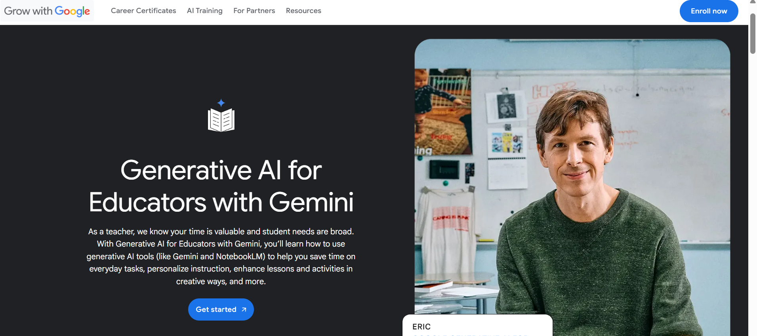
Additional resource
Google: Generative AI for Educators
Free ~2-hour self-paced course covering hands-on use of Google Gemini and NotebookLM for lesson planning, assessment, and feedback. Includes a certificate of completion.
https://grow.google/ai-for-educators/

Slide 24
03
Unit 3-
Ethical Considerations

Slide 25
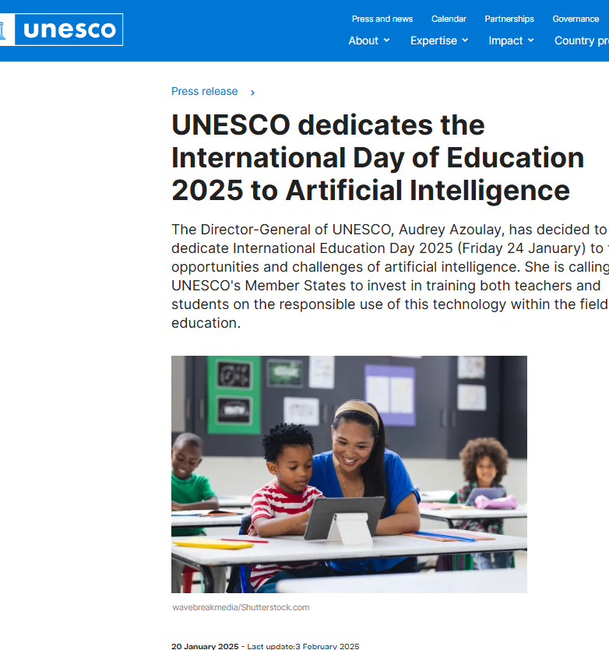
Ethics must travel alongside adoption
As AI tools become more accessible, the temptation is to focus on what they can do and worry about ethics later. This is a mistake.
UNESCO Director-General Audrey Azoulay stated on International Day of Education 2025: 'AI offers major opportunities for education, provided that its deployment in schools is guided by clear ethical principles.' The ethical dimensions of AI- bias, privacy, transparency, fairness, and environmental impact, are foundational to using AI well, and VET educators have a responsibility to model ethical practice from the very first interaction.
Notes:
UNESCO (2025); EU AI Act (2024)

Slide 26
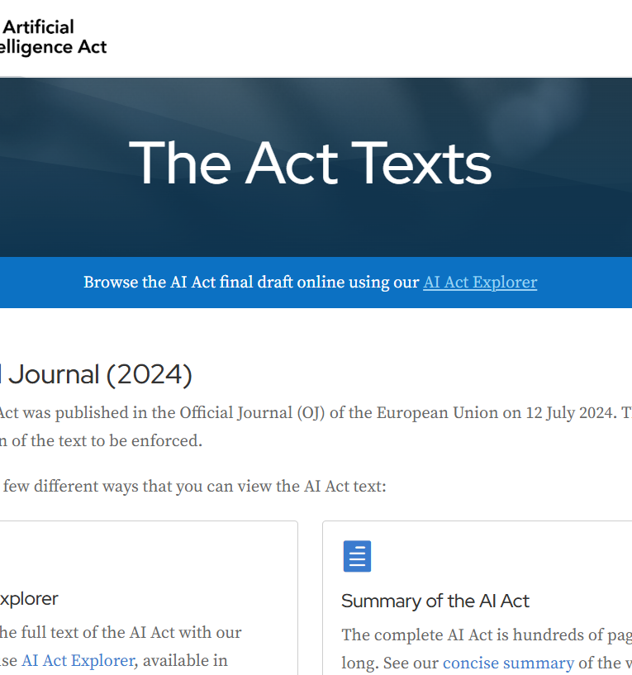
Ethics must travel alongside adoption
The EU AI Act (Regulation 2024/1689) classifies AI in education as a 'high-risk' area. AI systems used for determining access to educational institutions, evaluating learning outcomes, or monitoring behaviour during examinations are all subject to stringent requirements including risk management, data governance, transparency, and human oversight. The Act also bans emotion recognition systems in educational institutions entirely (effective February 2025). These regulations directly shape what AI tools VET institutions can and cannot use.
Notes:
UNESCO (2025); EU AI Act (2024)

Slide 27
Bias, fairness, and the limits of AI judgement
AI systems learn from data, and data reflects the world's existing inequalities. This means AI can reproduce and even amplify biases if we are not vigilant. Research has shown that AI-powered plagiarism detection tools disproportionately flag the writing of students for whom the language of instruction is not their first language, even when their work was written entirely without AI assistance. In another case, an AI-based dropout prediction tool disproportionately identified minority students as at-risk, risking the creation of self-fulfilling prophecies.
The practical lesson is straightforward: never use AI as the sole basis for consequential decisions about learners, admissions, grades, progression, or disciplinary actions. Always apply human judgement as the final check. When you use AI to generate content, review it for stereotypes, cultural assumptions, and one-sided perspectives. AI outputs are suggestions, not verdicts, and our professional responsibility to our learners remains unchanged.
Federation of American Scientists (2024); EdTech Magazine (2025)

Slide 28
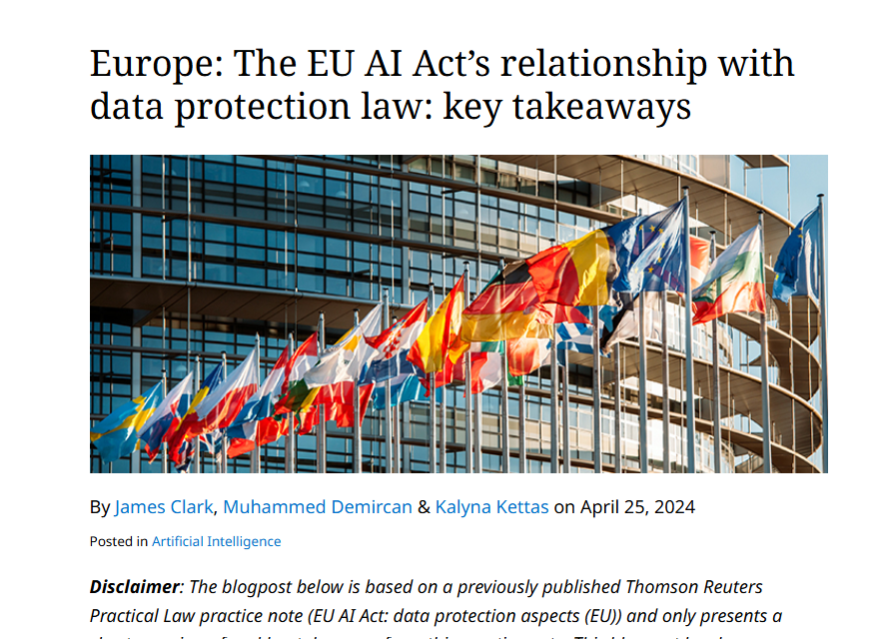
Data privacy, academic integrity, and environmental impact
Data privacy is non-negotiable. Under GDPR, student data is protected personal data, and inputting it into open AI platforms without proper safeguards can constitute a data breach.
Practical rules include: never enter student names, grades, or identifiable details into tools like ChatGPT; check whether your institution has approved specific AI tools with appropriate data processing agreements; and consult your data protection officer before adopting any new tool.
Notes:
UNESCO (2023); UK DfE (2025); NEA (2025); MIT News (2025)

Slide 29
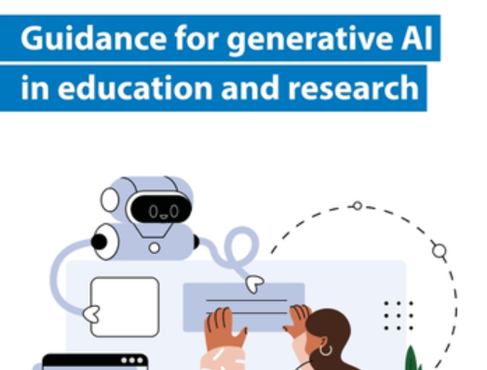
Data privacy, academic integrity, and environmental impact
Academic integrity requires new conversations with learners. UNESCO (2023) recommends that teachers clearly define the boundaries of acceptable AI use for each task and require students to report how they used AI in their work.
Finally, AI's environmental impact is particularly relevant for the SUSTaiN project, a single generative AI query consumes approximately 4–5 times the energy of a standard web search, and training large AI models can emit hundreds of tonnes of CO₂. Discussing these trade-offs openly is both an ethical obligation and a sustainability lesson.
Notes:
Guidance for generative AI in education and research, UNESCO 2023
UNESCO (2023); UK DfE (2025); NEA (2025); MIT News (2025)

Slide 30

CASE STUDY AI4InclusiveEducation (Belgium) UNESCO Prize Winner 2025
The AI4InclusiveEducation project, developed by La Scientothèque in Belgium as part of the Erasmus+ SteamCity initiative, received the UNESCO King Hamad Prize in 2025 for promoting responsible AI use in education. The project provides AI education from a civic and interdisciplinary perspective for young people aged 10–18, particularly from disadvantaged communities, exploring data privacy, algorithmic bias, and misinformation through activities anchored in local issues. The project has reached more than 6,000 learners and 300 teachers through open-access modules.
Notes:
UNESCO (2025); La Scientothèque / Erasmus+ SteamCity

Slide 31
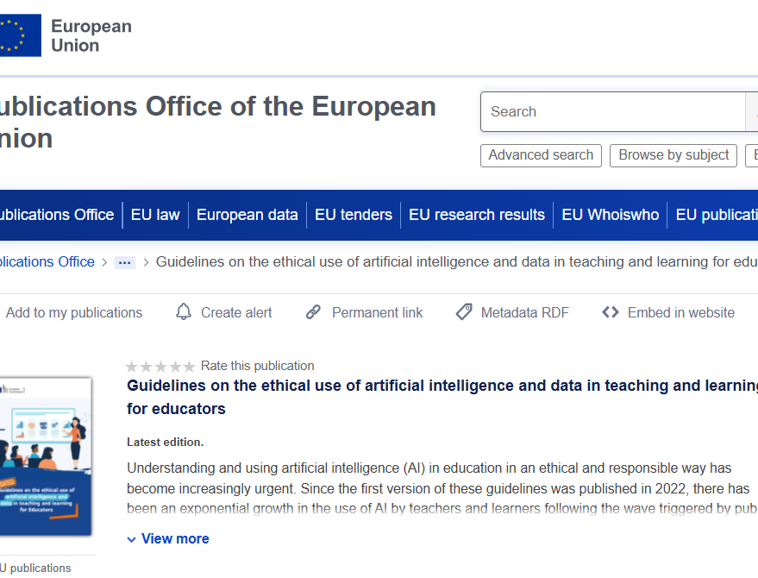
ADDITIONAL RESOURCE
European Commission: Ethical Guidelines on AI for Educators
Practical, scenario-based guidance for teachers with little or no prior AI experience. Available in all EU languages and promoted through Erasmus+.
https://education.ec.europa.eu/focus-topics/digital-education/action-plan/action-6

Slide 32
04
Unit 4-
Benefits of AI in teaching and learning

Slide 33

Personalisation that actually works
One of AI's most compelling benefits in education is its ability to personalise learning at a scale no single teacher can achieve alone.
A meta-analysis of AI-assisted personalised learning studies (2019–2024) found a medium-to-large positive effect on learning outcomes compared to non-adaptive approaches, with improvements of 0.36 standard deviations in overall academic achievement.
In a particularly striking 2025 result, students using AI tutors at Harvard University's physics department learned more than twice as much in less time compared to traditional active-learning classrooms.
Notes:
David Publisher (2025); Harvard Physics Study (2025)

Slide 34
Personalisation that actually works
In VET specifically, AI-driven personalisation takes on a practical urgency. Vocational classrooms often bring together learners with widely varying prior knowledge, language abilities, and learning speeds. AI tools like Diffit can take a complex technical manual and produce versions at multiple reading levels in minutes, while ChatGPT can generate scaffolded explanations of the same concept at different complexity levels.
For VET educators serving diverse cohorts, including adult learners, migrants, and career changers, this kind of rapid, targeted adaptation is a practical necessity.
Notes:
David Publisher (2025); Harvard Physics Study (2025)

Slide 35
Reclaiming time for what matters most
VET educators consistently report that administrative tasks, planning lessons, drafting assessments, writing feedback, managing documentation, consume time they would rather spend with learners.
A UK Education Endowment Foundation pilot (2023) found that using ChatGPT for administrative tasks reduced planning and admin time by approximately 31%, or around 25 minutes per week per teacher. Other studies report teachers using AI at least weekly save an average of 5.9 hours per week, with 55% saying AI has given them more time for direct student interaction.
Notes:
EEF (2023); Gallup / DemandSage (2025); UK DfE (2025)

Slide 36

Reclaiming time for what matters most
The UK Department for Education invested £3 million in AI-powered tools for teachers, recognising that generative AI can help the education workforce by reducing administrative burdens. For VET trainers who divide their time between classroom instruction, workshop supervision, employer liaison, and documentation, even modest time savings can translate into meaningfully more time for the high-value, human parts of their role, mentoring, demonstrating, and coaching learners through practical tasks.
Notes:
EEF (2023); Gallup / DemandSage (2025); UK DfE (2025)

Slide 37
Supporting inclusion and bridging the skills gap
AI has significant potential to make VET more inclusive and accessible. The OECD's 2025 report on AI and neurodivergent learners in VET, based on interviews with over 50 stakeholders, found that AI and advanced technologies can make VET more adaptive, accessible, and inclusive for learners with autism, ADHD, dyslexia, and other conditions. Text-to-speech, speech-to-text, and generative AI tools allow learners to engage with materials in their preferred format, while extended reality environments provide psychologically safe spaces for practising skills before entering real workplaces.
In Finland's largest special-needs VET college, 360° workplace scenes built with Thinglink and AR smart glasses allow learners to pre-visit work sites, rehearse task sequences, and build confidence before real-world placements. The broader point is powerful: AI does not only serve the most tech-savvy learners, when designed and used thoughtfully, it can be a force for equity, reaching those who have traditionally been underserved by conventional VET delivery.
Notes:
OECD (2025); EVTA / Recogn(AI)ze Project (2025)

Slide 38

CASE STUDY AI-Guided XR Welding Trainer, Embodied AI Learning in TVET
Researchers developed a multisensor AI-assisted welding trainer integrating HD cameras, RGB-D sensors, and machine learning algorithms to provide real-time, personalised feedback on learners' motor skills and technique. In a controlled trial, trainees using the AI-guided system demonstrated significantly improved welding accuracy and accelerated learning curves compared to both traditional instruction and non-AI virtual reality training. This 'embodied AI learning' approach is considered one of the most rigorous controlled studies of AI in TVET to date.
Notes:
Lee et al. (2021); Preprints.org Systematic Review (2025)

Slide 39
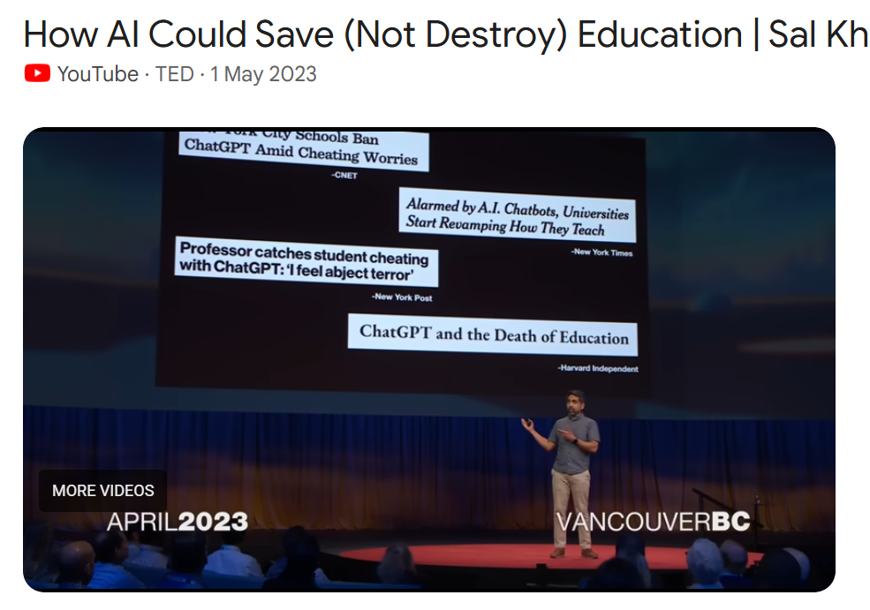
ADDITIONAL RESOURCE
Sal Khan: How AI Could Save (Not Destroy) Education
A 15-minute TED Talk from 2023 demonstrating Khanmigo, an AI tutor, in real time. Highly accessible for beginners and a compelling introduction to the positive potential of AI in education.
'Sal Khan TED AI education 2023'

Slide 40
05
Unit 5-
AI tools for teaching and learning

Slide 41
You do not need to master every tool, start with one or two
The landscape of AI tools for education is expanding rapidly, and it can feel overwhelming. The good news is that you do not need to learn them all. The most effective approach is to identify one or two tools that match your current needs and your learners' context, experiment with them in a low-stakes setting, and build from there. Most of the tools covered in this unit offer free versions that are more than sufficient to get started, and if you can type a question or upload a document, you can use these tools.
When choosing a tool, ask three questions. First, does it address a real need in my practice, such as lesson planning, creating differentiated materials, assessment, or supporting multilingual learners? Second, is it free or affordable, and does it comply with my institution's data protection requirements? Third, will it genuinely save me time or improve my learners' experience, or am I adopting it just because it is new?
The UNESCO AI Competency Framework for Teachers (2024) encourages educators to evaluate AI tools not just for their technical capabilities, but for their alignment with pedagogical goals and ethical principles.

Slide 42
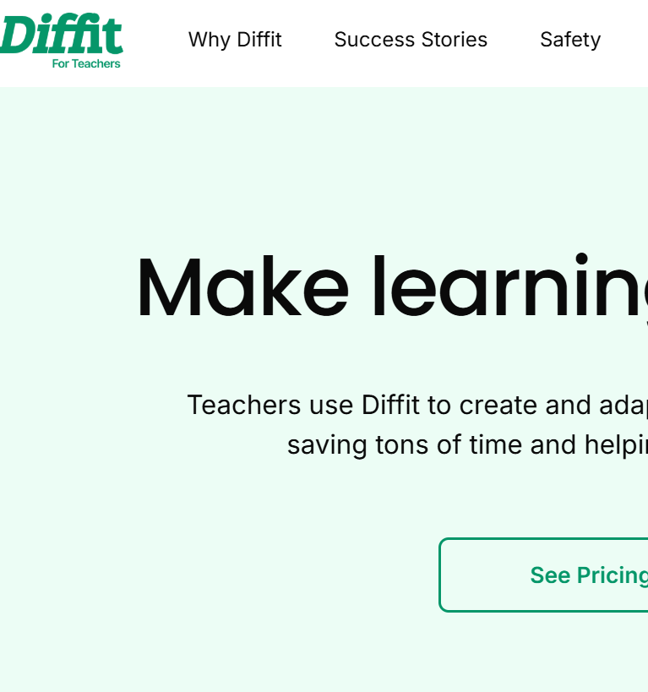
AI tools across the teaching workflow
AI tools can support VET educators at virtually every stage of the teaching workflow. For planning and content creation, tools like ChatGPT and MagicSchool.ai can generate lesson outlines, learning objectives, and activity ideas in minutes ,you provide the vocational context and the tool provides a first draft to refine.
For differentiation and accessibility, Diffit can adapt technical texts to multiple reading levels, and Twee can create language exercises using workplace-specific vocabulary, critical for programmes with multilingual learners.
Notes:
Edutopia (2025); San Diego State University (2025)

Slide 43
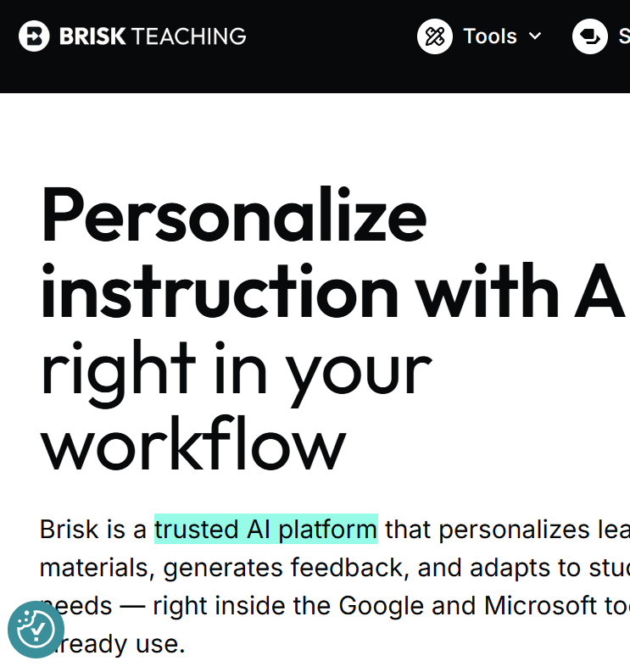
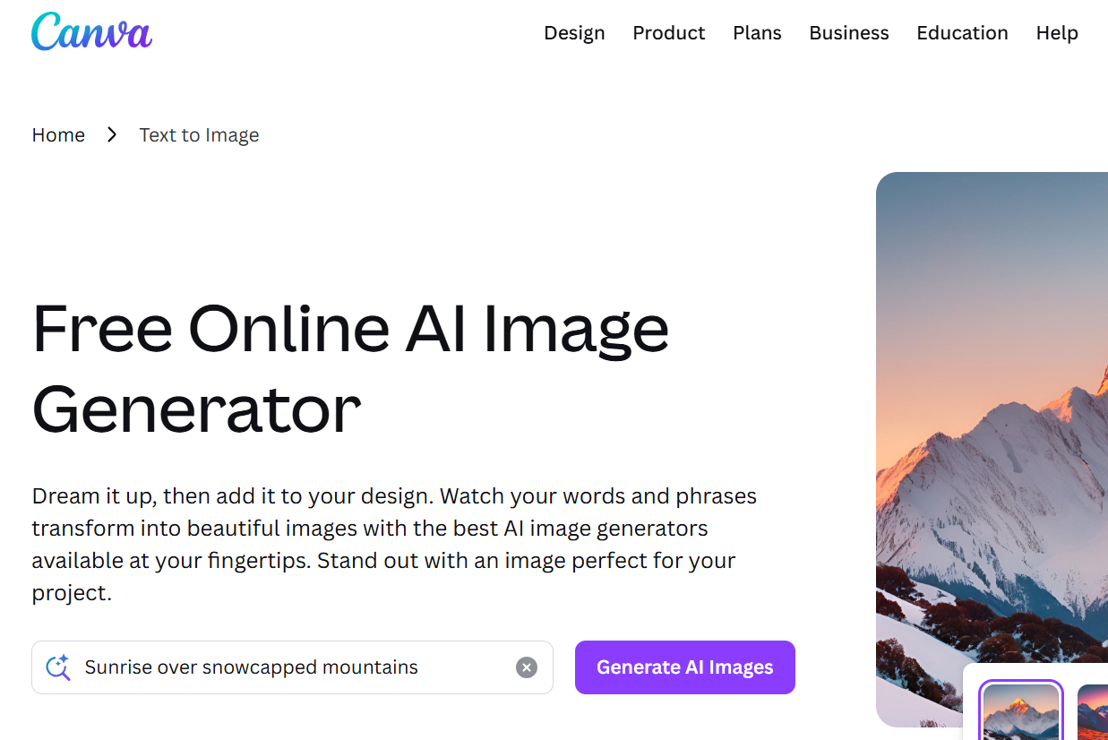
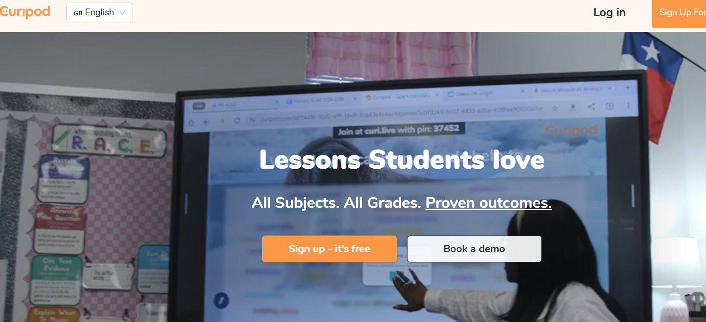
AI tools across the teaching workflow
For assessment and feedback, Brisk Teaching (a free Chrome extension) can generate quizzes from any web content, including YouTube tutorials and industry articles, while Eduaide.AI offers over 100 content types including rubrics and competency-based assessments.
For visual and media creation, Canva for Education (free for educators) includes AI-powered features for creating workshop posters and safety infographics. And for student engagement, Curipod turns lesson topics into interactive presentations with polls and discussion prompts, ideal for getting vocational learners actively participating before heading to the workshop.
Notes:
Edutopia (2025); San Diego State University (2025)

Slide 44


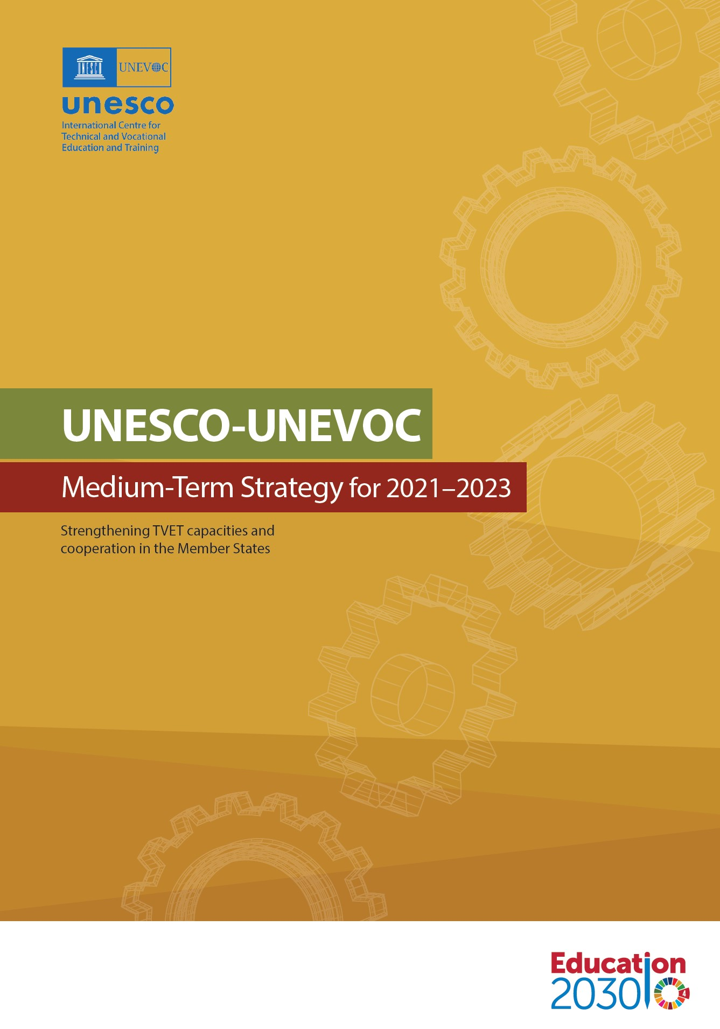
Connecting AI tools to the sustainability mission
For VET educators working within the SUSTaiN project's sustainability focus, AI tools are not just about efficiency, they can directly support green skills education. ChatGPT and Google NotebookLM can be prompted to generate lesson plans on energy auditing, sustainable agriculture, circular economy principles, or green building practices. NotebookLM can process sustainability reports and climate data, producing student-friendly study guides and audio summaries. Canva offers sustainability-themed templates for awareness materials and infographics.
The connection runs deeper than content creation. By discussing AI's own environmental footprint with learners, the energy consumed by data centres, the carbon cost of training large models, educators can turn AI use itself into a sustainability lesson. Encouraging learners to use AI purposefully and efficiently, rather than generating unlimited queries, is a practical application of the resource-consciousness that underpins sustainability thinking. As UNESCO-UNEVOC stated in 2021: all TVET institutions should incorporate AI into their planning, forward thinking will put VET institutions and their graduates in a position to thrive in the era of AI.
Notes:
UNESCO-UNEVOC (2021); SUSTaiN Project

Slide 45
AI Tools for VET Educators
Tool | What it does | VET use | Cost
ChatGPT (OpenAI) | Conversational AI for generating text, brainstorming, translating, and explaining concepts | Lesson plans; workplace scenarios; simplify technical texts; draft sustainability content | Free / Plus €20/mo
MagicSchool.ai | All-in-one educator AI platform with 80+ tools for planning, assessment, and rubrics | Competency-based lesson plans; formative assessments; scaffolded materials for mixed-ability groups | Free / Plus ~€8/mo
Canva for Education | Graphic design with AI-powered image generation and text generation | Safety posters; workshop infographics; student portfolios; sustainability visuals | Free for educators
Diffit | Adapts any text or topic to multiple reading levels with vocabulary lists and comprehension questions | Adapt technical manuals; trade-specific vocabulary exercises; support learners with lower literacy | Free / premium plans
Google NotebookLM | AI-powered research tool — upload documents and get summaries, study guides, and audio overviews | Upload training manuals or regulations; generate audio summaries for learners who prefer listening | Free (up to 100 notebooks)
Notes:
UNESCO-UNEVOC (2021); SUSTaiN Project

Slide 46
AI Tools for VET Educators
Tool | What it does | VET use | Cost
Brisk Teaching | Chrome extension generating quizzes, guided notes, and feedback from any web content | Quizzes from industry articles or YouTube trade tutorials; feedback on student workplace reports | Free / premium features
Eduaide.AI | Teaching assistant with 100+ content types in 15+ languages | Rubrics for practical skills; competency-based assessments; multilingual VET classroom content | Free / Pro €5/mo
Twee | Generates vocabulary activities, speaking prompts, and comprehension tasks | Workplace-specific vocabulary exercises; speaking activities based on workplace scenarios | Free / premium plans
Notes:
UNESCO-UNEVOC (2021); SUSTaiN Project

Slide 47
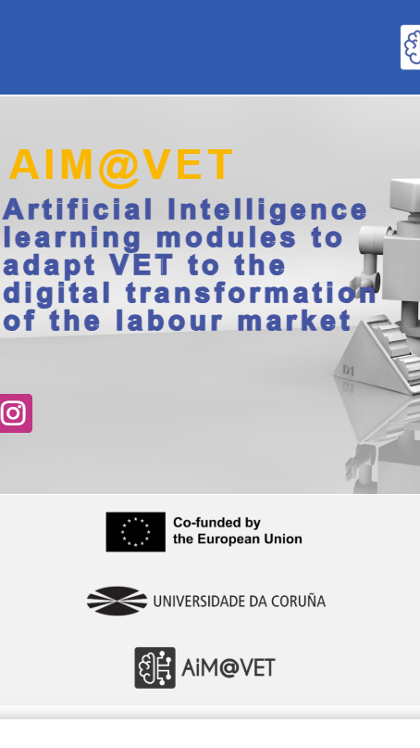
CASE STUDY AIM@VET Erasmus+ Project, AI Tools in Practice across Spain, Portugal & Slovenia
The AIM@VET project, an Erasmus+ initiative involving six partner institutions across Spain, Portugal, and Slovenia, developed teacher-centred learning modules on AI applications including computer vision, robotics, and ambient intelligence. At CIFP Rodolfo Ucha Piñeiro in Spain, VET students engaged in hands-on workshops combining theoretical lessons with practical tasks using Python and robotics simulations. Students valued the balance between theory and practice and showed keen interest in exploring tools like ChatGPT further.
Notes:
IntechOpen (2024); AIM@VET Project

Slide 48
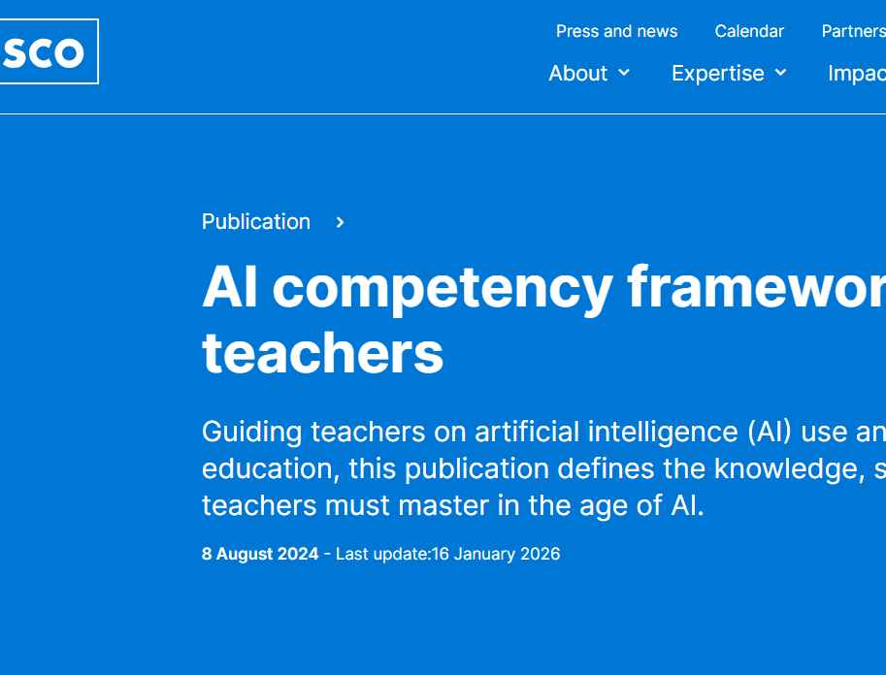
ADDITIONAL RESOURCE
UNESCO AI Competency Framework for Teachers (2024)
15 competencies across three progression levels (Acquire, Deepen, Create) to guide VET educators in developing their AI skills systematically. Free PDF available.
https://www.unesco.org/en/articles/ai-competency-framework-teachers

Slide 49
follow our journey
Thank you
Any questions?
www.website.eu

